Slide 1
Matt Sperazzo
Regional Vice President
John Hancock Investments
Notes:
Good [morning/afternoon/evening].
Today we’re going to talk about Social Security. Even though Social Security has been around for over 75 years, it turns out there’s quite a bit about the program that many people misunderstand. As a result, it can be a challenge to make the most of what we all have coming to us.
So this presentation is going to focus specifically on how we can grow our Social Security benefits into their fullest potential. After all, we earned it!

Slide 2
Table of contents
  The roots of Social Security
  Where Social Security stands today
  Changes for 2016
  Maximizing your Social Security benefit
Notes:
We’ll start with a review of the changes put in place for 2016, and then get into how the program got started and where it stands today.
Then we’ll discuss how the program can work with other retirement savings, how we can plan to make the most of our retirement portfolios in light of Social Security, and, finally, some strategies for maximizing Social Security benefits.

Slide 3
  The roots of Social Security
Notes:
It’s just as important to understand where we came from in order to see where we’re going with Social Security.

Slide 4

The roots of Social Security
1935
1937
1940
Social Security Act was signed into law on August 14
Taxes were collected for the first time in January and the first one-time, lump-sum payments were made that same month
Regular ongoing monthly benefits started in January
Notes:
The Great Depression of the 1930s revealed a real vulnerability in our society—namely, that the elderly could have their savings wiped out by bank failures and have no other source of income when jobs are scarce. There has to be a safety net, and that’s what Social Security was created to do.
At the signing of the law in 1935, Franklin Delano Roosevelt said, “We can never insure one hundred percent of the population against one hundred percent of the hazards and vicissitudes of life, but we have tried to frame a law which will give some measure of protection to the average citizen and to his family against the loss of a job and against poverty-ridden old age.”
The program gradually rolled out over the next several years and was making regular monthly payments by 1940.

Slide 5
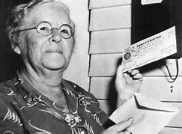
The roots of Social Security
1940
1937
On January 31, 1940, the first monthly retirement check was issued to Ida May Fuller of Ludlow, Vermont, in the amount of $22.54. Miss Fuller, a legal secretary, retired in November 1939. She started collecting benefits in January 1940 at age 65 and lived to be 100 years old, dying in 1975. During her lifetime she collected a total of $22,888.92 in Social Security benefits.
Notes:
May Fuller made history by receiving the first Social Security benefit check in early 1940.

Slide 6
Social Security statistics
  62 million people receive benefits
  Nearly 9 out of 10 people age 65 or older receive benefits
  By 2035, the number of people 65 or older will increase to 79 million, from 48 million today
  In 1940, the life expectancy of a 65 year old was almost 14 years;
  today it is about 20 years
  48% of married couples and 71% of unmarried persons receive
  50% or more of their income from Social Security
  31% of the workforce has no savings for retirement and
  51% has no private pension coverage
  Social Security offices receive 480,000 calls and 180,000 visits per day, with an average wait time of 3 hours
Source: Social Security Administration, https://www.ssa.gov/news/press/factsheets/basicfact-alt.pdf, December 2016.
Notes:
Here are some interesting statistics on the past, present, and future of Social Security. It’s important to note the changing demographics and life expectancy of the benefits base.

Slide 7
  Where Social Security stands today
Notes:
We have seen the evolution of Social Security since its humble beginnings. Now let’s take a look at where the program stands today.

Slide 8



Where Social Security stands today
It appears to be in financial trouble
It will almost certainly be fixed
It still won’t grow fast enough
Notes:
How is Social Security doing nearly 80 years later?
For starters, it must be said that any government program that lasts for 80 years is in some measure a success. But Social Security has changed over the years, and it now appears to be in financial trouble.
Let’s talk about those changes, why Social Security will almost certainly be fixed, and why Social Security benefits still won’t grow fast enough to keep up with inflation.

Slide 9
Social Security appears to be in trouble
1935
2018
The average life expectancy of retirees is longer today
63 years
85 years
Retired workers
Social Security benefits must cover more people
Spousal benefits
Retired workers
Survivor benefits
Disability benefits
There are far fewer workers contributing per beneficiary
160 workers
per recipient
2.8 workers
per recipient
Source: Social Security Administration, 2013.
Notes:
One thing that changed over the past 80 years is our life expectancy: We started living longer!
That’s good news for us, but bad news for Social Security, which was created for retirees who weren’t really living all that long on average. In fact, the average life expectancy of retirees has increased 22 years since the inception of Social Security.
Over the years, Social Security also expanded to cover more people. When Social Security was first created, it only provided benefits to retired workers. But today, it also pays spousal benefits, survivor benefits, early retirement benefits, cost of living adjustments, and disability benefits. This means the system is paying out much more than it used to.
Finally, as a result of us all living longer and the decline of the country’s birth rate, there are far fewer workers per beneficiary paying into Social Security today than there were in 1935.

Slide 10
Social Security’s days of reckoning
If Congress does not address the program’s issues:
2010
2034
Started paying out more in benefits than it collected
in revenues
Trust funds will be depleted by 2034
2089
Annual revenues from payroll tax would cover only 75% of benefits through 2089
2021
REVENUES
REVENUES
BENEFITS
BENEFITS
Trust fund reserves will grow until 2021
Source: Social Security Administration, https://www.ssa.gov/oact/trsum/, 2017. Chart is for illustrative purposes only.
Notes:
You’ve probably heard the stories that because of the imbalance in its finances, Social Security is going to go broke sometime in the not-too-distant future.
The fact is, the program has been paying out in benefits more than it collects in revenues since 2010. How is that possible? Because the program has built up a trust fund of surplus revenues over the years, it can now draw on those revenues to meet its obligations.
However, the Social Security Administration estimates that by the year 2034—if nothing is done to change the system—the program will only be able to meet 75% of its obligations. In other words, it will be bankrupt.
How many of you think this will actually happen?

Slide 11
Proposals to strengthen Social Security
  RAISE the full retirement age
  BEGIN longevity indexing
  RECALCULATE the cost-of-living adjustment
  INCREASE the payroll tax cap (currently $132,900)
  ELIMINATE the payroll tax cap
  REDUCE benefits for higher-income earners
  INCREASE the payroll tax rate (6.2%)
  TAX all salary reduction plans
  INCREASE number of years used to calculate initial benefits
  INVEST a portion of funds in a broad equity market fund
Source: Center for American Progress, Cato Institute, 2013.
Notes:
Most of the proposals either deal with fact that people are living longer (raise the full retirement age) or that there isn’t enough revenue (eliminate the payroll tax cap). But some proposals are more creative (have the government invest a portion of the funds in stocks).
It’s too soon to tell how this will shape up, but I think you can already see that solving the Social Security problem is not that complicated.

Slide 12




Benefits still won’t keep up with some expenses
Average annual increases (1990-2018)
Source: Bureau of Labor Statistics, Census Bureau, College Board, 2013.
Notes:
Nor do the Social Security benefits we get today keep up with the rise in prices of some everyday items. This chart shows that the automatic cost of living adjustments that Congress put in the program in 1972 keep pace with some items, but look pretty tame compared with the rising cost of housing, automobiles, or gas.
How many of you expects to spend your entire retirement without ever replacing your car?
So the reality is that Social Security is limited in what it will provide and in how fast it will grow.

Slide 13
COLA adjustments over the years
Social Security cost-of-living adjustments
Source: Social Security Administration, 2017.
Notes:
The COLA is calculated once a year based on changes in the consumer price index. It can be 0% in a year, but it’s never negative, even when prices decline.

Slide 14
  Maximizing your Social Security benefit
Notes:
Now that we have seen the limitations of the Social Security program, let’s see how you can maximize your Social Security benefit.

Slide 15
Changes for 2016
File and suspend – Age 66 by April 30th, 2016
Restricted application – Age 62 by Dec. 31st, 2015
Notes:
Two major strategies will be coming to an end in 2016.

Slide 16
File and suspend
  The file and suspend option is being eliminated as of April 30, 2016
  By using the file and suspend strategy, you could allow other family members to claim a benefit based on your earnings record, while at the same time allowing your own benefit to continue to compound and grow.
  After May 1, 2016, instead of family members being allowed to receive a benefit based on your earnings record after you have merely filed, the law makes it necessary for you to actually be receiving benefits for them to do so.
  What to do: If you are at your full retirement age or older, you can file and suspend your Social Security benefits by May 1 and still have a spouse or child collect benefits based on your earnings record, while your own benefit is suspended.
Notes:
While file and suspend is coming to an end on April 30, 2016, it’s not too late to take advantage of the highly effective strategy.

Slide 17
Restricted application
  The restricted application option was eliminated as of
  December 31, 2015
By using this approach, you could receive at least some Social Security benefits, while still allowing your own retirement benefit to earn delayed credits until as late as age 70. At that time, you could switch over to your own, higher benefit.
What to do: If you were age 62 or older by the end of the year, you could still use the restricted application strategy. If you were younger than 62 at the end of 2015, you would no longer be able to collect spousal benefits at full retirement age or later while letting your own benefit grow.
Spouses who are already collecting benefits on their partners’ earnings record can continue to do so and switch to their own larger retirement benefit at a later date—up to age 70.
Notes:
You can no longer take advantage of the restricted application, which was eliminated as of December 31, 2015.

Slide 18
2019 changes and updates
Topic | 2018 | 2019
Maximum annual payout (could be higher with deferred credits beyond FRA) | $33,456 per year, or $2,788 per month | $34,332 per year, or $2,861 per month
Cost-of-living adjustment | 2.0% | 2.8%
Taxable income limit | $128,400 | $132,900
Increased earnings limit penalty before FRA | $17,040 before FRA $45,360 year of FRA | $17,640 before FRA $46,920 year of FRA
As of 2018, Social Security only sends paper statements
to clients age 60 or older who are not receiving benefits
and do not have an online account.

Slide 19
Strategies for maximizing Social Security
Know when to file for benefits
Individual benefits
Spousal benefits
Survivor benefits
Divorced benefits
Notes:
So we talked about the future of Social Security and how it can change the way you think about your retirement investment strategy. We’re going to finish the presentation by reviewing some strategies for how to make the most of the benefit you have coming to you.
Briefly, we’ll touch on knowing the best time to file, striking a balance between working and collecting, knowing when your benefits are taxable, maximizing spousal benefits, and utilizing life insurance to bridge any unexpected gaps.

Slide 20
Social Security eligibility
  You must have worked and paid into Social Security for at least 10 years (earned 40 credits at 4 credits per year)
  Your earnings are restated in terms of today’s wages to reflect wage growth
  Your highest 35 years of earnings are averaged and divided by 12 to arrive at an average indexed monthly earnings (AIME)
  A Social Security benefit formula is applied to AIME to produce a primary insurance amount (PIA), which is the benefit payable to you at full retirement age
ü
ü
ü
ü
Notes:
The following is a discussion about the eligibility requirements for Social Security benefits.

Slide 21
What is the full retirement age?
  The full retirement age is the point in your life that you’ll receive your full Social Security benefit amount.
  Your benefit amount will be reduced if you retire before reaching full retirement age.
  If your birth year is 1948 or earlier, you are already eligible for the full Social Security benefit.
Year of birth | Full retirement age
1943–1954 | 66
1955 | 66 and 2 months
1956 | 66 and 4 months
1957 | 66 and 6 months
1958 | 66 and 8 months
1959 | 66 and 10 months
1960 or later | 67
Notes:
While it seems to be a straightforward calculation, the full retirement age varies based on your date of birth and can impact benefits received.

Slide 22
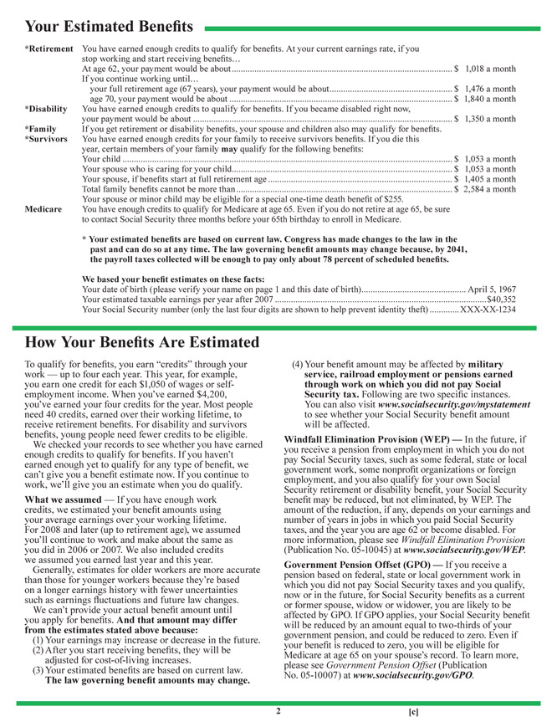

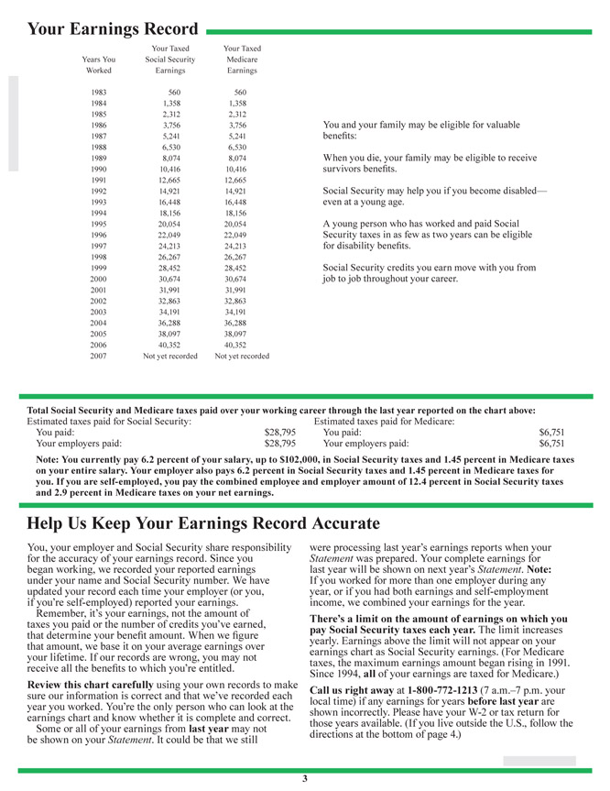
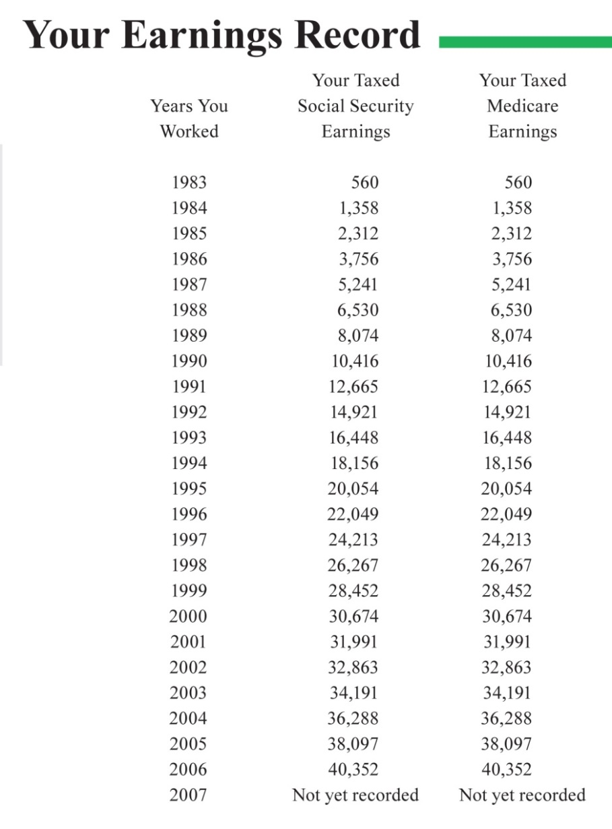
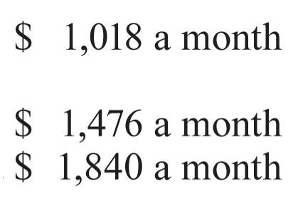
Social Security statements
Source: www.SSA.gov, 2010
Source: ssa.gov, 2010.
Notes:
This statement will show the benefits you may receive if you start receiving them at age 62, at full retirement age or at age 70. It will also show you what your earnings record is for purposes of calculating Social Security benefits.
Many individuals are not aware that they are not only entitled to Social Security benefits based on their earnings record, but also are entitled to a percentage of benefits based on the spouse’s benefits, whichever is greater (but not both).

Slide 23
When to take individual benefits
 | Age Social Security taken | % of FRA benefits received | Amount of benefits received
Early | 62 | 75% | $1,500
Full retirement age | 66–67 | 100% | $2,000
Delayed | 70 | 132% | $2,640
Note: Maximum benefit at FRA in 2018
$33,456 per year, or
$2,788 per month
Percentage is based on someone born 1943–1954; please consult ssa.gov for more information. There is no cost-of-living increase for 2016.
Notes:
We want to ensure clients are maximizing their benefits. With this in mind, it is important to remember that individuals who begin receiving benefits prior to their FRA lose approximately 25% of their benefits, but those who defer taking Social Security past their FRA could increase their benefits by roughly 32%.

Slide 24
When to take individual benefits
 | Age Social Security is taken | % of FRA benefits received | Amount of benefits received
Early | 62 | 74 | $1,480
FRA | 66–67 | 100 | $2,000
Delayed | 70 | 129 | $2,580
Note: Maximum benefit at FRA in 2018
$33,456 per year or
$2,788 per month
Source: https://www.ssa.gov/oact/cola/examplemax.html, 2017. Percentage is based on someone born 1943 to 1954; please consult ssa.gov for more information.
Notes:
We want to ensure clients are maximizing their benefits. With this in mind, it’s important to remember that individuals who begin receiving benefits prior to their FRA lose approximately 26% of their benefits, but those who defer taking Social Security past their FRA could increase their benefits by roughly 29%.

Slide 25
Early Retirement Benefits
Benefits are reduced for each month taken before your full retirement age.
Example: If born between 1943 – 1954 and benefits start:
  at Age 62 Reduced 25%
  at Age 63 Reduced 20%
  at Age 64 Reduced 13.3%
  at Age 65 Reduced 6.7%
Reduction is Permanent
25

Slide 26
Know when to file
Delaying benefits can increase the amount you receive over your lifetime
Example of a $24,000 annual benefit at full retirement age
100% OF BENEFITS
Total collected
by age 85
$414,000
Total collected
by age 85
$456,000
Total collected
by age 85
$475,200
Age
Source: ssa.gov, 12/31/15.
Notes:
In the 1950s, Congress amended the Social Security law to allow people to start taking benefits at age 62. This was originally intended for spouses only, but later extended to everyone. The catch is that the benefit you receive is 75% of what you would have received if you collected at full retirement age (age 66 for those born between 1943 and 1954 ), and you’re stuck with that lower payment forever.
Taking payments early is tempting, but if you want to make the most of Social Security, your best bet is to delay collecting until age 70.
This chart shows an example of someone who would collect $24,000 a year at full retirement age. By collecting early, that benefit is reduced to just $18,000 annually. By waiting until age 70, that annual benefit grows to more than $31,000. Over time, these differences add up. Consider that the difference between collecting at age 70 and at age 62 is worth more than $60,000 by the time this person reaches age 85.
It’s true that each person here has his or her own breakeven age. We don’t know how long we’re going to live, so the impulse is to start getting payments as soon as we can. However, as we’ll see on the next slide, people may live longer than you think.

Slide 27
What is breakeven?
Total received
Assuming a monthly payment of:
$1,483
$2,000
Total benefits
at age 95
$2,613
$775,980
66 vs. 62
70 vs. 66
$688,000
Break-even point
for claiming at:
$584,100
78
82
95
62
66
70
Source: ssa.gov, 2018.
Notes:
For those that expect to:
Live to or beyond their life expectancy, it may make sense to delay taking Social Security benefits
Take distributions at age 62, assuming a payment of $1,483 a month and no annual inflation adjustment, the total amount of Social Security benefits at age 95 is $587,400
Take distributions at age 66 and 2 months, assuming a payment of $2,000 a month and no annual inflation adjustment, the total amount of Social Security benefits at age 95 is $692,000
Take distributions at age 70, assuming a payment of $2,613 a month and no annual inflation adjustment, the total amount of Social Security benefits at age 95 is $784,000
Even if you don’t live to age 95, it may make sense to delay benefits.
If you delay taking distributions until:
Age 66 instead of 62, and you live past age 78, you’ll receive more Social Security benefits
Age 70 and live past age 82, you’ll receive more Social Security benefits
The longer you live past those break-even points, the more benefits you’ll receive.

Slide 28
Maximize spousal benefits
  Spouse will receive own benefit or a portion
  of spouse’s benefit, whichever is greater
    Early election (age 62) 35% of spouse’s FRA benefit
    At FRA or later (age 66–70) 50% of spouse’s FRA benefit
    Maximum Spousal Benefit 50% of spouse’s FRA benefit
Center for Retirement Research at Boston College, 2011.
Notes:
In 1939, Congress amended Social Security to include a provision for spouses who may not have a sufficient earnings history to generate a decent Social Security benefit on their own.
Spouses have a choice: they can take their own benefit or a portion of the primary earner’s benefit, whichever is greater.

Slide 29
When to take spousal benefits
 | Age Social Security taken | % of FRA benefits received | Amount of benefits received
Early | 62 | 35% | $700
Full retirement age | 66–67 | 50% | $1,000
Delayed | 70 | 50% | $1,000
FRA benefit of the primary wage earner is $2,000
Percentage is based on someone born 1935–1936; please consult ssa.gov for more information. The spousal benefit is 50% of the covered spouse’s benefit. There is no cost-of-living increase for 2016.
Notes:
First, we want to make sure your clients are maximizing their benefits. With this in mind, it is important to remember that spouses who begin receiving benefits prior to their FRA lose approximately 30% of their benefits and those who defer taking Social Security past their FRA receive nothing more than their FRA benefit amount.

Slide 30
Maximize survivor benefits
  At death, the surviving spouse will receive the greater
  of own benefit or the deceased spouse’s benefits
  Early benefit elections = REDUCED benefits for two lives
53% of people take Social Security at age 62.*
* Center for Retirement Research at Boston College, 2011.
Notes:
There are various strategies to maximize survivor benefits.

Slide 31
Widow and widower benefits
Family members who can
collect benefits include a
widow or widower who is:
  60 or older
  50 or older, if disabled
  Any age if he or she is caring
  for your child who is younger than 16 or disabled and entitled to Social Security benefits on the deceased’s record
Children can receive benefits if:
  They are unmarried
  Younger than 18 years old
  Between 18 and 19 years old, but in elementary or secondary school as full-time students
  Age 18 or older and severely disabled (the disability must have originated before age 22)
Additionally, parents of the deceased can receive benefits on the deceased’s earnings if they were dependent on the deceased for at least half of their support.
Notes:
The following is a discussion of widow and widower benefits, which includes the potential for others, such as children and parents of the deceased, to collect benefits.

Slide 32
When to take survivor benefits
 | Age Social Security taken | % of FRA benefits received
Early, not disabled | 60 | 71%
Early, higher % | 62 | 81%
Full retirement age | 66–67 | 100%
Delayed | 70 | 100%
Percentage is based on someone born 1943–1954; please consult ssa.gov for more information. The survivor benefit is 100% of the covered spouse’s benefit. There is no cost-of-living increase for 2016.
Notes:
It is important to know when to take survivor benefits, including what ages are best for maximizing benefits.

Slide 33
Divorce rules
1
  Marriage lasted 10 years or longer
  Currently unmarried
  Divorced for at least 2 years
  Need to be age 62 to receive spousal benefit, or age 60 to receive a survivor benefit
  Ex-spouse must be at least 62 and worked 40 quarters to receive a spousal benefit
  If ex-spouse remarried and client does not, client remains entitled to spousal and survivor benefits of ex-spouse
2
3
4
5
6
Notes:
There are a number of hurdles that must be cleared by divorced couples before they can gain access to Social Security benefits.

Slide 34
When to take divorce benefits
 | Age Social Security taken | % of FRA benefits received | Amount of benefits received
Early | 62 | 35% | $700
Full retirement age | 66–67 | 50% | $1,000
Delayed | 70 | 50% | $1,000
FRA benefit of the primary wage earner is $2,000.
Percentage is based on someone born 1935–1936; please consult ssa.gov for more information. Person must not be currently married and must have been married to the same individual for at least 10 years. Divorce benefit is 50% of the covered spouse’s benefit. There is no cost-of-living increase for 2016.
Notes:
You can see that the rules pertaining to divorce benefits are different than those for individuals, widows or widowers, and married spouses.

Slide 35
Divorced Survivor Benefits
Will step up to 100% ex-spouses benefits
Must still be currently unmarried
One exception- can remarry after the age of 60 and continue receiving benefits

Slide 36
Social Security elections
Factors to consider
?
Need income
Health
Longevity
Married
Age difference between spouses
?
?
?
?
The greater the age difference, the longer the benefit payment and the bigger the impact when making an early election
Notes:
When advising clients on their Social Security options, there are several factors that need to be considered.
(Read slide)

Slide 37
Social Security Disability
1)Must have worked in jobs covered by social security
2) Will pay benefits for people who can not work for at least a year due to disability
3) If you are working in 2016 and your earnings average more than $1,130 a month, you generally cannot be considered disabled.
4) 1st check comes 6 months after your disability occurred
5) Can do regular “check-ins” to confirm you are still disabled
*If you are receiving Social Security disability benefits when you reach full retirement age, your disability benefits automatically convert to retirement benefits, but the amount remains the same.

Slide 38
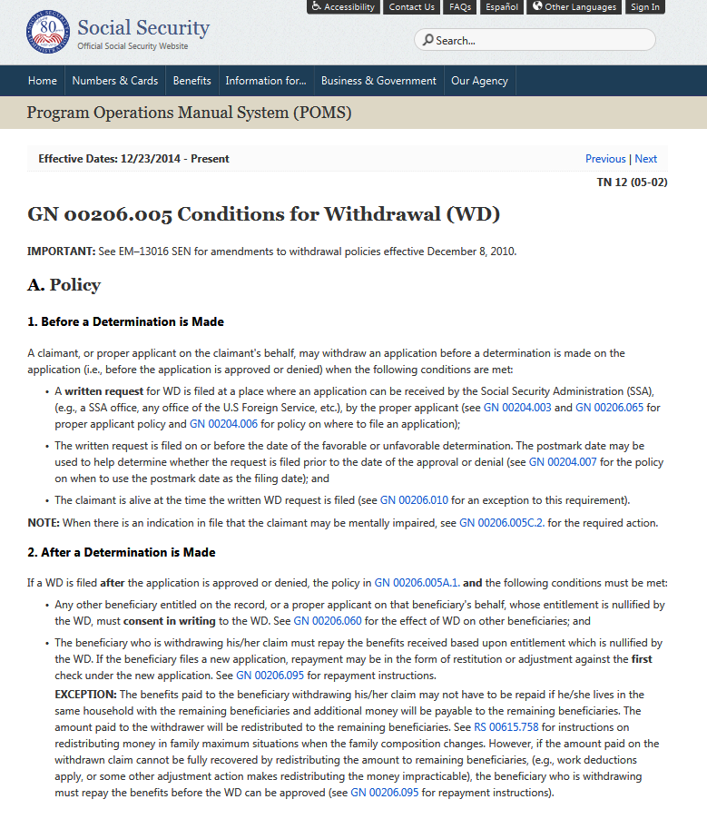

Do over
  File Form SSA-521 within 1 yr
  No interest or penalty paid
  Withdraw application
  Apply later
  Kind of like a “trial run”
  After filing SSA-521, SSA will
  send letter indicating amount
  of benefits to be repaid
Notes:
Here are the steps to follow if a client wants to withdraw from receiving Social Security benefits.

Slide 39
Know when your benefits are taxable
Social Security is taxable if your combined income is high enough
What counts as combined income?
  Adjusted gross income
  Nontaxable interest
  Half of Social Security benefits
  Calcxml.com
How much of Social Security is taxable?
Combined income amount (for joint/single filers) | Taxable
Less than $32,000/$25,000 | 0%
Between $32,000 and $44,000/$25,000 and $34,000 | Up to 50%
More than $44,000/$34,000 | Up to 85%
Notes:
Regardless of when you file, your combined income can have an adverse affect on your Social Security benefits in another way: taxes. A portion of your benefits will be taxable once your combined income passes a certain threshold. For example, married couples who earn over $44,000 will have up to 85% of their benefits subject to taxes.

Slide 40


Find a balance between working and collecting
For early retirees, benefits are reduced
by $1 for every $2 earned over $17,640
The Smiths
The Sullivans
 | Age 62: Taking early benefits | Age 66: Full retirement age
Potential S.S. benefit | $20,000 | $20,000
Earned income | $40,000 | $40,000
Actual S.S. benefit | $ 8,469 | $20,000
Total income | $48,469 | $60,000
$23,080
over the
limit
No
limit
This is a hypothetical example.
Notes:
Another way to maximize benefits is to not have them reduced by your earned income.
Before you reach full retirement age, any earnings over a certain annual limit ($15,720 in 2016) will reduce your benefits by $1 for every $2 earned over that limit.
Let’s use an example of the Smiths and the Sullivans.
The Smiths are age 62, and they file for early benefits. They are due a combined $20,000, but they also want to work, and their $40,000 in earned income reduces their $20,000 Social Security benefit to just $7,850!
The Sullivans are at full retirement age, so they can earn as much as they want and it won’t penalize their benefit.

Slide 41
Estimated time: full retirement age (FRA)
Social Security benefits begin the year of reaching FRA
Example
Example
If earnings from January 1 of the year of reaching FRA to end of month prior to FRA is less than the earnings limit, $44,880, then benefits will be paid for the months prior to FRA.
Samantha reaches FRA in April 2015. If her earnings are less than $41,880 January 1 to March 2015, then she is able to begin receiving benefits in January. The amount can be reduced depending on age.
This is a hypothetical example.
Notes:
The following are a couple of examples focused on the maximizing benefits upon reaching the full retirement age.

Slide 42
“WORK”
What is work??
Wages
Self-employment
What is not work??
Income from rental properties
Investments
IRA’s, 401k’s, deferred comp
Gambling & Lottery Winnings
.

Slide 43
Considerations before you file
Will your benefits
be coordinated with
those of your spouse?
Are you planning on working in retirement?
Your financial advisor has the experience and tools to help you plan!
Have you planned for how your required minimum distributions will affect
your income mix and
Social Security benefit?
Do you have a
retirement income-tax strategy in place?
Notes:
We’ve covered a great deal in this presentation, but we’ve also left a lot unexplored. Your financial advisor has the experience and the analytical tools to help you plan for Social Security and make the most of your retirement assets. Here are a few other things to consider before you file.

Slide 44

Example: Harry and Ruth Sullivan
Age
60 | Married; both 60
62
64
66 | Full age filing | Harry’s full monthly S.S. benefit at age 66 will be $2,000
68
70
72
74
76 | Harry dies at 75
78
80
82
84
86
88 | Ruth dies at 88
Ruth stayed home and raised the family,
so she has no earned S.S. benefits of her own.
This is a hypothetical example.
Notes:
We’re going to return to the Sullivans, Harry and Ruth.
In this scenario, Harry was the primary breadwinner and expects to receive a monthly benefit of $2,000 at full retirement age. Ruth outlives Harry by 13 years.

Slide 45
Scenario 1: both file early
Age
60 | Married; both 60
62 | Early filing | Harry’s monthly S.S. benefit at age 62 is $1,500
64
66
68
70
72
74
76 | Harry dies at 75
78
80
82
84
86
88 | Ruth dies at 88
Ruth’s monthly S.S. benefit is
35% of Harry’s PIA, or $700.
Ruth collects 100% of Harry’s monthly S.S. benefit of $1,500
Ruth collects a total of $351,600 over her lifetime
This is a hypothetical example.
Notes:
If Harry claims at the earliest age of 62, he will receive a reduced benefit of $1,500 a month until his death.
Ruth also files at age 62, and as a result is eligible to receive 35% of his benefits, or $700 per month. Pretty small.
Upon Harry’s death, Ruth will receive the greater of her benefit or Harry’s. So in this case, she will receive $1,500 month.
Upon Ruth’s death at age 88, she will have received $315,600 in spousal and survivorship benefits over her lifetime.

Slide 46
Scenario 2: both file at age 66
Age
60 | Married; both 60
62
64
66 | Full age filing | Harry’s monthly S.S. benefit at age 66 is $2,000
68
70
72
74
76 | Harry dies at 75
78
80
82
84
86
88 | Ruth dies at 88
Ruth’s monthly S.S. benefit is
50% of Harry’s, or $1,000.
Ruth collects 100% of Harry’s monthly S.S. benefit of $2,000
Ruth collects a total of $432,000 over her lifetime
This is a hypothetical example.
Notes:
If Harry waits until full retirement age to claim benefits, he’ll receive $2,000 a month until his death.
Ruth can claim 50% of his benefit at her full retirement age (age 66), or $1,000 until Harry dies.
Upon Harry’s death, Ruth will receive the greater of her benefit or Harry’s. So in this case, Ruth will receive $2,000 a month.
Upon Ruth’s death at age 88, Ruth will have received $432,000 in spousal and survivorship benefits over her lifetime.

Slide 47
Scenario 3: Delay Until 70*
Age
60 | Married; both 60
62
64
66 | Full age filing
68 |  | (Ruth starts getting $1000 at 70)
70 |  | Harry begins receiving delayed monthly S.S. benefits of $2,640
72
74
76 | Harry dies at 75
78
80
82
84
86
88 | Ruth dies at 88
Ruth’s monthly S.S. benefit is
50% of Harry’s, or $1,000.
Ruth collects 100% of Harry’s monthly S.S. benefit of $2,640
Ruth collects a total of $471,840 over her lifetime
*Ends 4/30/16. This is a hypothetical example.
Notes:
In this scenario, Harry wants to delay collecting benefits to make the most of the higher payout at age 70.
To do that, he takes advantage of a strategy known as file and suspend.
Harry files at full retirement age, but then immediately suspends his payments.
This enables Ruth to claim 50% of his benefit at her full retirement age (age 66), or $1,000 until Harry dies.
Upon Harry’s death, Ruth will receive the greater of her benefit or Harry’s. So in this case, Ruth will receive $2,640 a month.
Upon Ruth’s death at age 88, Ruth will have received $531,840 in spousal and survivorship benefits over her lifetime.

Slide 48

Talk to your financial advisor
Notes:
Talk to your financial advisor for help in paving the way to a secure retirement.

Slide 49
John Hancock Investments
A trusted brand
John Hancock Investments is a premier asset manager representing one of America’s most trusted brands, with a heritage of financial stewardship dating back to 1862. Helping our shareholders pursue their financial goals is at the core of everything we do. It’s why we support the role of professional financial advice and operate with the highest standards of conduct and integrity.
A better way to invest
We build funds based on investor needs, then search the world to find proven portfolio teams with specialized expertise in those strategies. As a manager of managers, we apply vigorous oversight to ensure that they continue to meet our uncompromising standards and serve the best interests of our shareholders.
Results for investors
Our unique approach to asset management enables us to provide a diverse set of investments backed by some of the world’s best managers, along with strong risk-adjusted returns across asset classes.
Notes:
Read slide.

Slide 50
This material does not constitute tax, legal, or accounting advice, and neither John Hancock nor any of its agents, employees, or representatives are in the business of offering such advice. It was not intended or written for use, and cannot be used, by any taxpayer for the purpose of avoiding any IRS penalty. It was written to support the marketing of the transactions or topics it addresses. Anyone interested in these transactions or topics should seek advice based on his or her particular circumstances from independent professional advisors.
MF263926
SSNPPT 2/16

