Slide 1
Presenter’s name
Presenter’s title
<Date>

Slide 2

Changing times
A Kodak moment
Do you recall what happened to one of the greatest brands in the United States?
Notes:
I’m sure many of you can recall the history of Kodak–the former industrial giant and iconic brand in the United States. Founded in 1888 by George Eastman, Kodak was responsible for the rise of amateur photography among American consumers, and it took photography out of the professional portrait studio and into everyday life. At its peak, about 70% of the U.S. film market, consumer or otherwise, was locked up for Kodak, and the company had a strong international distribution as well. The gross margins on film sales approached 70%; Kodak was selling a lot of film and it was bringing in a ton of money. The company developed a complete focus on selling inexpensive cameras to keep consumers buying its film. The way Kodak saw it, there was nothing more important to the company’s success than protecting its interests in film photography.

Slide 3

Is this the financial services’ “Kodak moment?”
Source: George Eastman Museum.
Notes:
And then change came—right under their own roof. Did you know that the next generation of technology, the digital camera, was invented in 1975 by an electrical engineer named Steve Sasson—who actually worked at Kodak? They didn’t want this camera to succeed and infringe on their film business, so for the most part they dismissed the technology. But then, some patents expired and other companies embraced the technology and grabbed market share. Then, in the late 1980s, a futurist was hired by Kodak to consult with them regarding their future. She told Kodak to go into digital instead of print. She was promptly fired. The company had so much success doing what they were doing they didn’t find the need to go beyond their core profit center—film. In other words, they were protecting their current interests and profitability, but by doing so they failed to protect themselves for the future. And in 2012, Kodak filed for bankruptcy.
Why did I share this story with you? Click – to show “Is this the Financial Services “Kodak Moment”? One of the biggest challenges in financial services today is building a growing, sustainable, and valuable practice for today and tomorrow, and to do that, a firm needs to capture clients today and in the future. Now the reason I say that is, if you think about the history of the financial services industry and how advisors typically built their book; 30 years ago, that was through cold calling, conducting seminars, and networking, and advisors built their books of business by bringing in clients who were often their age, with any level of assets, and they grew with their clients. In other words, in the past, advisors built their books of business that would grow with them—not intentionally—but that’s what happened. Today, many build their book with those who have already amassed assets and are typically older. This presentation is about how we can reach all generations and intentionally build a growing, sustainable, and valuable practice for today and tomorrow. And tomorrow may come sooner than we think.

Slide 4

The challenge
The reality with existing clients
66% of children fire their parents’ financial advisor
after they inherit their parents’ wealth¹
Only 38% of investors retain the same advisor
when their spouse dies²
1 Skinner, Liz, “The great wealth transfer is coming, putting advisers at risk,” InvestmentNews.com, 7/13/15.
2 “Roadmap for a new landscape: Managing the Transition of Wealth Across Generations,” State Street Global Advisors, 2016.
Notes:
So once again, I’ll ask: When you look at your existing clients, what’s the likelihood of you keeping the account when your client passes away?
Many of you have built your business by focusing on investors that have already amassed assets and they’re typically older. Advisors need to imagine what their balance sheets would look like if 66% of their clients left.
My goal today is to share with you how you can reach all generations so not only do you retain assets when clients pass away, you also continue to build a great practice for today and tomorrow.

Slide 5
The opportunity
Intergenerational wealth transfer—it’s just starting
U.S. investable assets transferred by year
Source: “The ‘Greater’ Wealth Transfer,” Accenture, 2015.
Notes:
We’ve all seen charts like this before. Here are the facts:
Boomers are still inheriting money from their parents, the so-called silent generation. Wealth transfer from Boomers starts now and will continue over the next 30 to 40 years. Starting in 2026, eight years from now, every five years, 10% of the country’s wealth will change hands. The amount of money that transfers will peak in 2036, with an estimated $30 trillion being passed down from one generation to the next.
But, make no mistake about it, due to the challenge and the opportunity that I just shared, there will be advisors who are aggregators of new clients and AUM, and, unfortunately, there will be advisors on the opposite side of that transaction that will be transferring their clients and AUM to those aggregators.

Slide 6
Today’s objectives
1
Generational intelligence
2
Multigenerational communication
of value
3
Strategies for retaining assets through the next generation
Notes:
Today we’re going to discuss three objectives for building a sustainable, valuable practice for years to come, no matter where you are in the stage of your practice. First we’ll talk about generational intelligence. What do we need to know about the different generations? Second, we’ll share ideas for communicating your value to all generations. And third, we’ll learn about strategies for retaining the next generation, which could be any of the three—Baby Boomers, who are still receiving assets from the generation before them (the Silent Generation), as well as Gen Xers and Millennials, who have just begun receiving assets from the generations before them.

Slide 7
What is your generational intelligence?
Starter quiz
1. Which generation likes control the most?
A. Baby Boomer
B. Gen X
C. Millennial
D. Silent Generation
2. Which generation feels strongest that the position they’re in is based on their hard work?
A. Baby Boomer
B. Gen X
C. Millennial
D. Silent Generation
Source: Collaborative Coaching research for John Hancock Investments, November 2015.
Notes:
So let’s take a little starter quiz to determine where you’re at in your generational intelligence—your understanding of all the generations.

Slide 8
What is your generational intelligence?
Starter quiz
3. Which generation has
the highest number
of billionaires?
A. Baby Boomer
B. Gen X
C. Millennial
D. Silent Generation
4. Which generation of these four is the largest?
A. Baby Boomer
B. Gen X
C. Millennial
D. Silent Generation
Source: Collaborative Coaching research for John Hancock Investments, November 2015.

Slide 9
What is your generational intelligence?
Starter quiz
5. The Silent Generation and Baby Boomers are the most conservative investors. Which generation is the next most conservative?
  A. Gen X
  B. Millennial
  C. All of the above
6. Which generation wants the most education from their financial advisor?
  A. Baby Boomer
  B. Gen X
  C. Millennial
  D. Silent Generation
Source: Collaborative Coaching research for John Hancock Investments, November 2015.

Slide 10
Generational quadrant
SILENT GENERATION
1928–1945
BABY BOOMER
1946–1964
GENERATION X
1965–1980
MILLENNIAL
1981–1997
Source: Collaborative Coaching research for John Hancock Investments, November 2015.
Notes:
You’ll notice a Generational Intelligence workbook on your table or in your folder. Turn to page 2 in the workbook and you will notice this chart.
Where do you fall? Put an X in that quadrant.
How about your team? Where does your team fall? Raise your hand if you have a millennial on your team. Mark an X for each team member that falls in each quadrant.
Now how about your client base? Where would you estimate they would fall in this generational quadrant? Put a number in each quadrant.
This gives us a start to understanding what your book looks like in terms of the generations you serve.

Slide 11
Segment your clients by generation
SILENT GENERATION (Age 73+)
BABY BOOMER (Age 54 to 72)
Clients
Assets
Clients
Assets
36%
37%
43%
48%
79% of clients and 85% of assets
GENERATION X (Age 38 to 53)
MILLENNIAL (Age 21 to 37)
Clients
Assets
Clients
Assets
17%
14%
4%
1%
Source: Red Zone Marketing research for John Hancock Investments, January 2016.
Notes:
On the screen is an advisory practice in Virginia with $400 million in assets under management. They want to continue the practice for years to come. This team probably looks a lot like you.
Look where these clients and assets fall in each generation.
Click – Here is the age breakdown. 36% of their clients are over age 73, 43% are between ages 54-72.
Click – Now, let’s look at assets. 37% assets are with clients over age 73.
Click – 48% assets are with clients ages 54–72.
Click, Click. As you can see 79% of clients and 85% assets are in the two generations and with older clients.

Slide 12
Segment your team of advisors by generation
SILENT GENERATION
1928–1945
BABY BOOMER
1946–1964
1 advisor
1 advisor
GENERATION X
1965–1980
MILLENNIAL
1981–1997
0
0
Source: Red Zone Marketing research for John Hancock Investments, January 2016.
Notes:
This is what the firm’s advisor base looks like. They have 2 advisors and 7 other staff members. The other staff members are younger, but they haven’t had success retaining younger advisors.
What is the risk if:
They want to continue the practice for years to come?
They decide to sell the practice?
How does your book meet your clients of tomorrow?

Slide 13
What is your generational risk factor?
Think about your practice like a portfolio
Based on your age and goals, and the age and assets
of your clients, how diversified is your practice
What is the practice’s
expected client retention?
HIGH RISK
How marketable is a
practice to a successor?
HIGH RISK
How marketable is a firm to investment prospects when the most trusted
advisors are nearing retirement age?
HIGH RISK
Notes:
Determine your generational risk factor. Is your practice diversified? Think about your business like a portfolio: stocks, bonds, and alternatives. Millennials, and arguably even Gen Xers, are alternatives—for now.
These are the questions that the firm in Virginia started asking. They saw what was happening to the value of other advisors’ businesses and their decreasing—not increasing—value and decided to develop a formula for identifying the generational risk factor for their practice. Using simple terms, they evaluated their practice with low, medium, and high risk.
Client retention based on age? Their answer: [CLICK] High risk of not retaining assets over the next 15 to 20 years.
How marketable is the practice to transition to another advisor? When nearly 85% of your assets are over the age of 55, [CLICK] the risk is high.
How marketable is the practice to a firm of new investment prospects with the advisors’ ages averaging high? The marketability is low, so the risk is high. [CLICK] There needs to be a diversification in age of the advisors in a practice.
Having all 3 questions answered with 3 highs means greater practice risk. Where does your practice fall?
How did they solve this problem of high generational risk? They decided to get better at reaching out to younger generations.

Slide 14
Reducing your generational risk factor
Needs
Reach out to the next generation of your clients to develop a retention plan
Develop the next generation of advisors
Challenges
Finding the time to connect with the next generation of your clients
A small pool of younger advisors and training
Low profitability
Notes:
This team, and maybe you as well, realized they had two big needs.
Reaching out to the next generation of clients so they retain assets.
Realizing that they needed to develop the next generation of advisors—which meant bringing on a junior advisor.
I don’t want to overlook the obvious—this isn’t easy, there are challenges:
Time it takes to connect and how do you go about it.
Finding the right younger advisor.
It’s an investment, meaning we might experience lower profitability in beginning.
Where do you start? First, we need to better understand each generation.

Slide 15

Source: PoliticalCartoons.com.
Notes:
So what is the solution? First, we must understand the differences between the generations so we can be increasingly effective in reaching generations that are different from ours.
As the cartoon shows, we are different, and we were raised differently. It’s not to judge other generations, but to understand them.
---------------------------------------------------------------
License
Content license
This is a license of reproduction rights only. No transfer of tangible property is made and no sales tax or delivery charge is due. By purchasing these cartoons we give you permission to reproduce them. This permission is for one time use in the publication/website you indicated by the licensing information you provided during purchase. The customer agrees to the terms of use posted on our PoliticalCartoons.com site.

Slide 16
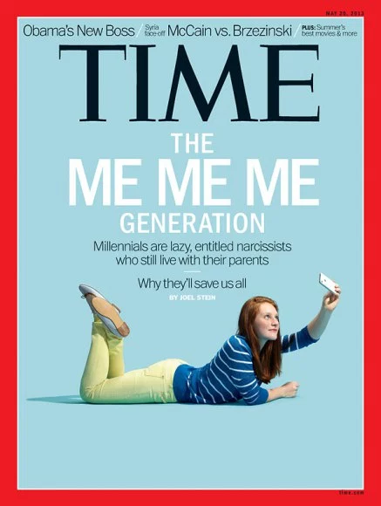
Disclaimer…
“Everyone hates millennials until it’s time to convert a PDF into a Word document.” – Sara Valentine
Source: Time Inc.
Notes:
TIME and Time Inc. are not affiliated with, and do not endorse products or services of, Licensee.

Slide 17
Generational diversity—basic premises
Lifecycle effects
Certain rites of passage
are true regardless of time
or culture
Child and adult development
Socialization
Formative experiences
Economy
Historical events
Social norms
Popular culture
Technology and science
Source: Collaborative Coaching research for John Hancock Investments, November 2015.
Notes:
Each generation is built on both lifecycle effects, which typically occur through each generation, and formative experiences, which take into account what’s happening in the world around them as they’re growing up.
Think about when some of you grew up—you could go out and play in the neighborhood or go miles away with your friends. You were gone from morning ‘til night many days in the summer and on the weekends. Today, in many cases it isn’t safe to let younger children out of your sight. The world is perceived to be much more dangerous than it was. So let’s take a granular look at each generation and what you should know to truly be generationally intelligent.

Slide 18

The Silent Generation: formative events and heroes
Formative events
World War I and II
The Great Depression
The Roaring 20s
The Korean War
The G.I. Bill
The McCarthy era
Heroes
Winston Churchill
Franklin D. Roosevelt
Charles de Gaulle
Amelia Earhart
General Patton
Dwight Eisenhower
Source: Collaborative Coaching research for John Hancock Investments, November 2015.
Notes:
Let’s begin with the Silent Generation. Wars and the Great Depression define this generation. Their heroes were military and political leaders, for the most part, such as Winston Churchill, General George Patton, and Franklin D. Roosevelt.

Slide 19
Major differences between generations
SILENT GENERATION
Command style of leadership
Interested in investment protection
Prefer formal language and formal dress
Social conformity trumps self-expression
Do not like change
Seldom buy alone — address concerns children will raise
BABY BOOMER
SILENT GENERATION
Command style of leadership
Interested in investment protection
Prefer formal language and formal dress
Social conformity trumps self-expression
Do not like change
Seldom buy alone—address concerns children will raise
GENERATION X
MILLENNIAL
Source: Collaborative Coaching research for John Hancock Investments, November 2015.
Notes:
The major differences between the Silent Generation and the other generations include their command style of leadership, their desire for investment protection, and their preference for formal language and formal dress.
They continue to make up a significant portion of boards of directors, they prefer social conformity, not self-expression, and they’re resistant to change.

Slide 20

Baby Boomers: formative events and heroes
Formative events
The Civil Rights Movement, feminism, protests
The space race: putting a man on the moon
The 60s: sex, drugs, and rock ‘n’ roll; hippies
Vietnam War
Dr. Spock, “Every child has a gift”
Heroes
Ronald Reagan
John F. Kennedy
Martin Luther King
John Glenn
Gloria Steinem
Source: Collaborative Coaching research for John Hancock Investments, November 2015.
Notes:
Now the Baby Boomers. They grew up with a different set of events and heroes. Think about the issues that were formative: The civil rights movement, the feminism movement, the Vietnam War, and many protests. A wildly popular book for raising kids was Dr. Spock’s Baby and Childcare, which formed the way many parented, including the fact that every child has a gift. Their heroes are former presidents Kennedy and Reagan, civil rights leaders Martin Luther King Jr. and Gloria Steinem, and astronaut John Glenn.

Slide 21
Major differences between generations
SILENT GENERATION
Command style of leadership
Interested in investment protection
Prefer formal language and formal dress
Social conformity trumps self-expression
Do not like change
Seldom buy alone — address concerns children will raise
BABY BOOMER
Believe in hard work and freedom
Work identity is important
Place value on uniqueness
Prefer in-person meetings
Control 70% of U.S. net worth/
will inherit another $8 trillion
Have not saved enough for retirement
BABY BOOMER
Believe in hard work and freedom
Work identity is important
Place value on uniqueness
Prefer in-person meetings
Control 70% of U.S. net worth/
will inherit another $8 trillion
Have not saved enough for retirement
GENERATION X
MILLENNIAL
Source: Collaborative Coaching research for John Hancock Investments, November 2015.
Notes:
The major differences between the Baby Boomer generation and the other generations include their belief that hard work and freedom are foundational, they have a strong identification with their work, they prefer to meet in person, and they have, on average, six grandkids.
While they’re no longer the largest generation, they do control 70% of the U.S. net worth, and they’re still inheriting from the Silent Generation. They support their grandkids’ college educations and are willing to sell real estate to support retirement; however, many have not saved enough to last through their retirement years.

Slide 22

Gen X: formative events and heroes
Formative events
Watergate, oil embargo
Vietnam aftermath
Inflation and corporate
layoffs (1980s)
Challenger explosion
Sesame Street and MTV; PC
was invented; punk rock
Divorce rate tripled
Latchkey children
Heroes
Very few global/national
heroes
Family members
Teachers
Source: Collaborative Coaching research for John Hancock Investments, November 2015.
Notes:
For Gen Xers, formative events include Watergate, the oil embargo, the aftermath of the Vietnam War, inflation, and layoffs, Sesame Street, a new way to appreciate music, and tragedies like the Challenger explosion. They’re also very independent, as they experienced a tripled divorce rate over previous generations, and were the first generation of latchkey kids.
Their heroes, interestingly, are not typical of previous generations. They have few global/national heroes. Their heroes are those around them, like family members and schoolteachers.

Slide 23
Major differences between generations
SILENT GENERATION
Command style of leadership
Interested in investment protection
Prefer formal language and formal dress
Social conformity trumps self-expression
Do not like change
Seldom buy alone — address concerns children will raise
BABY BOOMER
Believe in hard work and freedom
Work identity is important
Place value on uniqueness
Prefer in-person meetings
Control 70% of U.S. net worth/
will inherit another $8 trillion
Have not saved enough for retirement
GENERATION X
A “get it done” attitude—very independent
Hitting their peak earning years; will own the C-suite in 2020
More optimistic and satisfied—but healthy skeptics
Curb your enthusiasm—Xers will doubt what you say
Balance retirement goals with college savings for their children (true sandwich generation)
In 2012, 63% of Gen X investors worked with an advisor—now it’s only 23%
GENERATION X
A “get it done” attitude — very independent
Hitting their peak earning years; will own the C-suite in 2020
More optimistic and satisfied — but healthy skeptics
Curb your enthusiasm — Xers will doubt what you say
Balance retirement goals with college savings for their children (true sandwich generation)
In 2012, 63% of Gen X investors worked with an advisor
— now it’s only 23%
MILLENNIAL
Source: Collaborative Coaching research for John Hancock Investments, November 2015.
Notes:
The major differences between Gen Xers and the other generations is they are very independent, possess a “get it done” attitude, are hitting their peak earning years right now, and they’re much more optimistic.
They work to balance retirement and college savings, and are the primary sandwich generation, taking care of the generations before and after them. They have a sensitive BS meter, do not like sales pitches, and are becoming more skeptical of advisors. In 2012, 63% worked with an advisor. By 2016, that number was down to 23%.

Slide 24
Gen Xers as investors: what to keep in mind
Why the mass affluent left their advisors
Especially for Gen Xers, the trend has gone towards self-managing
their assets and using low fee investment strategies
Source: “Digital Disruption in Wealth Management,” Deloitte, 2013.
Notes:
Gen Xers are not as inclined to work with financial advisors as previous generations. This chart shows why Gen Xers are trending toward self-management of assets.
Why did mass affluent Gen X leave their advisors in 2012? Here is what the research shows:
The number one reason: trust. More than one-quarter said they felt their advisor was putting his or her interests ahead of their own.
Felt they get better outcomes on their own.
Realized that they enjoyed managing investments on their own. Note: we’re in year nine of a bull market, so it hasn’t been difficult to find winning investments.
Note that especially for Gen Xers, the trend goes toward self managing their assets and using low fee investment strategies.

Slide 25

Millennials: formative events and heroes
Formative events
School shootings
September 11
Gulf Wars, the War on Terror
Child-centered parenting
Digital natives/social media
Economic prosperity in early 2000s, the Great Recession
Heroes
Mark Zuckerberg
Steve Jobs
Barack Obama
Bill Gates
Beyoncé
Jay Z
Parents
Source: Collaborative Coaching research for John Hancock Investments, November 2015.
Notes:
Millennials were taught they can change the world, they should love their job, and that they’re important. Their formative events include school shootings, 9/11, Gulf Wars, and the Great Recession. They grew up being protected by their parents, as the world they lived in grew more dangerous. They’re digital natives and never knew anything but computers and social media, and they build their communication style around what they know. Their heroes are Silicon Valley moguls Zuckerberg, Jobs, and Gates, as well as President Barack Obama, Beyoncé, Jay Z, and, yes, their parents.

Slide 26
Major differences between generations
SILENT GENERATION
Command style of leadership
Interested in investment protection
Prefer formal language and formal dress
Social conformity trumps self-expression
Do not like change
Seldom buy alone — address concerns children will raise
BABY BOOMER
Believe in hard work and freedom
Work identity is important
Place value on uniqueness
Prefer in-person meetings
Control 70% of U.S. net worth/
will inherit another $8 trillion
Have not saved enough for retirement
MILLENNIAL
Rank #1 career priority as “doing something
enjoyable,” while 61% feel responsible for
making a difference
Raised with a strong belief that their voice matters
43% consider themselves conservative investors
Only 18% of Millennials believe stocks are a good
way to save
Most do not use an actual telephone
to communicate in the traditional sense
GENERATION X
A “get it done” attitude — very independent
Hitting their peak earning years; will own the C-suite in 2020
More optimistic and satisfied — but healthy skeptics
Curb your enthusiasm — Xers will doubt what you say
Balance retirement goals with college savings for their children (true sandwich generation)
In 2012, 63% of Gen X investors worked with an advisor
— now it’s only 23%
MILLENNIAL
Rank #1 career priority as “doing something enjoyable,” while 61% feel responsible for
making a difference
Raised with a strong belief that their voice matters
43% consider themselves conservative investors
Only 18% of Millennials believe stocks are a good
way to save
Most do not use an actual telephone
to communicate in the traditional sense
Source: Collaborative Coaching research for John Hancock Investments, November 2015.
Notes:
At the outset of their careers, Boomers ranked “earning as much money as possible” as their #1 priority. Millennials rank their #1 career priority as “doing something enjoyable,” while 61% feel responsible for making a difference.
Their parents are their #1 trusted advisor—the opportunity with Millennials may still be with the Baby Boomers.
93% worldwide believe all people must be treated with respect, regardless of their differences.
They were raised with a strong belief that their voice matters, causing them to have a strong sense of immediacy and empowerment.
43% consider themselves conservative investors, versus Gen Xers at 27% and Boomers at 31%.
Only 18% of Millennials believe stocks are a good way to save, and, yes, there are more Millennials than any other generation in the workforce today.

Slide 27
Opportunities for each generations
SILENT GENERATION
Loyalty
Transfer of wealth
BABY BOOMER
Inspire with “It’s the right thing to do”
Trigger words = individual, original, discovery
Only 6% that work with a financial advisor use
estate-planning services
Balance servicing Boomer clients with developing a value proposition/promise for their next generation
GENERATION X
Value proposition has to be strong, as more want
to donate to charity than engage an advisor
Be concise and use straightforward facts
Give them access to information
Ask for their feedback
Sealing a deal via email often works
47% have never discussed retirement planning goals and don’t know how much they will need in retirement ($1.5 million median savings)
MILLENNIAL
Help them navigate their inheritances—62% would
like to be walked through retirement planning
Prove that you can do something they can’t
  Open to alternatives and ESG strategies
  to reach financial goals
1 in 4 Americans with $1+ million in investable assets
is under 40 — only 3% inherited their wealth
Have younger advisors as main point of contact
BABY BOOMER
Inspire with “It’s the right thing to do”
Trigger words = individual, original, discovery
Only 6% that work with a financial advisor use
estate-planning services
Balance servicing Boomer clients with developing a value proposition/promise for their next generation
GENERATION X
Value proposition has to be strong, as more want
to donate to charity than engage an advisor
Be concise and use straightforward facts
Give them access to information
Ask for their feedback
Sealing a deal via email often works
47% have never discussed retirement planning goals and don’t know how much they will need in retirement ($1.5 million median savings)
MILLENNIAL
Help them navigate their inheritances — 62% would
like to be walked through retirement planning
Prove that you can do something they can’t
  Open to alternatives and ESG strategies
  to reach financial goals
1 in 4 Americans with $1+ million in investable assets
is under 40 — only 3% inherited their wealth
Have younger advisors as main point of contact
Source: Collaborative Coaching research for John Hancock Investments, November 2015.
Notes:
As the Silent Generation is transferring their wealth, they’re creating opportunities.
(advance slide)
When attracting Baby Boomers as clients, know they prefer regular contact and the desire to understand their long-term goals and expectations. Big opportunities for financial advisors include the fact that only 6% of Baby Boomers with a financial advisor use estate planning services (and they need it). Also, retaining loyalty with Boomers is critical while showing what you’ll do for their next generations.
(advance slide)
In order to attract Gen Xers, it’s important to have a strong value proposition if you want to engage them, be very concise and straightforward, and be transparent, involve them and communicate like you would with a friend. Your value proposition has to be strong, as more want to donate to charity (29%) than engage a financial advisor (27%). A big opportunity for working with Gen Xers: 47% of them have not discussed retirement planning goals and don’t know what they need.
(advance slide)
In order to attract Millennials as clients, you must truly understand them to work with them. They also need deliberate plans to help them navigate their inheritances. They’re open to alternative ways of reaching financial goals, and you may need to prove that you can do something they can’t do; for example, IPO stocks aren’t available to retail investors, and you can save them time by reading proprietary research.
Another key attraction focus: Have younger advisors as the main point of contact as they will relate better and perhaps feel more comfortable.
There are big opportunities with Millennials, as 1 in 4 with $1+ million in investable assets is under 40 and only 3% inherited their wealth.
They would also like to be walked through every step of the retirement planning process, but few follow up on this intention.

Slide 28
Today’s objectives
1
Generational intelligence
2
Multigenerational communication
of value
3
Strategies for retaining assets through the next generation
Notes:
Now that you know more about the differences and opportunities with each generation, how do you communicate your value?

Slide 29
Why do your clients pay you a fee?
Strategy of a top producer
“The value of our services is worth at least 3%
of your assets under care with us annually”
1
2
3
Notes:
The key exercise is to answer the question of why do your clients pay you a fee? What is it you do?
One advisor, in Ohio, who has a growing, truly multigenerational firm that manages about $600 million, has been using this method for several years. He’s confident that this method of communication of the firm’s value when meeting with someone is the key to his ability to really reach the next generations. He’s working with many families through four generations and has communication with all of his top clients’ children or beneficiaries as part of his process. We’ll talk about some of his methods and others for getting in front of the next generation in the next section of this presentation, but let’s go over how he shares his team’s value, customized for each client’s particular situation and generation. The key here is a visual, memorable description of what he does and WHY what he does should be meaningful to the person he’s sitting with.
This visual presentation of value works with all generations because it’s a flexible way of describing what you do. On the next few slides, I will show in words the differences that you can use and highlight for the Baby Boomer, Gen Xers, and Millennial generations.
Now, where does someone come up with 3% in today’s day and age? How is it even possible to say something like that? Let me outline this advisor’s strategy.

Slide 30

Your core story
Goals-based
wealth management
Personalized
advice
Intellectual
capital
Understanding client’s
life priorities
Identifying family values
Setting legacy goals
Understanding what wealth means to the family
Discussing all aspects of the client’s financial life
Enhancing intergenerational communication
Risk tolerance
Banking and lending
Quarterly strategy meeting
All advice will be based on a formal and focused financial life plan that will adapt with client’s changing life priorities
Investment and
manager research
Build investment plan
Monitor performance and results – vs. client’s stated goals
Stress test the portfolio –
2 times per year
Quarterly investment outlook
Team experience – niches, designations, years in business **Benefit to the client**
Family advisor
Technology assistant
Your personal CFO. If a decision involves anything with a $, please come to me
  Social Security questions
  Pension questions
  Refinancing or paying
  off a mortgage
1
1
1
______%
______%
______%
3
____%
Notes:
As all generations are different—there are different ways of presenting your value so that it resonates and is memorable and powerful. For Baby Boomers, here’s a sample of a communication style that may work for them.
After describing the value delivered in each funnel, the advisor says, The value of what we do under “Complete financial planning” OR “Investment management” OR “Intellectual capital” is worth about 1% of your assets under care and writes “1%” under that funnel. The advisor then repeats this process with each funnel.
Then, he says, after going through all three funnels: “Our goal is to deliver far more in value than we’ll ever charge you in a fee. Our average fee is actually closer to 1.25%.” And he writes that down in the box at the bottom.
Then he asks the key question: “Do you have any questions about our value?” The answer the advisor gets is “no” because the value has been described with clarity and it’s memorable.

Slide 31
Your core story—Baby Boomers
Goals-based
wealth management
Personalized
advice
Intellectual
capital
Maximize all of your hard work and savings
Understanding client’s life priorities – and plan for
what’s next
Identifying family values
Setting legacy goals
Enhancing intergenerational communication
Understanding what wealth means to the family
Discussing all aspects of the client’s financial life – from
a holistic standpoint
All advice will be based on a formal and focused financial life plan that will help you reach your retirement, estate planning, and charitable goals
Investment and
manager research
Build investment plan
Monitor performance and results – vs. client’s stated
goals to help you avoid
costly mistakes
Stress test the portfolio –
2 times per year
Quarterly investment outlook
Team experience – niches designations, years in business
**Benefit to the client**
Family advisor
Technology assistant
Regular in-person communication
Your personal CFO. If a
decision involves anything
with a $, please come to me
  Social Security questions
  Pension questions
  Refinancing or paying
  off a mortgage
______%
______%
______%
____%
Notes:
[Read through the slide]

Slide 32
Your core story—Generation X
Goals-based
wealth management
Personalized
advice
Intellectual
capital
Collaborate to understand client’s life priorities
Identifying family values
Setting legacy goals
Enhancing intergenerational communication
Understanding what wealth means to the family
Discussing all aspects of the client’s financial life – through education of the planning process
All advice will be based on a formal and focused financial life plan that considers your risk tolerance and will adapt with client’s changing life priorities
Investment and
manager research
Work with you to build a transparent investment plan
Monitor performance and results – vs. client’s stated goals
Stress test the portfolio –
2 times per year
Quarterly investment outlook
Team experience – niches
designations, years in business
**Benefit to the client**
Family advisor
Technology assistant
Your personal CFO. If a
decision involves anything
with a $, please come to
me to help make the best decisions for you
  Social Security questions
  Planning for future
  family expenses
  Pension questions
  Refinancing or paying
  off a mortgage
______%
______%
______%
____%
Notes:
[Read through the slide]

Slide 33
Your core story—Millennials
Goals-based
wealth management
Personalized
advice
Intellectual
capital
We work with you to plan your life priorities – because this is the best way to reach your financial goals
Identifying family values
Setting legacy goals
As your goals change in the future we’ll continue flexing the plan to meet your needs
Understanding what wealth means to the family
Discussing all aspects of the client’s financial life
All advice will be based on a formal and focused financial life plan that will adapt with client’s changing life priorities
Investment and
manager research
Build a personalized investment plan ‒ we don’t ever want to take more risk than you’re comfortable with or invest in anything you don’t agree with
Monitor performance and results ‒ vs. client’s stated goals
Stress test the portfolio –
2 times per year
Quarterly investment outlook
Team experience – niches designations, years in business
**Benefit to the client**
Family advisor
Technology assistant
A dedicated peer will act as
your personal CFO. If a
decision involves anything
with a $, please come to me
  Paying off student loans
  Purchasing a home
  Planning for future
  family expenses
______%
______%
______%
____%
Notes:
[Read through the slide]
So, in summary, the total value of our overall process is 3% annually.
So why would you go through all of this just to articulate your value?
This is why: Because at some point a client will come into your branch with the news that her brother’s sister-in-law’s cousin is now in the business and he is charging 1% vs. your 1.35%.
At least now, you have the ability to say: “Great, let’s sit down and objectively talk about it. Why don’t you bring into the branch what that other advisor is proposing that he will do for you and we can compare and discuss.” As you can imagine, that other advisor is not likely to have the ability to articulate his value like you now can.
Now, of course the other reason you will want to go through this exercise with your clients is a downturn will come to pass and we will all find ourselves in a prolonged bear market and a client will come into your branch asking the question: “Why am I paying you a fee just to lose money?” At this time, there is a 1 to 1 correlation that exists in your client’s mind. That correlation is the fee and the investment platform. Those two things are mutually exclusive to each other in the minds of your clients. We need to do a better job of helping our clients understand that the cost of doing business—the 1.35% fee is the cost to manage the ENTIRE RELATIONSHIP, not just the cost to manage the portfolio. Moving forward, it will not be the advisor that has the lowest fee that prevails, but the advisors that can articulate their true value in ways that clients understand and embrace.

Slide 34
Why do your clients pay you a fee?
Strategy of a top producer
“The value of our services is worth at least 3%
of your assets under care with us annually”
1
“Do you have any questions on our value?”
2
“Our goal is to far exceed in value what
you will ever pay us in a fee.”
3
Notes:
The next question to ask is: “Do you have any questions on our value?” And most clients say, “I have no questions on your value.”
So, it sounds like you charge 3%. The value of your services is around 3%, but your clients are paying less than that. Most importantly, every meeting, every phone call, and every discussion must end with, “Our goal is to far exceed in value what you will ever pay us in a fee.”
Framing the conversation is critical. Start with, “The value of our services is worth at least 3% of your assets under care with us annually.” This sets the stage to review what services you’re going to bring and reinforcing our value. Then ask if there are any questions about your value. Again, it’s important to close with, “Our goal is to far exceed in value what you will ever pay us in a fee.”
So we went through all of that to reach 1.65, 1.75, 1.5., etc. Why did we do all that? Because we all know that a call is going to come. “Hello. My cousin/brother/neighbor just got in the business. He/she looked at my account and said he/she could do the same thing for 1.0%.”
How do we typically respond? “Well, let me tell you all the things that we do.” And you go through a laundry list of all the things you do. And what does the client hear? The client hears that you do a lot of stuff. Then he or she goes back to the other person who says they’ll do a laundry list of stuff for less. And what did the client hear? You do a lot of stuff and the other person can do a lot of stuff, but one’s 1.75, and one is 1.00.
It comes down to math—a lot of stuff versus a lot of stuff; 1.75 and 1.00. Client will go with 1.00 every day. And the only way you can defend that now is to lower your price down so that you can match them. Because the client can’t tell the difference.
Now, let’s play that same scenario a bit differently. The client calls up, “My cousin/brother/neighbor just got in the business and can do it for 1%.” But this time we say, “Really? Why don’t you bring it into the office and we’ll review it.” The client comes in, and you look at it and say, “Wow. That’s a fair price. 1% is exactly what they should charge you for what they’re offering. Now, let me review what it is we do. Remember, the value that we bring to you is 3% on the assets under care with us annually. Our goal is to always exceed in value what you will ever pay in a fee. So, let me share it with you. We do your total asset allocation, we assess your risk tolerance, and we review it on an ongoing basis. Remember how we made the adjustments over the last few quarters when things got a little choppy in the market? We got them done for you. That’s worth 1%.
“Second thing we do is build your total portfolio. My team and I check the managers. We check the asset allocation against the models. We make sure there’s no overlap. We make sure everything fits your goals and objectives.
“Remember how we recently made changes because a manager left? That’s worth 1%. You know how we tie everything in, and we have a total financial plan, so that we make sure that while you’re here we’ve got your 401(k); we make sure that your estate plan’s all set; we’ve got everything working here for your lending; whenever you need money, you come in here and we’re able to work on your margin account; everything takes place right here? That’s worth 1.00%. Total value we bring, 3.00%. You pay us 1.75%.” Now that’s a totally different discussion with your client.
Now, let’s take the cynic, the client who says, “That sounds really good. But he’s still going to charge me 1.00, and you’re charging 1.75. I like 1.00 better.”
You reply, “That’s fine. You tell me which parts you don’t want. You know how we review your risk tolerance, and make changes based on what your situation? Should we remove that part?” The client says, “Oh, no. You explained to me how asset allocation is 90% of the return. I’ve got to make sure that we have that.” “Well, that’s worth 1%.”
“Ok, well you know the part where my team and I go through and we look at thousands of different mutual funds, and make sure that they fit your objectives? Then we review them on an ongoing basis? Should we get rid of that?” The client says, “No, that’s the heart and soul. The investment’s everything that matters.” “So you want to keep that?” “Yes.”
“How about the part where we tie everything in? We make sure your 401(k), your estate plan, your lending, and your 529 plans are all accounted for. Should we get rid of that?” “No. I want that.” “So, you want 3.00% of value for 1.75%.” The client says, “Yes, I do.” Now the discussion’s become quite different.
And if the client still doesn’t want it, guess what? It’s FAC—Find Another Client. Clearly, the client doesn’t appreciate what it is that you do. And they probably won’t be a good long-term client for you. This is your opportunity to find out.

Slide 35
Today’s objectives
1
Generational intelligence
2
Multigenerational communication
of value
3
Strategies for retaining assets through the next generation
Notes:
Now let’s talk about the strategies that will help you get in front of the next generations so we can use our generational intelligence.

Slide 36
Developing initial relationships with the next generation
Find reasons for your clients to include family
in financial decisions or discussions
Family meetings—destination or offsite meeting
Lunch and learns for recent college graduates of clients
Hiring younger advisors—generational wealth manager
Family life organizer that prompts conversations with the next generation and/or a family meeting
Trustee education—scheduled meetings or conference calls
Complimentary financial planning for the entire family
Low cost account options to become a client
Family foundation/charitable giving—assistance and coordination with starting a foundation or being charitable as a family
Notes:
Our research has found that those advisors who are effective at reaching the next generations have several tactics for developing these relationships. The key is to find reasons for your clients to include their family in financial decisions or discussions. Here’s a list of the top tactics we uncovered. On page 8 in your workbook you will find all of these. Let’s talk more in depth about the first three.

Slide 37
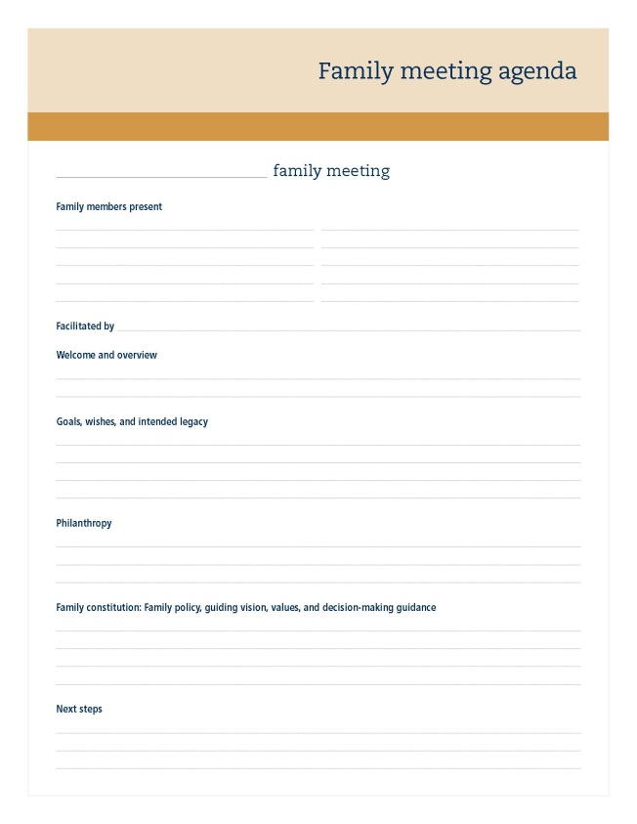
Strategy 1: family meeting
Sample agenda items
Welcome and overview
Goals, wishes, and intended legacy
Philanthropy
Family constitution: family policy, guiding vision and values
Next steps
Advisor role
Plan the agenda with the family patriarch and matriarch
Help select a location (destination meeting or office meeting in a neutral site)
Facilitate the meeting
Open up the meeting with your three funnels
Follow up after the meeting with each member
Notes:
Designed as a communication vehicle for high-net-worth families, this is also the chance for the financial advisor to build trust and relationships with the whole family. Focus on your Top 10 relationships. Start with number 10 and work your way up to #1. This will get you comfortable with this idea and you will learn a ton after each meeting. Work with the family patriarch or matriarch to plan the event. Many do it at a vacation spot like the beach when the family is all together. Open up with your three funnels—all the things you do, all the value you add. The results will be that the family members quickly realize they need more knowledge about financial planning, investments, lending and trustee responsibility.
At the second meeting, some family members may open accounts—some small and others large.
These meetings can also be held in the form of a WebEx with video.
Here’s an example of agenda.

Slide 38
Strategy 2: lunch and learns
Meet with clients’ adult children/grandchildren
for lunch after graduation
Investment 101
  Spend less than you make
  Invest early and often
  Fully fund the 401(k)
  Temperament is more important than intelligence
For older children of clients, demonstrate what you are doing for their parents—helping them to live independently and with dignity
It’ll allow you to make the connection to the next generation
It’ll thrill your existing clients
Notes:
The second strategy involves holding lunch and learn seminars for your clients and their families.

Slide 39
Strategy 3: hiring the next generation
Have a written strategy for hiring and retaining
the next generation of advisors
Consider internships—reach out to the local colleges in a sales or financial planning degree program
Think about applying the same principles used in a parent/child practice. The reason they work?
  Money, respect, mentoring, and second chances
Find out what they want out of a long-term situation
Consider salaried positions
Consider hiring a generational wealth manager
Notes:
If you’re not the right advisor for the next generation, you need to find someone that is. Consider internships. There are currently 115 universities offering financial planning baccalaureate programs in the U.S.

Slide 40
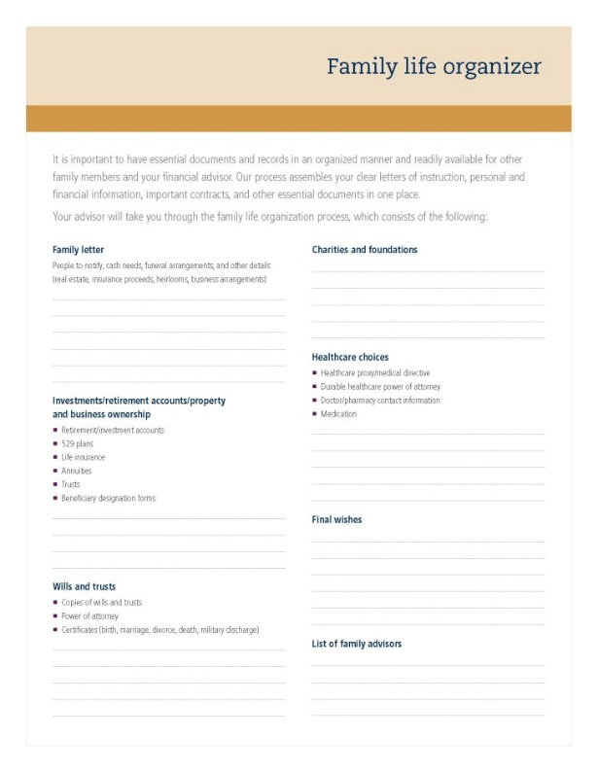
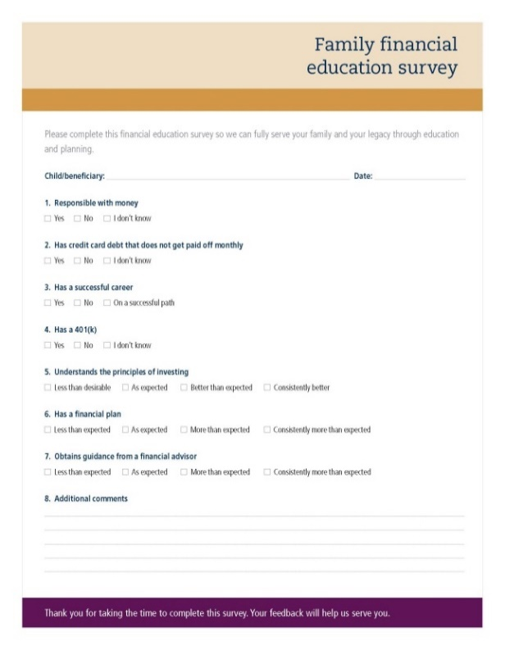
Additional resources
Family life organizer includes:
Family letter
Beneficiaries
Investments and
retirement accounts
Property
Business ownership
Life insurance
Wills and trusts
Charities/foundations
Healthcare choices
Final wishes
All family advisors
Next-generation survey for clients
A formal process to collect information about the next generation so you can serve the family
Notes:
We also have additional materials you can use with your clients.
Working with a family to put this life organizer together, or you can use an online vault, prompts the need for conversations with the next generations. You can help the clients fill their binders with the most valuable information, help them get everything organized, use it as your guide for the action items they still need to complete, and it also allows you to request conversations, family meetings, and interaction with the next generations. This sets you up to be the advisor of choice not only for the client, but for generations to come.
You can also conduct a survey with your clients to uncover key issues of their next generation and their financial education. The survey can be conducted in person, using paper, or by an online survey. After the survey, you can then deliver your customized recommendations of how you can serve their next generation with specifics such as planning, budget guidance, investment education, books, videos, family meeting, conference call, and so on. This allows you to initiate conversations with the next generation led by the parents’ intentions.

Slide 41

The Value Book
Notes:
Reinforcing your value starts with truly being able to define that value without boasting in many different situations—not just in the funnel conversation. At John Hancock Investments, we have created a great tool called the Value Book. Our business consultants are able to come in, sit down with you and discuss what it is you do. We’re not there to educate you. You have your own business, and you know it better than anyone. We are excellent moderators. We listen to what you have to say, talk to your whole team, and help you figure out ways to communicate your value in every aspect of your business. What do you deliver to your clients? What do you believe in? How are you going to articulate that to the clients? If you’d like to set up a meeting, please let us know.

Slide 42

Reinvention is the key to sustainability
“There was so much magic in Apple computer in the early 1980s that it is hard to believe that it may fade away. Apple went from hip
to has-been in just 19 years.”
BusinessWeek, 2/5/96
“By the time you read this story, the quirky cult company . . . will end its wild ride as
an independent enterprise.”
Fortune, 2/19/96
“Apple no longer plays a leading role . . .
‘The idea that they’re going to go back to the past to hit a big home run . . . is delusional,’ Dave Winer, a software developer.”
The Financial Times, 7/11/97
1997 Steve Jobs rehired
Deal announced to offer
Microsoft Office on Macs
2001 iPod launched
2003 iTunes launched
2007 first iPhone delivered
Are you creating generational diversity in your practice to ensure success in the future?
Notes:
There were many reports in the 1990s of the demise of Apple. In 1997 Steve Jobs was rehired, made a deal with Microsoft to offer Microsoft Office on Mac computers and began a reinvention of their computers. In 2001, Apple released the iPod in 2001, launched iTunes in 2003, and in 2007 the iPhone. From demise to success story. It is possible to reinvent—and necessary. To avoid a Kodak Moment, are you creating generational diversity in your practice?
Source: “Apple Computer, Inc.,” Library of Congress, Business References Services, 2008.

Slide 43
Take action!
Develop your core value funnels.
Communicate in ways that will reach the
next generation.
Meet with your John Hancock Investments
Business Consultant!
Notes:
Now it’s time to take action. Develop your core value funnels so your clients and their family and friends can clearly articulate what you do. We believe that you should find a communication strategy to effectively reach out using some of the ideas we shared here today to innovate your practice with the next generation. Focus on the language to use with each generation to start your funnel conversation, then create and execute on a plan to reach out to the next generation.
Please take advantage of the resources that your local John Hancock Investments Business Consultant can bring, through the funnel value presentation and laminated sheet, as well as assisting in creating your value proposition for all generations, and help you think through best practice strategies. I appreciate your time and attention. I look forward to letting us help you communicate your value. Thank you.

Slide 44
John Hancock Investments
A trusted brand
John Hancock Investments is a premier asset manager representing one of America’s most trusted brands, with a heritage of financial stewardship dating back to 1862. Helping our shareholders pursue their financial goals is at the core of everything we do. It’s why we support the role of professional financial advice and operate with the highest standards of conduct and integrity.
A better way to invest
We serve investors globally through a unique multimanager approach: We
search the world to find proven portfolio teams with specialized expertise for every strategy we offer, then we apply robust investment oversight to ensure they continue to meet our uncompromising standards and serve the best interests of our shareholders.
Results for investors
Our unique approach to asset management enables us to provide a diverse set of investments backed by some of the world’s best managers, along with strong risk-adjusted returns across asset classes.
Notes:
Throughout this presentation, I’ve used resources and tools from John Hancock Investments.

Slide 45

More information
For more information, contact your John Hancock Investments Business Consultant at 800-225-6020, or visit jhinvestments.com.
John Hancock Funds, LLC ▪ Member FINRA, SIPC
601 Congress Street ▪ Boston, MA 02210-2805 ▪ 800-225-6020 ▪ jhinvestments.com
NOT FDIC INSURED. MAY LOSE VALUE. NO BANK GUARANTEE. NOT INSURED BY ANY GOVERNMENT AGENCY.
THIS MATERIAL IS FOR INSTITUTIONAL/BROKER-DEALER USE ONLY. NOT FOR DISTRIBUTION OR USE WITH THE PUBLIC.
MF559743 CYV3PPT 12/18

