Slide 1

FIXED INCOME
Realities,
myths and
actionable ideas
MFGEPO-059-0419O 10174s74380
Figures are past results and are not predictive of results in future periods. Investments are not FDIC-insured, nor are they deposits of or guaranteed by a bank or any other entity, so they may lose value.
© 2019 Capital Group. All rights reserved.
For financial professionals only. Not for use with the public.

Slide 2
Fixed income at Capital Group
Capital Group
Founded in 1931
Privately held
$1.86 trillion in assets under management*
Manager of the American Funds mutual funds and Capital Group institutional strategies

Slide 3
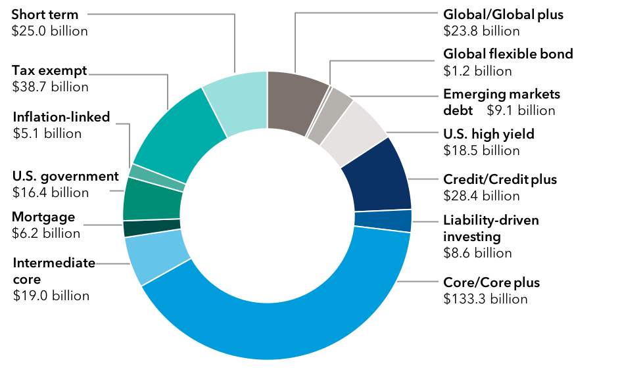
Broad fixed income capabilities
$333 billion in assets under management
Total fixed income assets by strategy
Taxable
American Funds U.S. Government
Money Market FundSM
Short-Term Bond Fund of America®
Intermediate Bond Fund of America®
The Bond Fund of America®
U.S. Government Securities Fund®
American Funds Inflation Linked Bond Fund®
American Funds Mortgage Fund®
American Funds Corporate Bond Fund®
American Funds Strategic Bond FundSM
Capital World Bond Fund®
American High-Income Trust®
American Funds Emerging Markets
Bond Fund®
Tax-exempt
American Funds Short-Term Tax-Exempt
Bond Fund®
Limited Term Tax-Exempt Bond Fund
of America®
The Tax-Exempt Bond Fund of America®
American High-Income Municipal Bond Fund®
The Tax-Exempt Fund of California®
American Funds Tax-Exempt Fund
of New York®
3

Slide 4
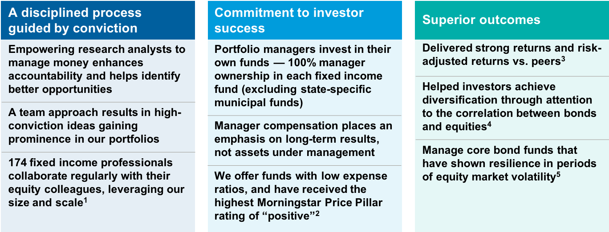
Pursuing durable outcomes for investors
Our focus on long-term client outcomes and downside protection has led to strong relative results
4

Slide 5
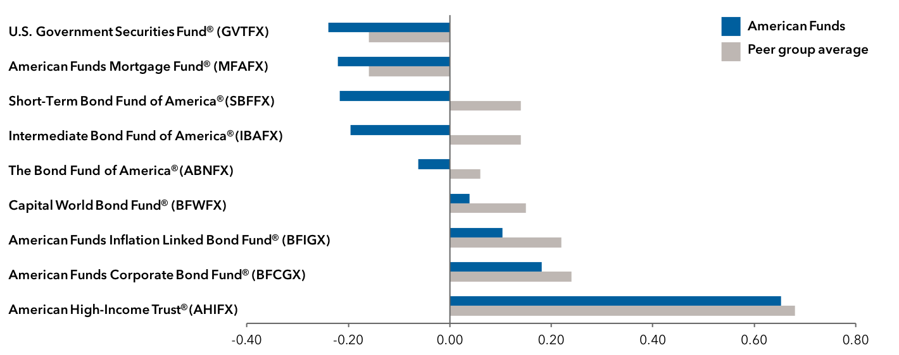
True diversification
Bond funds behaving like bond funds
Low correlation to the S&P 500 Composite Index — three-year period
5

Slide 6
A process built on experience
An experienced team of dedicated fixed income professionals
 |  |  |  | Average years of experience
 |  |  | Total | In the industry | With Capital Group
 |  | Portfolio managers | 31 | 25 | 17
 |  | Research analysts | 43 | 12 | 5
 |  | Trading professionals | 36 | 19 | 12
 |  | Macro analysts | 12 | 23 | 9
 |  | Risk and quantitative analysts | 10 | 12 | 5
 |  | Investment services professionals | 22 | 19 | 6
 |  | Other fixed income professionals | 20 | 16 | 8
 |  | Total fixed income professionals | 174
6

Slide 7
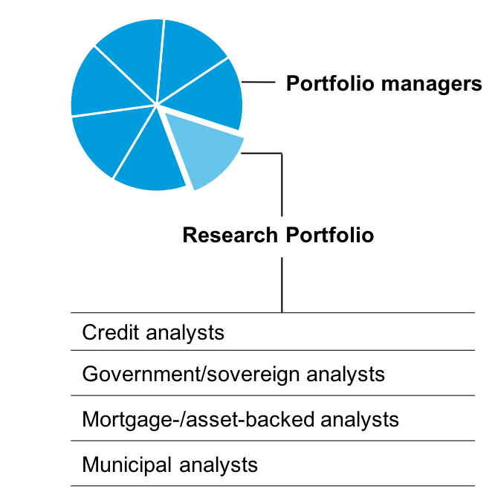
Our research advantage
Analysts managing money helps create value
Our commitment to research analysts managing assets helps us attract and retain excellent talent
Analysts typically begin to manage money soon after their initial investment review
Holdings in Research Portfolios (RPs) signal the analysts’ investment convictions to portfolio managers
Analysts learn how to construct portfolios and manage different types of investment risk early in their Capital careers
RP investment results help inform succession planning
Most new portfolio managers have a track record of successful investing within the RPs
Research Portfolios have, historically, been additive to fund results
7

Slide 8
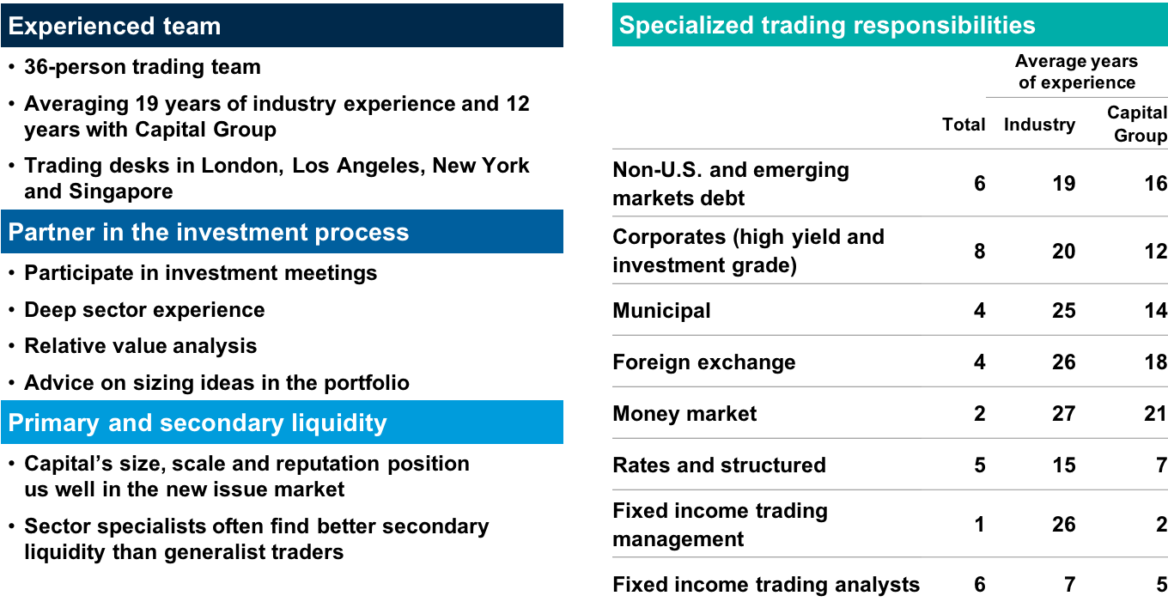
Trading experience
Institutional strength in trade execution
8

Slide 9
Realities, myths and actionable ideas
1
Macro perspectives
2
Myths and
realities
3
Actionable
ideas

Slide 10
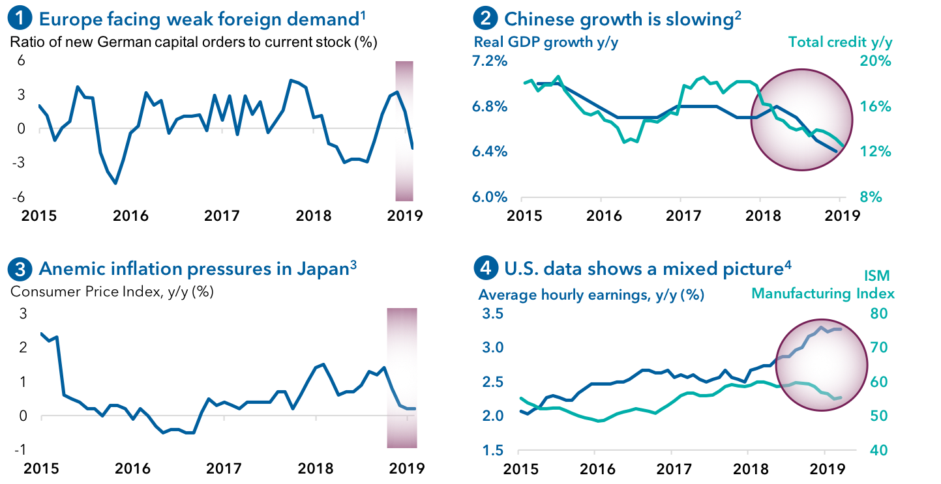
Global growth: Synchronized slowdown?
10

Slide 11
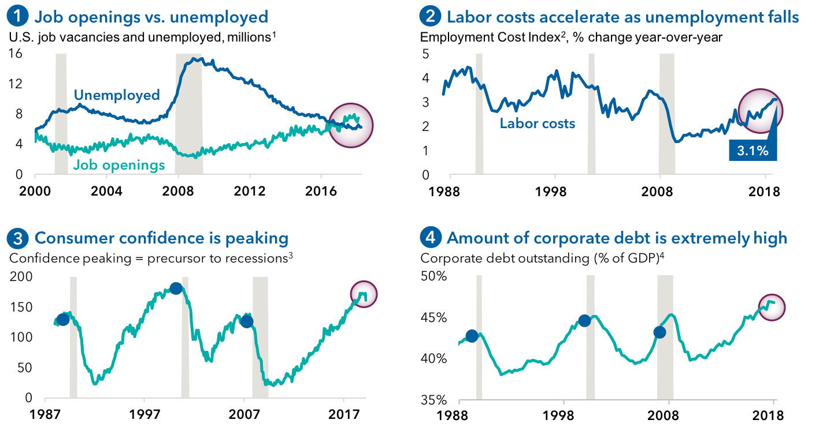
U.S. is late cycle
11

Slide 12
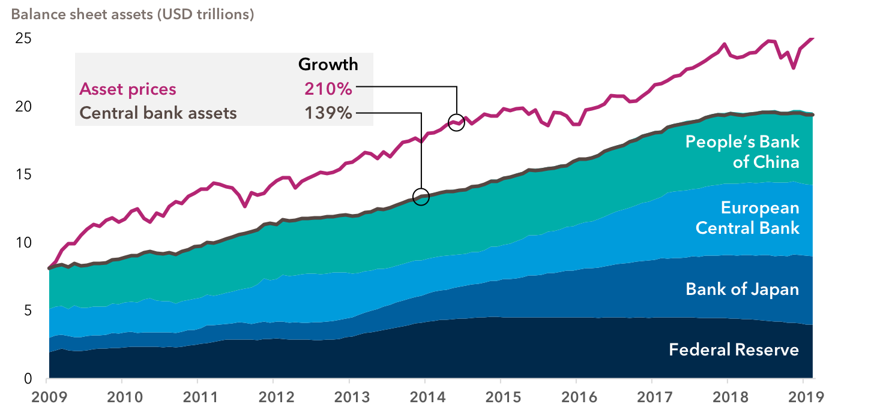
Monetary policy has driven asset prices
12

Slide 13
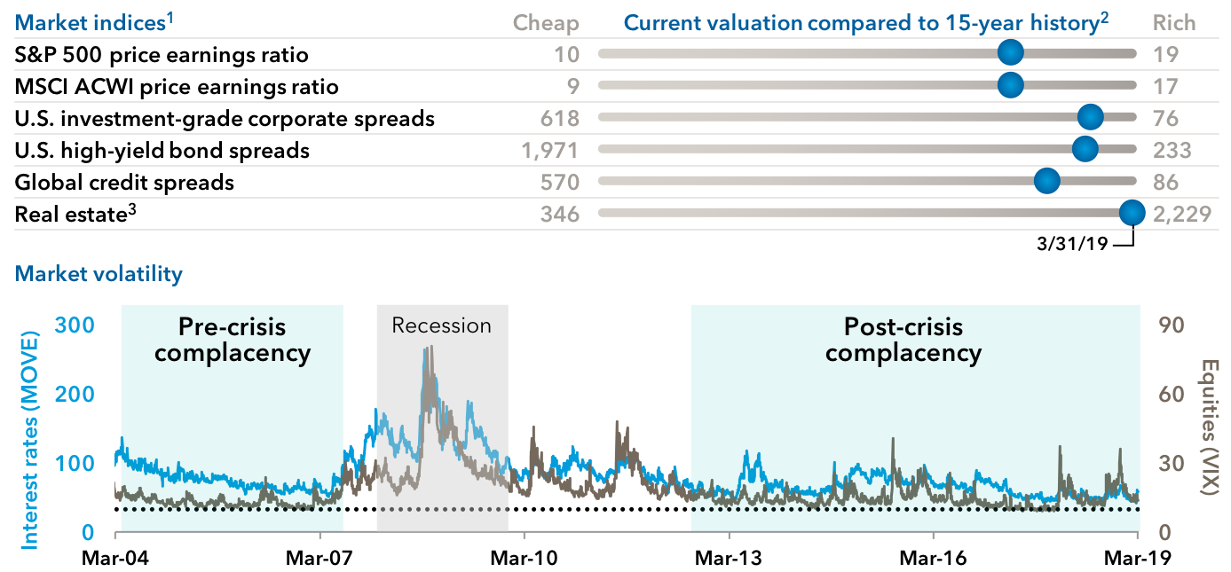
Easy money has led to stretched valuations and low volatility
13
Notes:
Scale represents minimum/maximum value for the index since 3/31/2004
X represents percentile of current reading on the min/max scale where max is the highest valuation (S&P: 77%, ACWI: 77%, IG: 92%, HY: 91%, Global Credit: 84%, Real Estate: 100%)

Slide 14
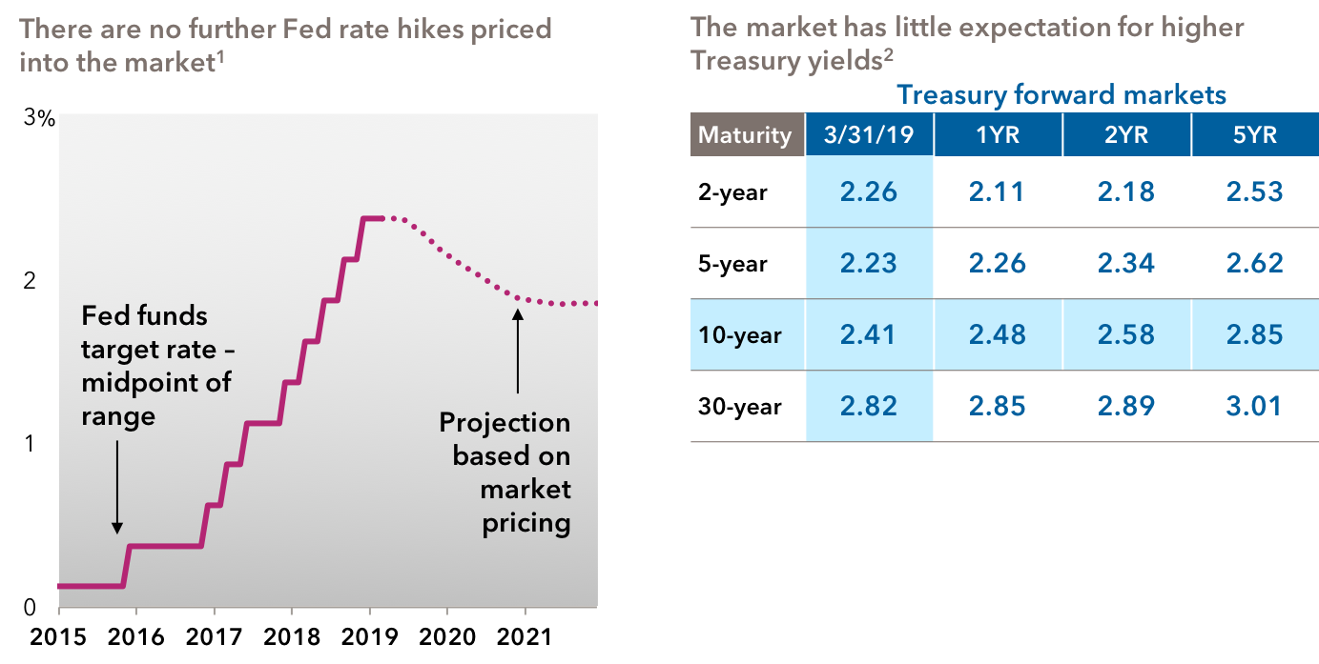
The market expects the Fed to pause (or even cut)
Treasury yields expected to stay lower for longer
14

Slide 15
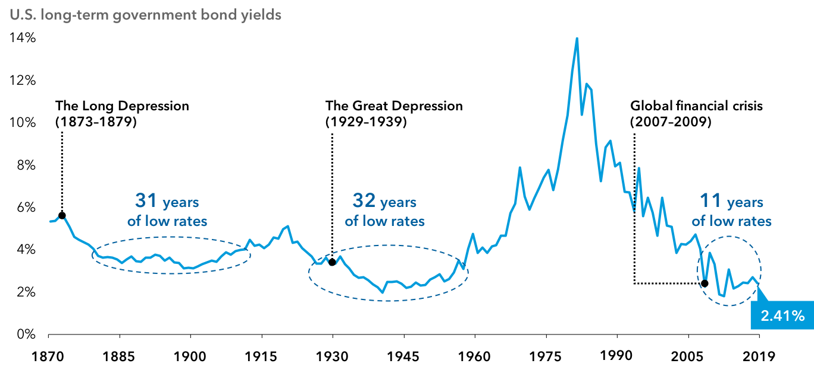
Lower rates for longer … still
In a low-growth, low-inflation world, rates could stay lower for longer
Sources: Federal Reserve, Robert Shiller, Thomson Reuters Datastream.
Data for 1871–1961 represents average monthly U.S. long-term government bond yields compiled by Robert Shiller. Data for 1962–2018 represents 10-year Treasury yields, as of December 31 each year within the period. Data for 2019 is as of March 31.
15

Slide 16
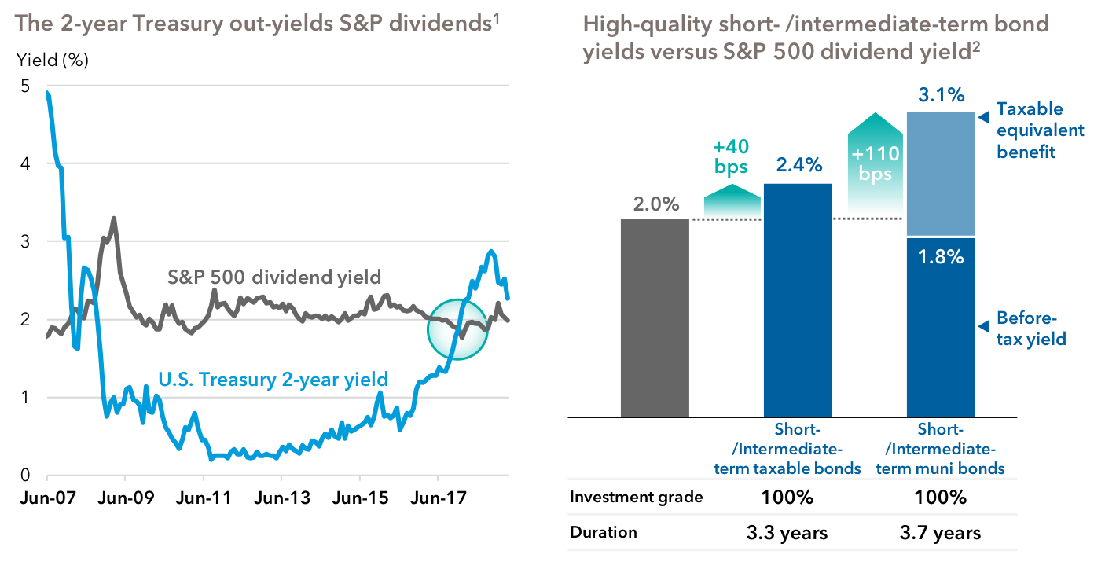
Short-term yields continue to be relatively attractive
2-year Treasury yields have risen significantly, so have bond fund yields
S&P
500
dividend yield
16

Slide 17
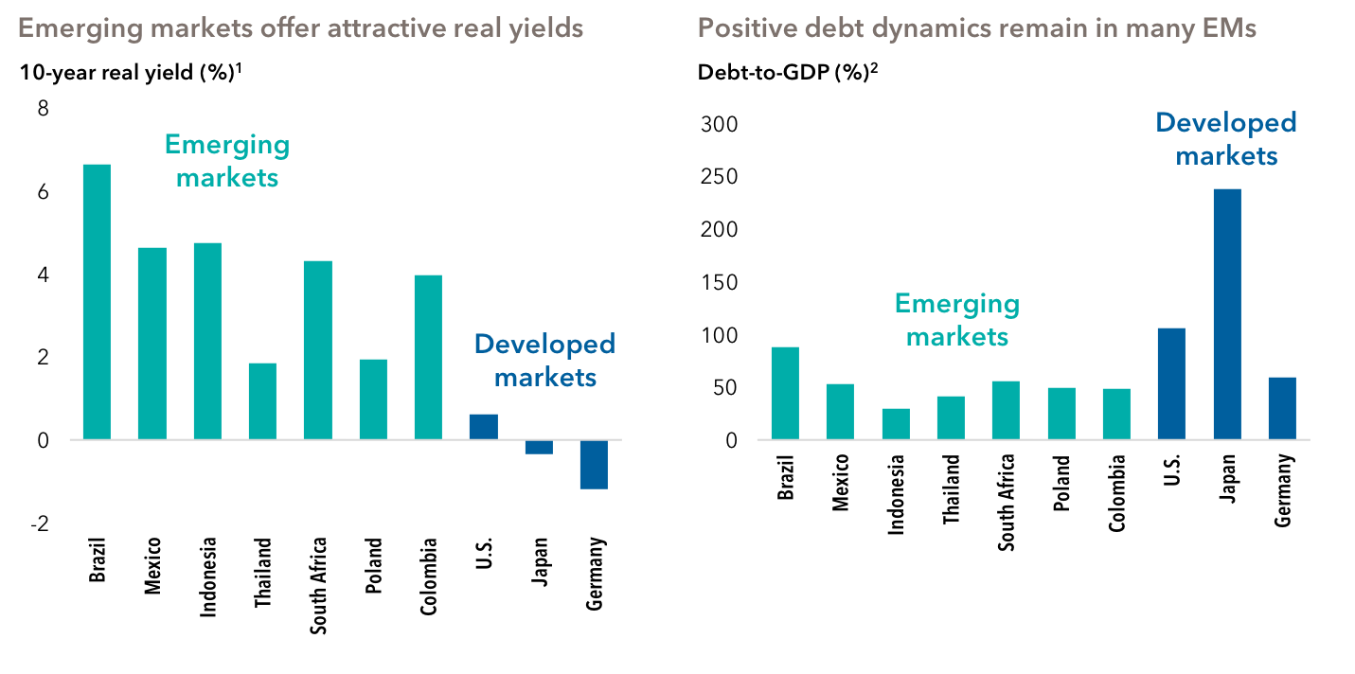
Emerging markets fundamentals are attractive
17

Slide 18
Macro summary
We’re late in the economic cycle and growth is diverging Monetary policy has driven asset prices … and outside the U.S it’s both experimental and stretched
Valuations are not cheap High-quality fixed income is a reasonable asset class to help generate income and preserve capital
Asset prices
Cheap | Fair value | Rich
1 | 5 | 10
What should bond risk appetite be?
Low | Medium | High
18

Slide 19
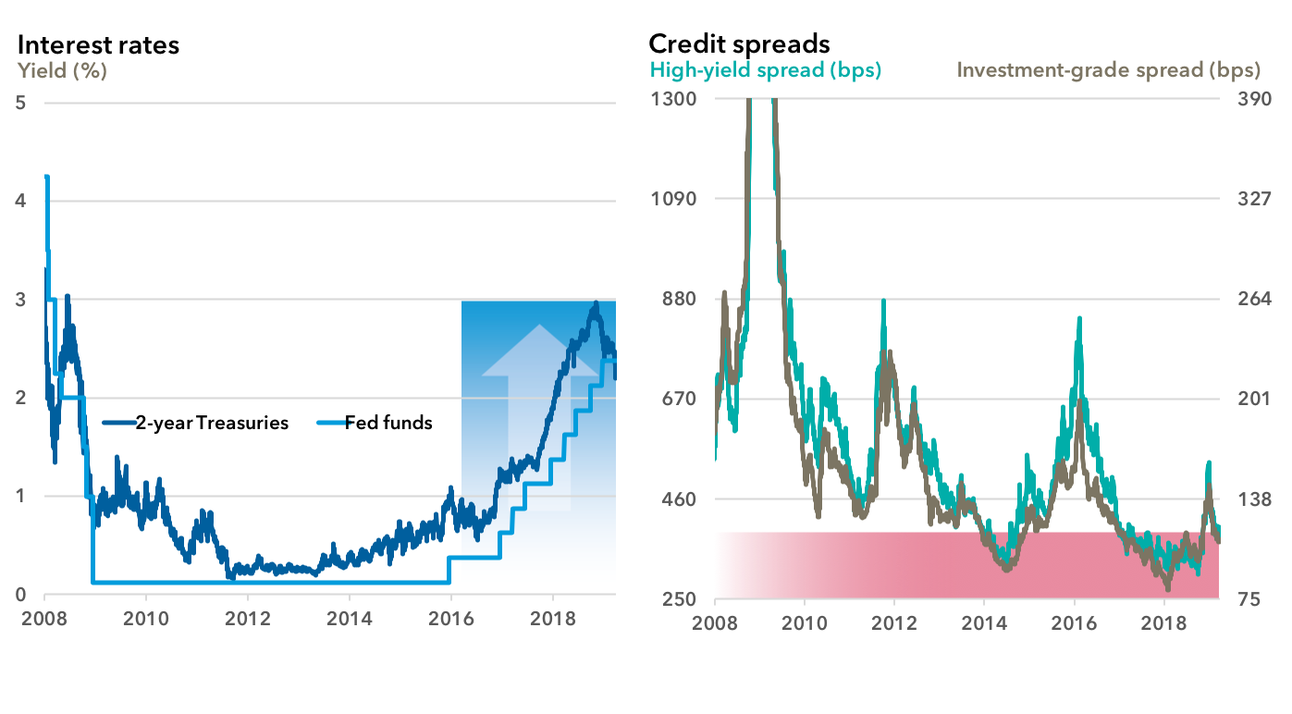
Myth: I should focus more on interest rate risk than credit
Reality: Rates have already moved and credit spreads are tight again
19

Slide 20
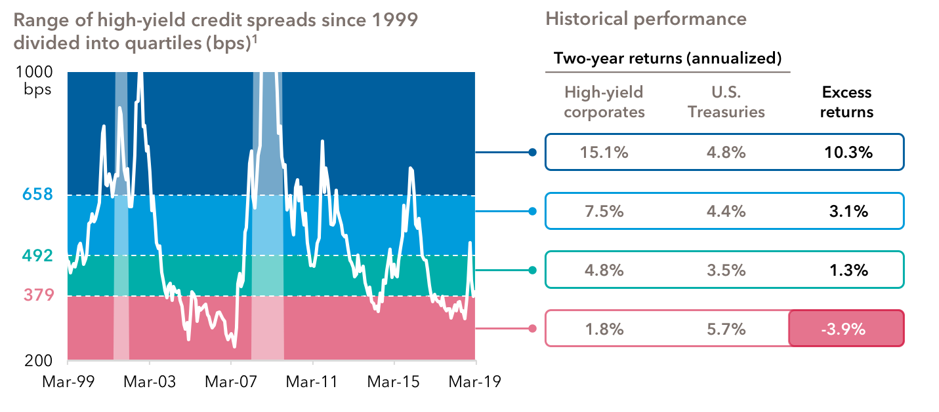
Myth: In a low-rate environment, I should reach for yield
Reality: Tight credit spreads are vulnerable late in the cycle
20

Slide 21
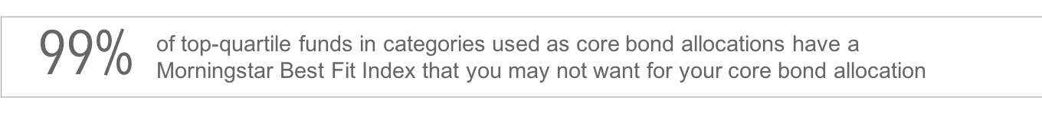
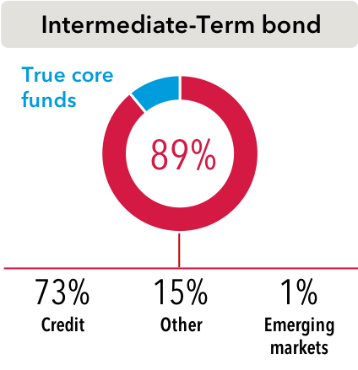
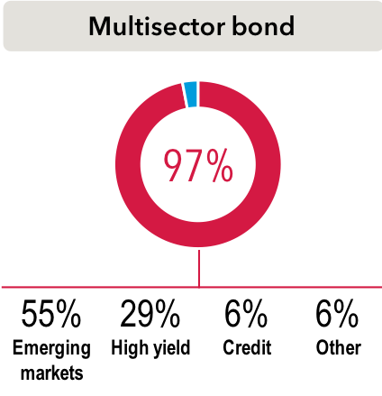
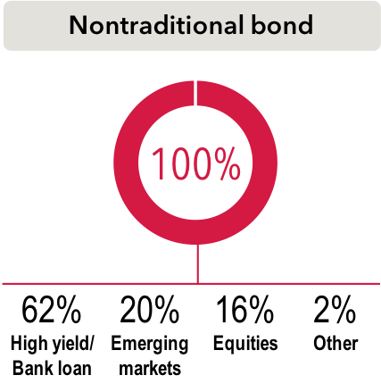
Myth: The centerpiece of bond portfolios today is truly core
Reality: Most top-performing Intermediate-Term, Multisector and Nontraditional bond funds appear credit heavy, but are used interchangeably
% of funds in these categories that did not behave like true core, and what they actually behaved like:
21

Slide 22
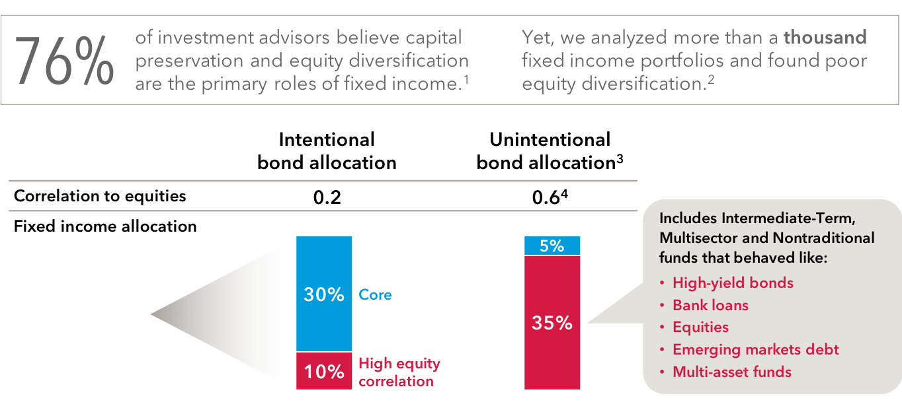
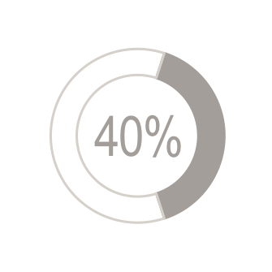
Myth: Your bond portfolio will behave like you expect it to
Reality: You may be exposed to unintended risks
22

Slide 23
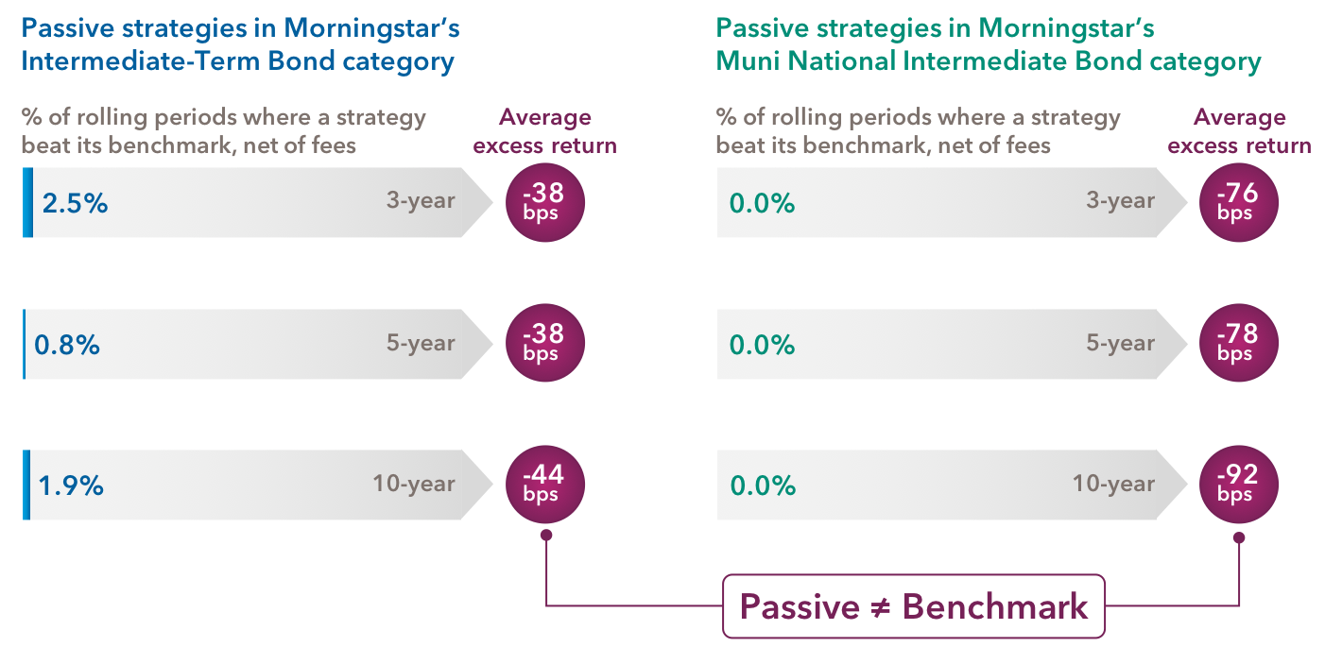
Myth: Passive strategies = benchmark returns
Reality: They are designed to track benchmarks but have usually fallen short
Myth
23

Slide 24
Reality check
Rising rates are no longer a concern, but investors do not seem to be worried enough about credit risk late in the cycle
Many bond managers are reaching in scope to increase portfolio yield while sacrificing diversification and capital preservation Passive bond funds and ETFs have usually failed to generate benchmark returns
Based on valuations today, what duration bond funds should investors own?
Short |  | Long
Based on valuations today, what level of credit risk should investors take?
Low |  | High
24

Slide 25
Important information
Figures shown are past results for Class F-2 shares and are not predictive of results in future periods. Current and future results may be lower or higher than those shown. Share prices and returns will vary, so investors may lose money. Investing for short periods makes losses more likely. Fund results shown are at net asset value with all distributions reinvested. Class F-2 shares do not pay an upfront or deferred sales charge. For current information and month-end results, visit americanfunds.com.
25

Slide 26
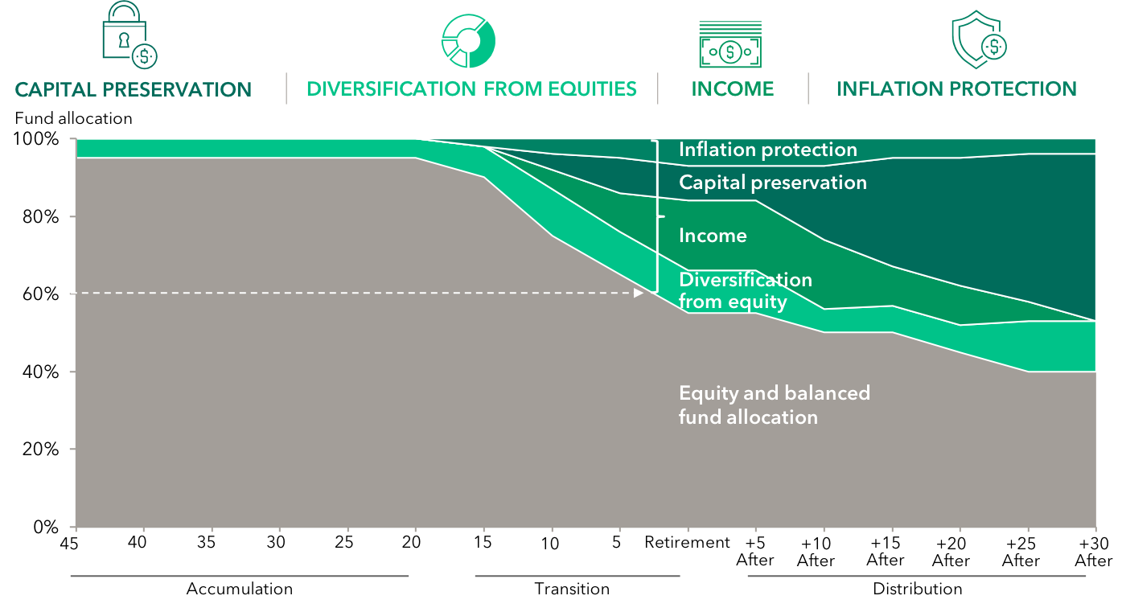
Back to basics: Fixed income has four key roles
American Funds Target Date Series® glide path
26

Slide 27
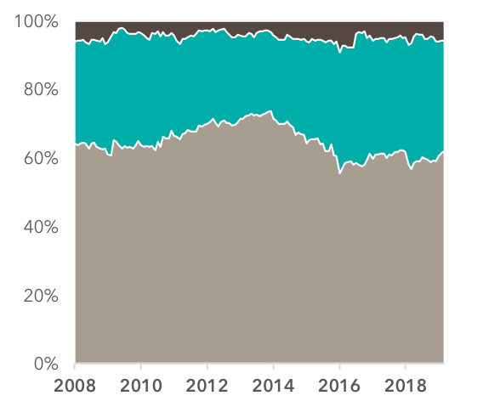

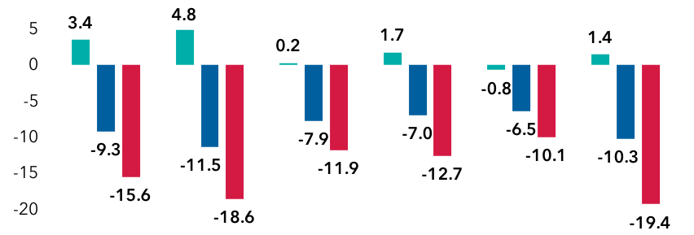
Balance: We practice what we preach
Use of fixed income in American Balanced Fund® (AMBAL)
American Balanced Fund (Asset allocation)
Fixed income has helped diversify (Class F-2 returns, %)
Cash
Flash
crash
U.S. debt downgrade
China slowdown
Oil price shock
U.S. inflation/
Rate scare
Global selloff
Bonds
4/23/10-
7/2/10
4/29/11-
10/3/11
5/21/15-
8/25/15
11/3/15-
2/11/16
1/26/18-
2/8/18
9/20/18-
12/24/18
Equities
American Balanced Fund has top-quintile Morningstar rankings over 1-, 3-, 5- and 10-year periods.*
27

Slide 28
Three actionable ideas
How to position fixed income portfolios in today’s environment
1 Upgrade your core bond allocation
2 Diversify portfolio income
3 Own munis for more than just tax-free income
28

Slide 29
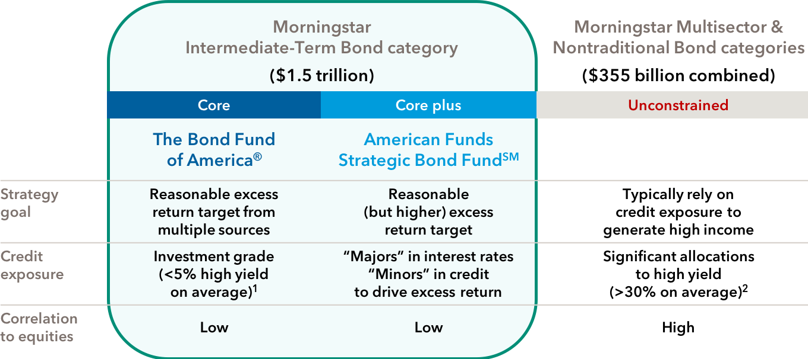
Action: Upgrade your core bond allocation
Balance your portfolio with American Funds intermediate-term bond funds
29

Slide 30

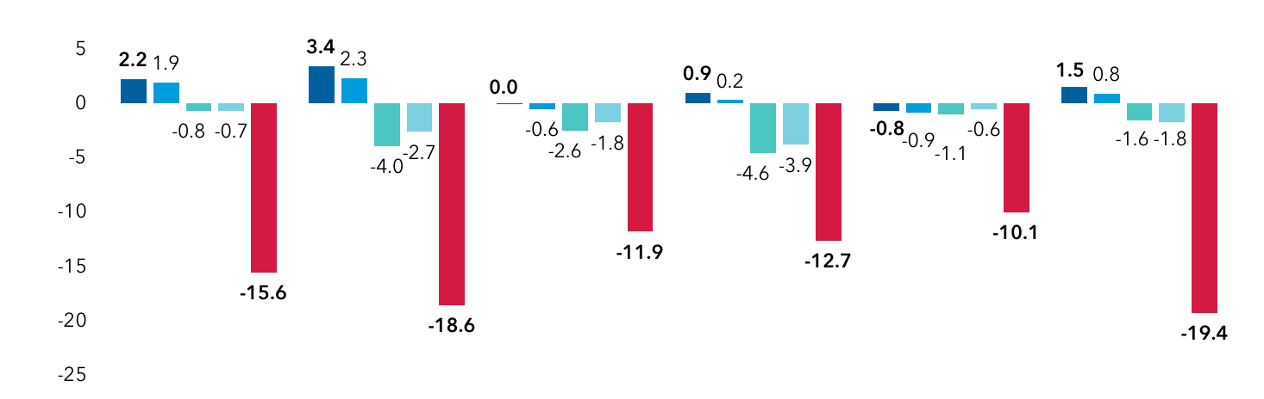
Core: The Bond Fund of America
Balance and diversification
Cumulative returns (%) during recent market corrections (Class F-2)
Flash
crash
U.S. debt downgrade
China
slowdown
Oil price
shock
U.S. inflation/
Rate scare
Global
selloff
4/23/10-
7/2/10
4/29/11-
10/3/11
5/21/15-
8/25/15
11/3/15-
2/11/16
1/26/18-
2/8/18
9/20/18-
12/24/18
30

Slide 31
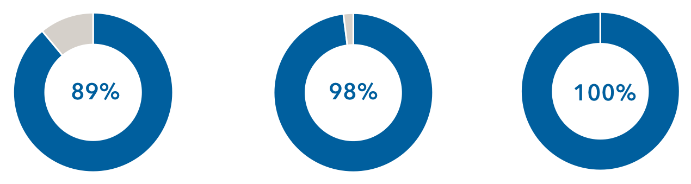
Core: The Bond Fund of America
Consistency and discipline
Percent of the time The Bond Fund of America outpaced the index¹ (Class F-2, net of fees)
3-year rolling periods²
5-year rolling periods³
7-year rolling periods⁴
31

Slide 32
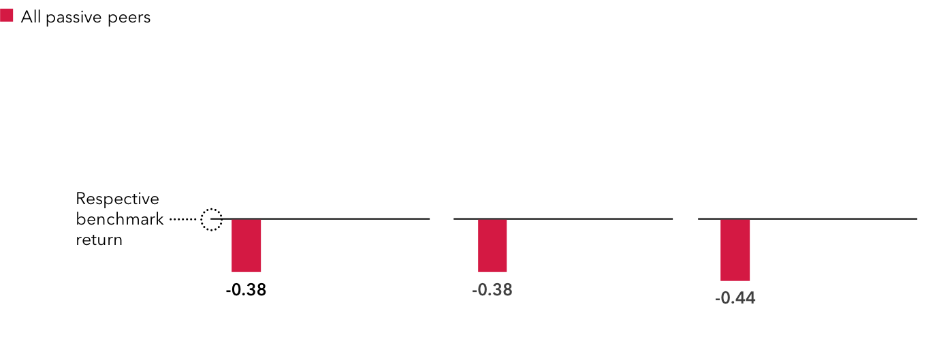
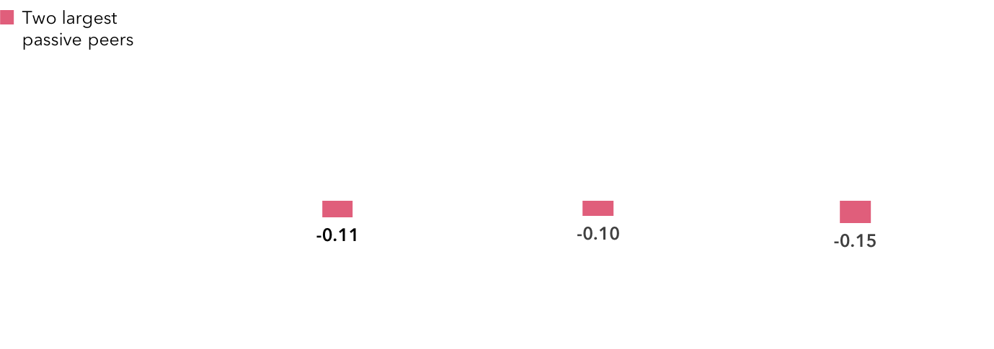
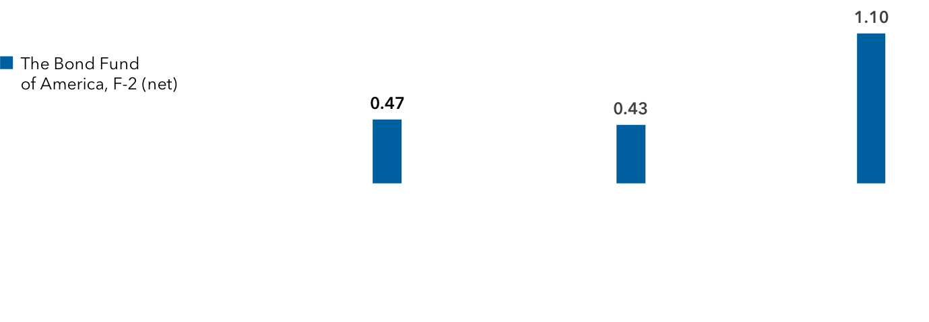
Core: The Bond Fund of America
Actively outpacing passive: BFA beat its benchmark while passive lagged
Average annualized excess returns for The Bond Fund of America and passive peers compared to their respective benchmarks(%)¹
3-year
5-year
10-year²
32
Notes:
It is instructive to note the disparity between our fund and its passive peers, which are designed to track – not beat their benchmark.
When contemplating passive versus active fixed income funds, it’s also important to consider, among other things, each fund’s investment objectives and policies, risks, tax implications from portfolio turnover and expenses.

Slide 33
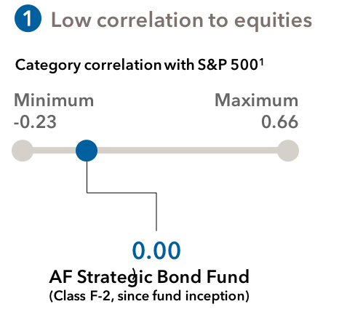
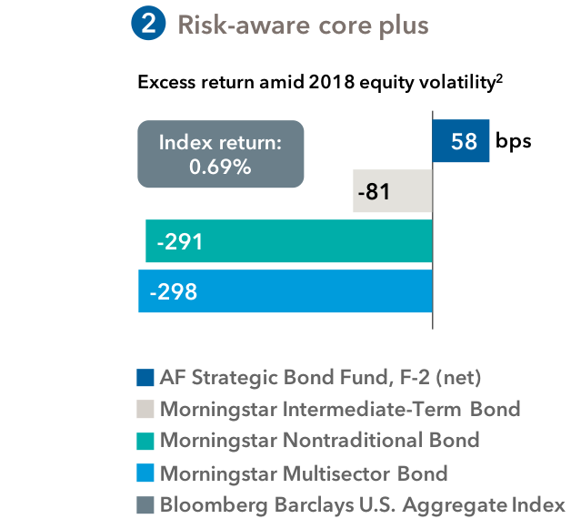
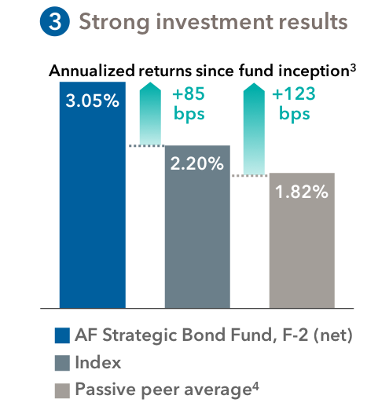
Core plus: American Funds Strategic Bond Fund
CAPITAL PRESERVATION | DIVERSIFICATION FROM EQUITIES | INCOME | INFLATION PROTECTION
A distinctive approach that “majors in rates and minors in credit”
33

Slide 34
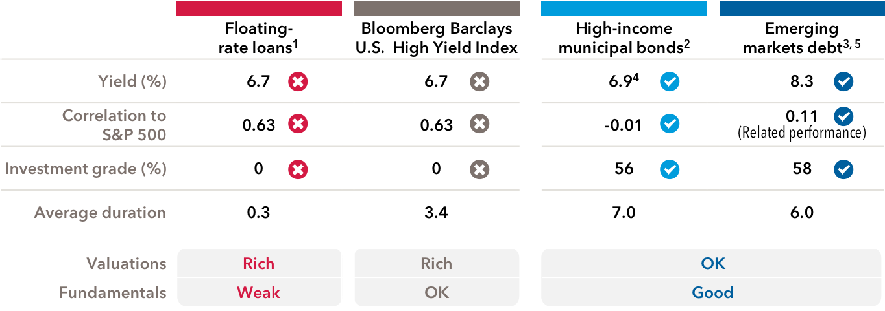
Action: Diversify portfolio income
Late-cycle behavior signals to diversify away from corporate credit
34

Slide 35
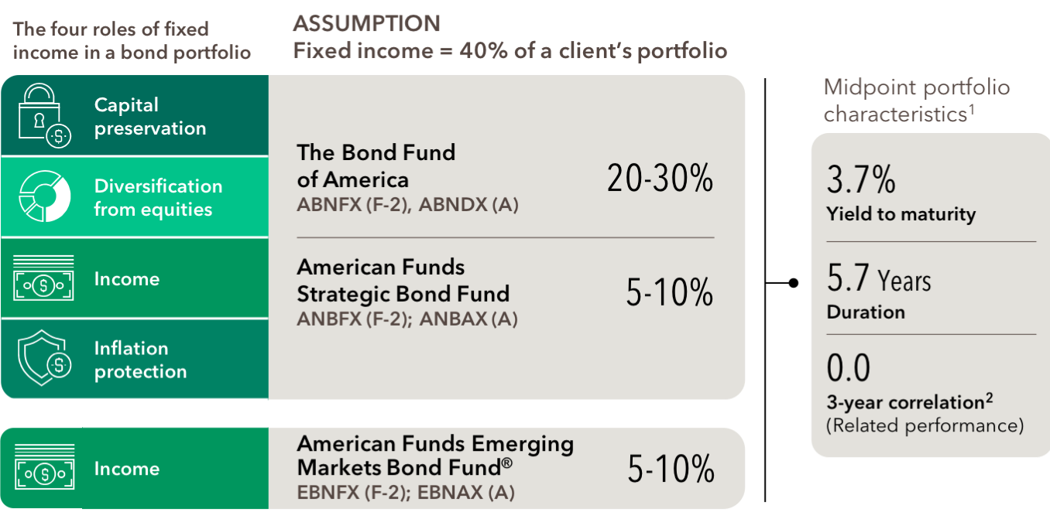
American Funds that can upgrade your bond portfolio
35

Slide 36
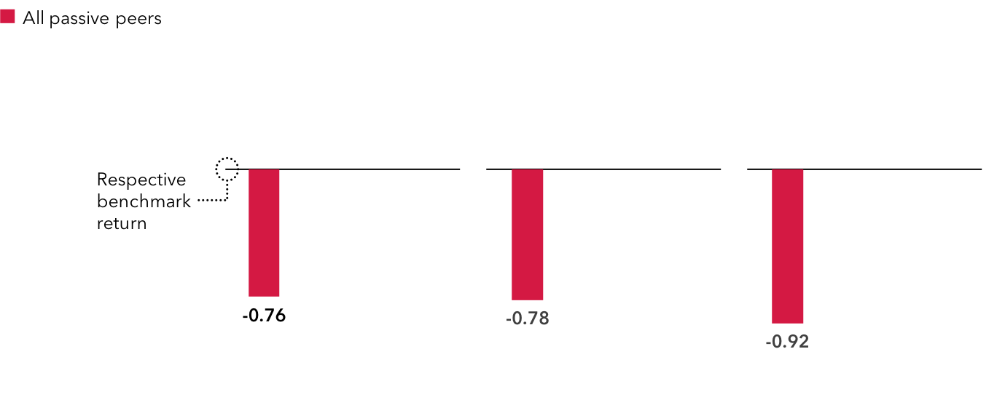
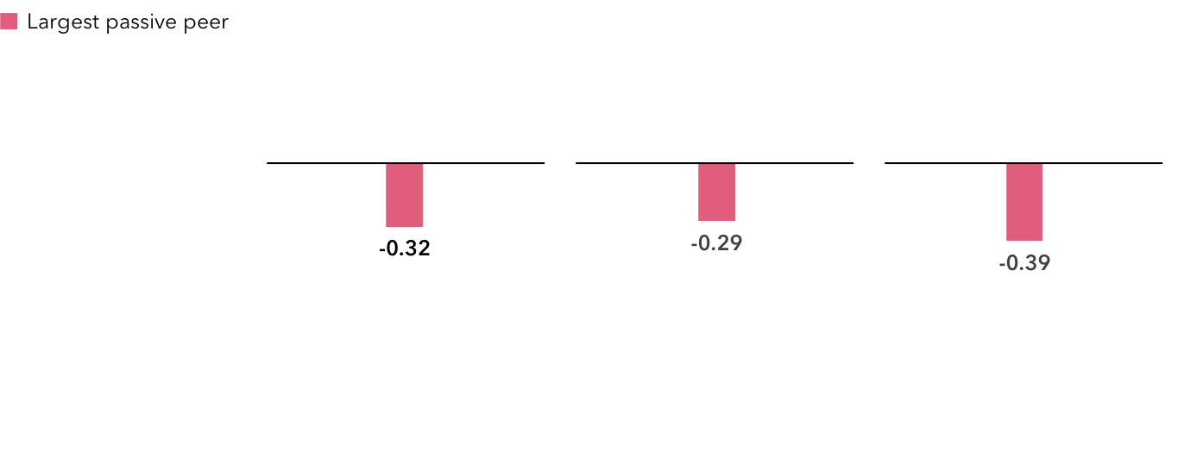
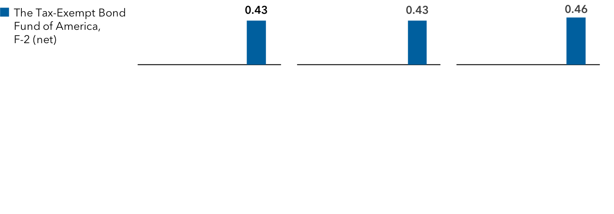
Munis: The Tax-Exempt Bond Fund of America
Actively outpacing passive: TEBF beat its benchmark while passive lagged
Average annualized excess returns for The Tax-Exempt Bond Fund of America and passive peers compared to their respective benchmarks (%)¹
3-year
5-year
10-year
36
Notes:
It is instructive to note the disparity between our fund and its passive peers, which are designed to track – not beat their benchmark.
When contemplating passive versus active fixed income funds, it’s also important to consider, among other things, each fund’s investment objectives and policies, risks, tax implications from portfolio turnover and expenses.

Slide 37
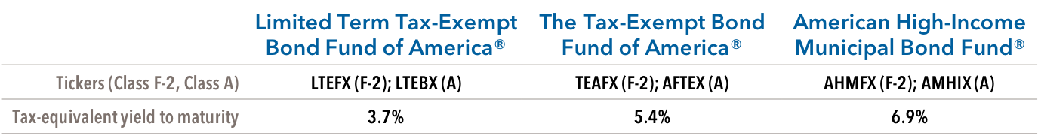
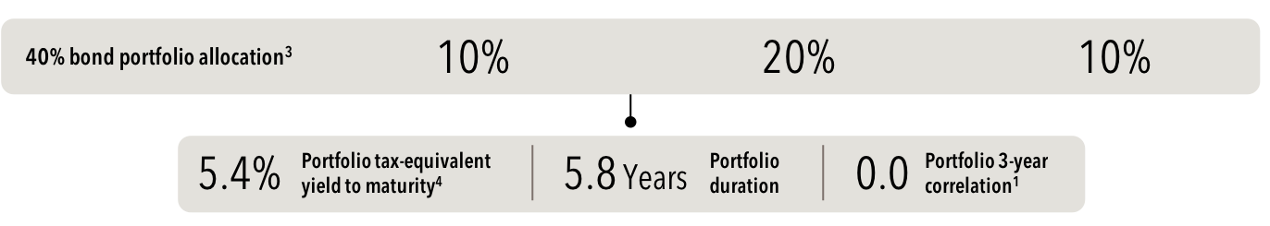
Action: Own munis for more than just tax-free income
Data is a weighted average of the funds in the model approach and is as of March 31, 2019. U.S. equity index proxies used are Standard & Poor’s 500 Composite Index.
¹F-2 share class.
²Inceptions: Limited Term Tax-Exempt Bond Fund of America: 10/06/93; The Tax-Exempt Bond Fund of America: 10/03/79; American High-Income Municipal Bond Fund: 9/26/94.
³The model approach is hypothetical and for illustrative purposes only. Allocations, holdings, yields and other data shown do not reflect an actual portfolio. Advisors should tailor client recommendations to their individual circumstances.
⁴Taxable-equivalent-rate assumptions are based on a federal marginal tax rate of 37%, the top 2019 rate. In addition, we have applied the 3.8% Medicare tax.
37
Notes:
Fund Inception Dates:
LTEX: 10/6/1993 (25+ years)
TEBF: 10/3/1979 (39+ years)
AHIM: 9/26/1994 (24+ years)

Slide 38
Appendix

Slide 39
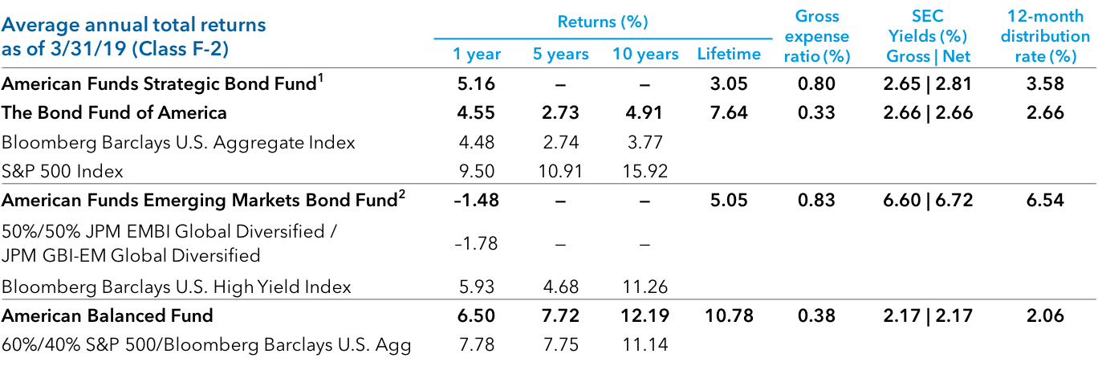
American Funds investment results
Figures shown are past results for Class F-2 shares and are not predictive of results in future periods. Current and future results may be lower or higher than those shown. Share prices and returns will vary, so investors may lose money. Investing for short periods makes losses more likely. For current information and month-end results, visit americanfunds.com.
39

Slide 40
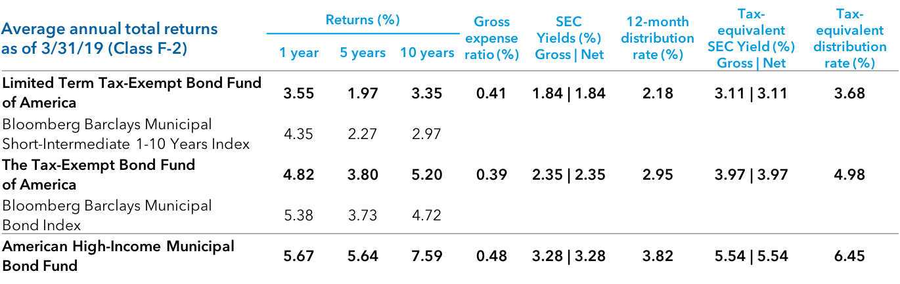
American Funds investment results
Figures shown are past results for Class F-2 shares and are not predictive of results in future periods. Current and future results may be lower or higher than those shown. Share prices and returns will vary, so investors may lose money. Investing for short periods makes losses more likely. For current information and month-end results, visit americanfunds.com.
40

Slide 41
Thank you.
41

Slide 42
Important information
Investors should carefully consider investment objectives, risks, charges and expenses. This and other important information is contained in the fund prospectuses and summary prospectuses, which can be obtained from a financial professional and should be read carefully before investing. This material must be preceded or accompanied by a summary prospectus or prospectus for the funds being offered.
42

Slide 43
Important information
If used after June 30, 2019, this material must be accompanied by the current American Funds quarterly statistical update.
Statements attributed to an individual represent the opinions of that individual as of the date published and do not necessarily reflect the opinions of Capital Group or its affiliates. This information is intended to highlight issues and not to be comprehensive or to provide advice.
Bond ratings, which typically range from AAA/Aaa (highest) to D (lowest), are assigned by credit rating agencies such as Standard & Poor's, Moody's and/or Fitch, as an indication of an issuer's creditworthiness. If agency ratings differ, the security will be considered to have received the lowest of those ratings, consistent with the fund's investment policies. Securities in the Unrated category have not been rated by a rating agency; however, the investment adviser performs its own credit analysis and assigns comparable ratings that are used for compliance with fund investment policies.
43

Slide 44
Important information
Investment allocations may not achieve fund objectives. There are expenses associated with the underlying funds in addition to fund-of-funds expenses. The funds' risks are directly related to the risks of the underlying funds as described below.
Investing outside the United States involves risks, such as currency fluctuations, periods of illiquidity and price volatility, as more fully described in the prospectus. These risks may be heightened in connection with investments in developing countries. The return of principal for bond funds and for funds with significant underlying bond holdings is not guaranteed. Fund shares are subject to the same interest rate, inflation and credit risks associated with the underlying bond holdings. Investments in mortgage-related securities involve additional risks, such as prepayment risk, as more fully described in the prospectus. Higher yielding, higher risk bonds can fluctuate in price more than investment-grade bonds, so investors should maintain a long-term perspective.
The use of derivatives involves a variety of risks, which may be different from, or greater than, the risks associated with investing in traditional cash securities, such as stocks and bonds.
44

Slide 45
Important information
Related performance disclosure
Emerging market debt correlation on slides 34 and 35 is calculated using composite investment results based on the historical results of American Funds Emerging Markets Bond Fund ("the fund") and all other accounts (the “other accounts”) managed by Capital Research and Management Company, the investment adviser to the fund, and its affiliates with investment objectives, policies, strategies and risks substantially similar to those of the fund. The current composition of the management team of the other accounts is substantially the same as the composition of the fund’s management team, but the composition of the management team of the other accounts has changed over time. The composite correlation is provided to illustrate the past performance of the investment adviser and its affiliates in managing the composite as measured against an appropriate index. The composite correlation does not represent the historical results of the fund and should not be interpreted as indicative of the future results of the fund or the investment adviser or be considered a substitute for the fund’s investment results.
45

Slide 46
Important information
Related performance disclosure
Emerging markets debt correlation to the S&P 500 on slides 34 and 35 is shown net of the highest management fees (0.60%), in each case in effect as of the date of the fund’s prospectus for any account in the composite that is offered to U.S. investors. All returns used in the calculation of composite results are asset-weighted and reflect the reinvestment (net of foreign withholding taxes) of dividends, interest and other earnings. Withholding tax rates apply primarily to U.S. investors. All returns used in the calculation of composite results reflect the deduction of brokerage commissions and execution costs paid by the accounts, and are before federal and state income taxes. The other accounts that are included in the composite are not subject to certain investment limitations, diversification requirements and other restrictions imposed by the Investment Company Act of 1940 and the Internal Revenue Code of 1986, which, if applicable, might have adversely affected the results of the other accounts. Unlike the fund’s 80% investment minimum in bonds and other debt securities, which was adopted by the fund to comply with rule 35d-1 under the Investment Company Act of 1940, the other accounts have policies to invest at least 50–80% of their assets in such securities. However, in practice the other accounts have generally invested at least 80% of their assets in bonds and other debt securities.
46

Slide 47
Important information
Bloomberg® is a trademark of Bloomberg Finance L.P. (collectively with its affiliates, “Bloomberg”). Barclays® is a trademark of Barclays Bank Plc (collectively with its affiliates, “Barclays”), used under license. Neither Bloomberg nor Barclays approves or endorses this material, guarantees the accuracy or completeness of any information herein and, to the maximum extent allowed by law, neither shall have any liability or responsibility for injury or damages arising in connection therewith.
Bloomberg Barclays U.S. Government/Credit 1-7 Years ex BBB Index is a market-value weighted index that tracks the total return results of fixed-rate, publicly placed, dollar-denominated obligations issued by the U.S. Treasury, U.S. government agencies, quasi-federal corporations, corporate or foreign debt guaranteed by the U.S. government, and U.S. corporate and foreign debentures and secured notes that meet specified maturity, liquidity and quality requirements, with maturities of one to seven years, excluding BBB-rated securities. Bloomberg Barclays U.S. Aggregate Index represents the U.S. investment-grade fixed-rate bond market. Bloomberg Barclays Municipal Short-Intermediate 1-10 Years Index is a market-value-weighted index that includes investment-grade tax-exempt bonds with maturities of one to 10 years. Bloomberg Barclays Municipal Bond Index is a market-value-weighted index designed to represent the long-term investment-grade tax-exempt bond market. Bloomberg Barclays U.S. Corporate High Yield Index covers the universe of fixed-rate, non-investment-grade debt. The Bloomberg Barclays U.S. Treasury Index measures U.S. dollar-denominated, fixed-rate, nominal debt issued by the U.S. Treasury. Bloomberg Barclays Global Aggregate Index represents the global investment-grade fixed income markets.
47

Slide 48
Important information
The Standard & Poor’s 500 Composite Index is a product of S&P Dow Jones Indices LLC and/or its affiliates and has been licensed for use by Capital Group. Copyright © 2019 S&P Dow Jones Indices LLC, a division of S&P Global, and/or its affiliates. All rights reserved. Redistribution or reproduction in whole or in part are prohibited without written permission of S&P Dow Jones Indices LLC.
We offer a range of share classes designed to meet the needs of retirement plan sponsors and participants. The different share classes incorporate varying levels of advisor compensation and service provider payments. The market indexes are unmanaged and, therefore, have no expenses. Investors cannot invest directly in an index. There have been periods when the fund has lagged the index.
Income from municipal bonds may be subject to state or local income taxes and/or the federal alternative minimum tax. Certain other income, as well as capital gain distributions, may be taxable.
Although the target date funds are managed for investors on a projected retirement date time frame, the fund's allocation strategy does not guarantee that investors' retirement goals will be met. American Funds investment professionals manage the Target Date Fund's portfolio, moving it from a more growth-oriented strategy to a more income-oriented focus as the fund gets closer to its target date. The target date is the year in which an investor is assumed to retire and begin taking withdrawals. Investment professionals continue to manage each fund for 30 years after it reaches its target date.
Securities offered through American Funds Distributors, Inc.
48

Slide 49
Important information
Methodology for calculation of tax-equivalent yield:
Based on 2019 federal tax rates. Taxable equivalent rate assumptions are based on a federal marginal tax rate of 37%, the top 2019 rate. In addition, we have applied the 3.8% Medicare tax. Thus taxpayers in the highest tax bracket will face a combined 40.8% marginal tax rate on their investment income. The federal rates do not include an adjustment for the loss of personal exemptions and the phase-out of itemized deductions that are applicable to certain taxable income levels.
© 2019 Morningstar, Inc. All rights reserved. The information contained herein: (1) is proprietary to Morningstar and/or its content providers; (2) may not be copied or distributed; and (3) is not warranted to be accurate, complete or timely. Neither Morningstar nor its content providers are responsible for any damages or losses arising from any use of this information. Past performance is no guarantee of future results.
49

Slide 50
FIXED INCOME
Realities,
myths and
actionable ideas
MFGEPO-059-0419O 10174s74380
Figures are past results and are not predictive of results in future periods. Investments are not FDIC-insured, nor are they deposits of or guaranteed by a bank or any other entity, so they may lose value.
© 2019 Capital Group. All rights reserved.
For financial professionals only. Not for use with the public.

