Slide 1

Peeling the LTC Insurance Onion
FPA of NENY – May 16, 2019

Slide 2
Peeling the LTC Insurance Onion
A closer look into the often overlooked LTCi design features that can save premium or make a big difference come claim time!

Slide 3
Agenda
Independent vs. Agency Home Care
Cash Benefit Options for Informal Care
Elimination Period Enhancements
Monthly vs. Daily Home Care
Shared Care
Creative Inflation Options
ROP options on Traditional LTCi
Traditional LTCi vs. Linked Benefit options

Slide 4
Peeling the LTC Insurance Onion
Independent vs. Agency Home Care

Slide 5
Independent vs. Agency Home Care
Most LTCi plans today require that the Certified Aide, LPN, RN, or Therapist be employed by a home care agency
There’s currently one carrier that allows the qualified caregiver to be independent and not employed by an agency
Allowing Independent aides/nurses is a huge advantage. The daily/monthly benefit will stretch much further while on claim as naturally independent caregivers can charge less

Slide 6
Peeling the LTC Insurance Onion
Cash Benefit Options

Slide 7
Cash Benefit Options
LTCi contracts today have an expense reimbursement chassis but some will offer a percentage of cash to be chosen in lieu of expense reimbursement for licensed care
Each month the insured elects whether they’d like 100% reimbursement for licensed care or take 30-40% of the daily or monthly benefit instead. This is a cash payout to be spent in any way they see fit and is not subject to the elimination period
This feature is a great adjustment benefit especially in the beginning of claim when the care may be minimal initially

Slide 8
Peeling the LTC Insurance Onion
Elimination Period Enhancements

Slide 9
Elimination Period Enhancements
Service Day EP - For many years the core chassis of LTCi policies had a service day elimination period (only days of licensed care is credited towards the elimination period)
Calendar Day EP - One enhancement option is a Calendar Day EP. Works more like a “waiting period” than a “deductible” – unlike service day EP. No out of pocket expense typically required as loved ones can provide care during the EP. Rider can cost ~3%
Waiver of HC EP - Another enhancement is Waiver of HC EP. This removes the deductible for a home care claim & often the carrier will allow days of home care as credit towards the facility EP. Rider can cost ~12-15%

Slide 10
Peeling the LTC Insurance Onion
Monthly vs. Daily Home Care

Slide 11
Monthly vs. Daily Home Care
Most LTCi plans have a cap per day for home care.
For example - $200/day is the limit for each day that home care is received.
Other carriers can have Monthly Home Care built in (or offered as a rider). So, instead of capping at $200/day one has $6,000 for the month to dice up how they need to
This feature provides greater flexibility while receiving home care

Slide 12
Peeling the LTC Insurance Onion
Shared Care

Slide 13
Shared Care
A Shared Care rider provides 2 great advantages to couples:
  If one spouse runs out of benefits they can dip into their spouse’s policy and use some or all of their pool of money
  And . . .
  Upon one spouse’s passing, the surviving spouse will inherit all of the deceased spouse’s unused pool of money
Shared Care creates a bridge to link both policies together. This is an attractive rider to consider when perhaps one spouse isn’t as onboard as the other spouse. Rider adds ~15-20%

Slide 14
Peeling the LTC Insurance Onion
Creative Inflation Options

Slide 15
Creative Inflation Options
Naturally Inflation protection is the most expensive LTCi rider so looking for ways to save premium is paramount
The industry “norm” today is 3% Compound but if the client intends to use their policy in more of a rural area consider 2% Compound (savings of ~20% over 3% Compound)
Also consider capping the back end of the inflation. One carrier offers a 10yr, 15yr, & 20yr inflation cap. A 20yr cap on a 60yr old client can save 20%!
That same carrier also offers inflation riders with a Buy-up / Buy-down feature. Allows one to increase their inflation percentage w/o additional underwriting or back down their inflation without losing the growth.
Another carrier doesn’t offer a fixed 3% option. They offer a “Tailored” option, which means that through age 60 one grows by 5%, ages 61-75% they grow by 3%, then the growth ceases at ages 76+

Slide 16
Peeling the LTC Insurance Onion
Return of Premium (ROP) Options on LTCi

Slide 17
ROP Options on LTCi
One carrier currently includes an ROP to age 65; another includes an ROP to age 67 at no cost
One carrier also offers a very affordable “3x MMB” ROP option. One would receive 3x their max monthly benefit (A $6K/month plan would provide an $18K ROP (less any claims paid out) so long as policy has been inforce for 10+ years. Rider adds ~12%
Two carriers currently offer a full ROP less claims paid out rider. One’s premium is more economical at a rider cost of ~40%, whereas the other carrier’s tends be double the premium.

Slide 18
Peeling the LTCI Onion
Is the client concern, “what if I never need Long-Term Care?”
In other words, are they worried about “use it or lose it?”

Slide 19

ROP Case Study
Case Study – LTCI vs. Life
55 year old male
NT user, preferred (life); standard (LTCI)
$6,000 per month; $300,000 lifetime LTC/Chronic benefit
100% HHC benefit
Non-inflated benefit
  Level death benefit on life; no inflation on LTCI
  This is important, as that’s not always the comparison

Slide 20

Peeling the LTCI Onion
Just what is “Linked Benefit?”
  Usually single premium (maybe able to spread out over 3,5,7 or 10 years in NY)
  Single premium buys death benefit and LTCI benefit pool
  The “1-2-5 plan” (depending on age, etc.) as some call it
    E.g. $1 of premium buys $2 of death benefit and $5 benefit pool for LTCI
Life insurance with an LTCI rider is different!
  With those, the death benefit is being “accelerated”

Slide 21

Peeling the LTCI Onion
So which one is “best?”
It depends!

Slide 22
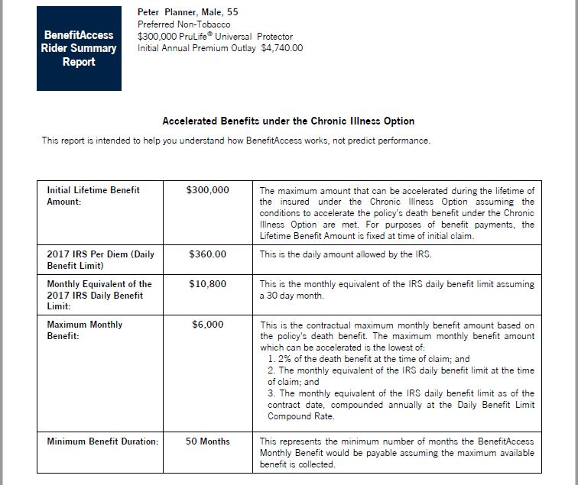

Slide 23
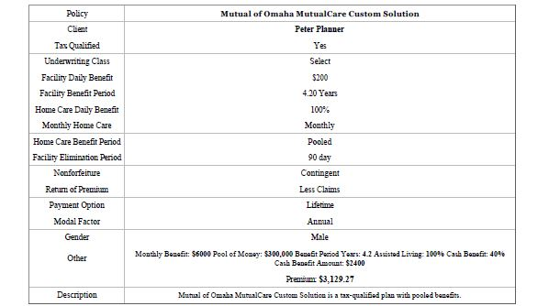
And we added one additional feature…

Slide 24
And we added one additional feature…

Slide 25
Traditional LTCI vs. Life with a Rider
Life w/Rider may be best client solution for:
Maximization of death benefit
Guarantee of future premiums
Ability to plan for multiple events
Those who may want to have third party ownership of policy
LTCI w/ROP rider may be best client solution for:
Most cost effective LTC benefit per premium dollar
Those less/not concerned with premium return at death can exclude rider
Those more comfortable with current LTCI premium levels

Slide 26
Considerations
No ONE solution is “best” for everyone
Consider financial logic vs. human emotion – e.g.:
  What if I never use it?
  Concern over rate increases on LTCI
P.s. November 217 SOA LTCI Pricing Study
  The “rear view mirror” vs, the “windshield”
Questions?

