Slide 1













Slide 2
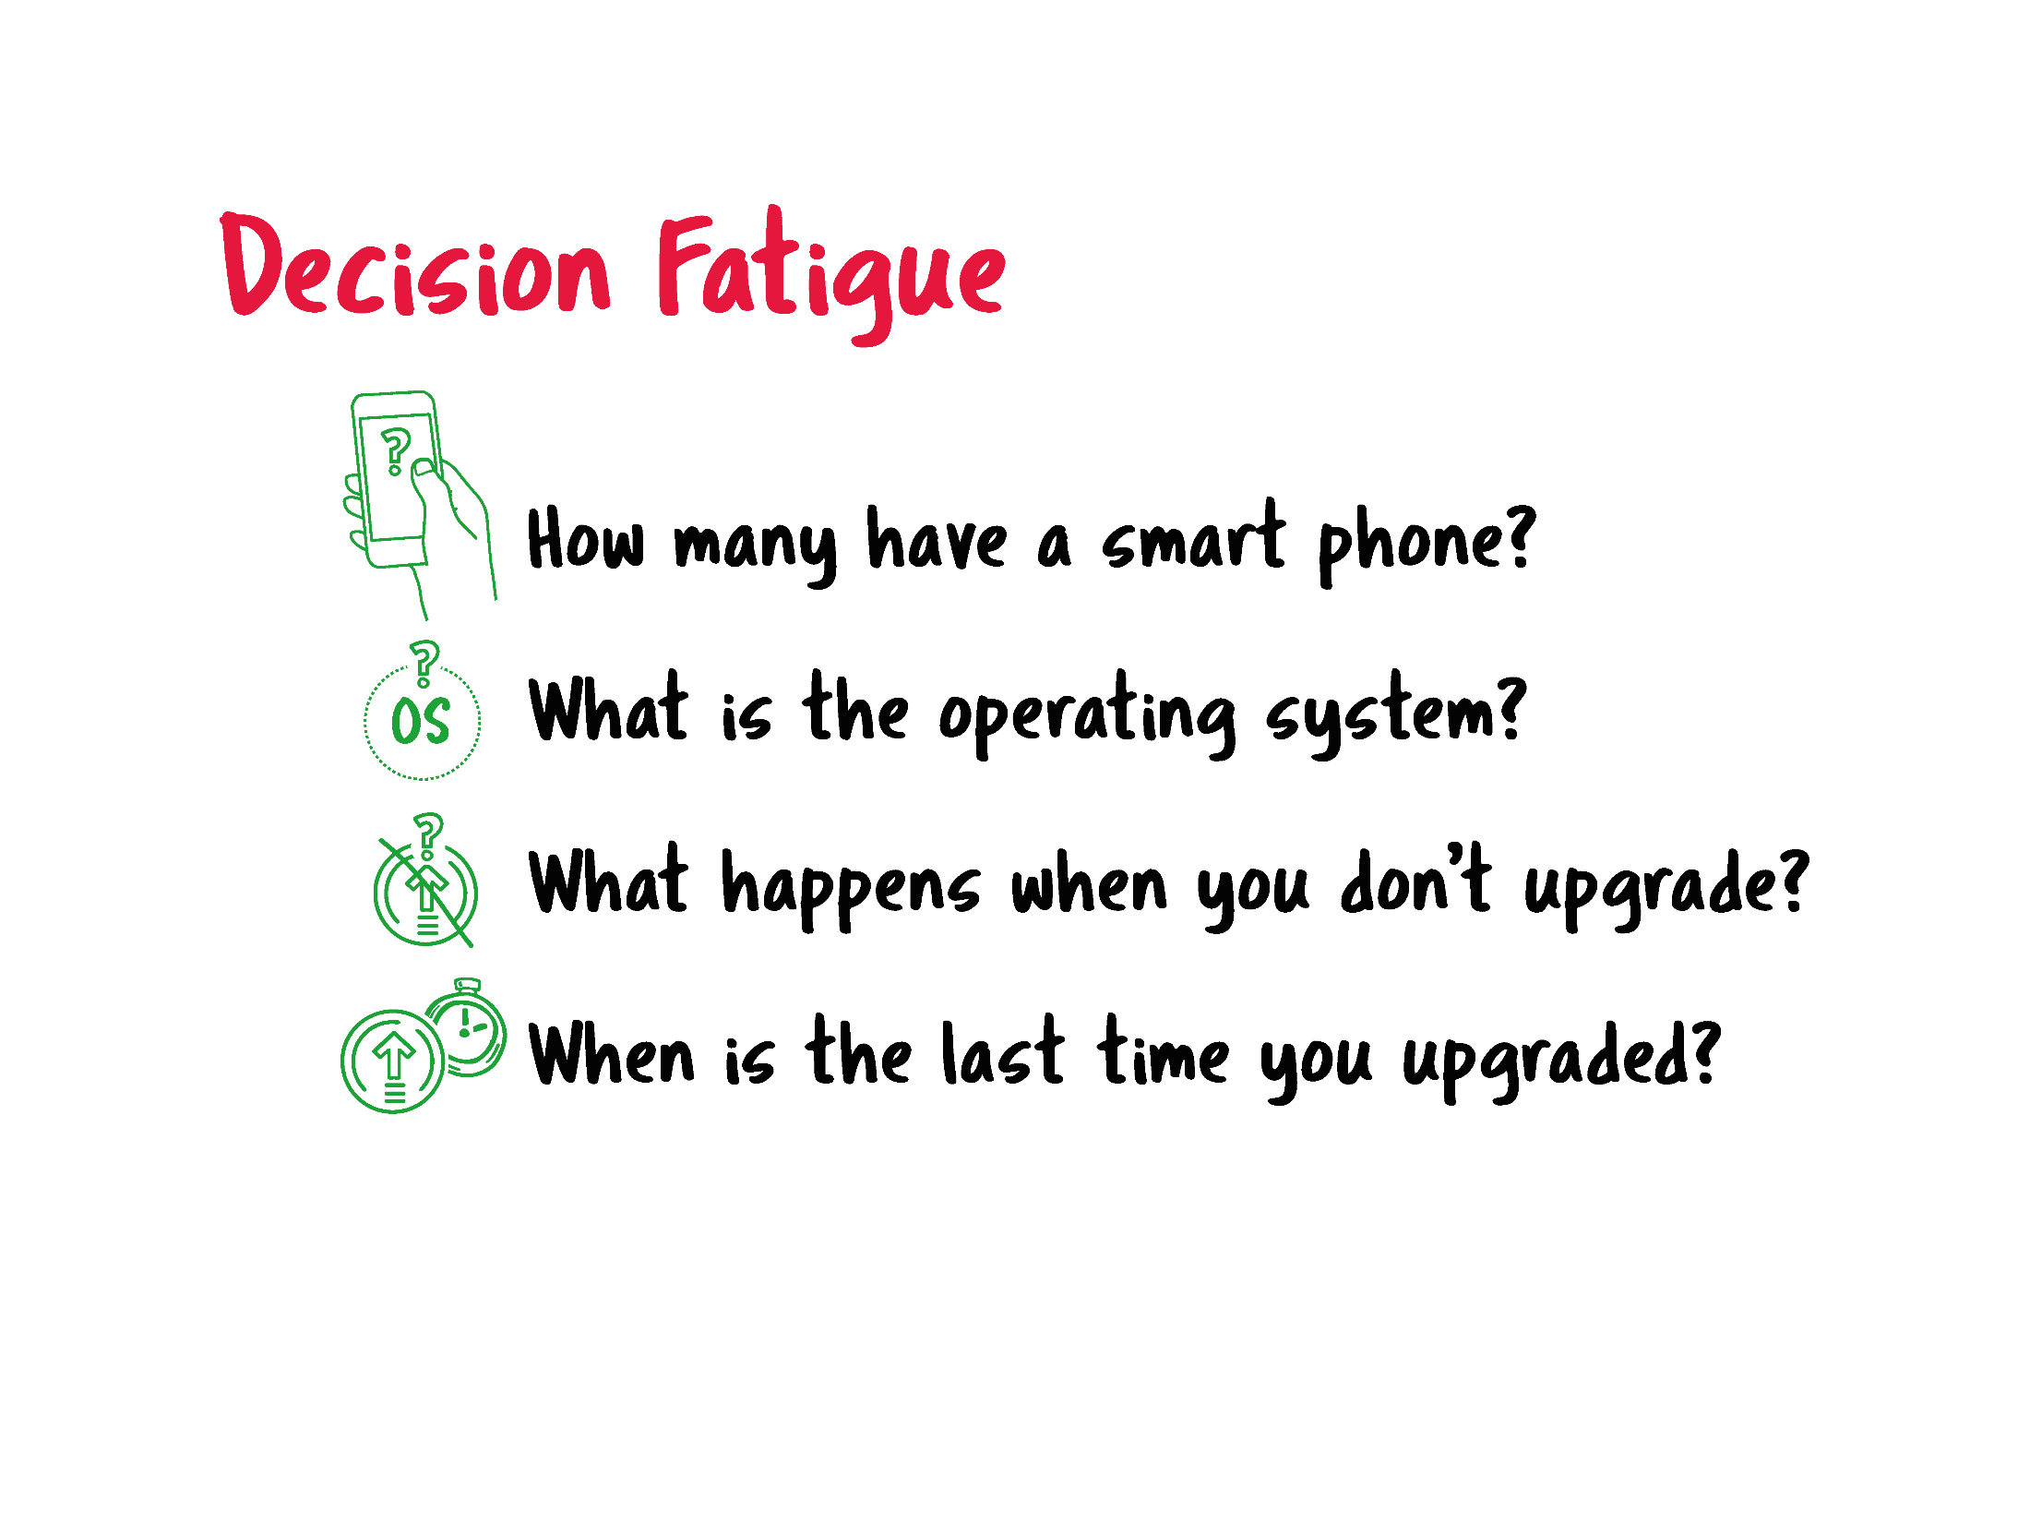

Slide 3
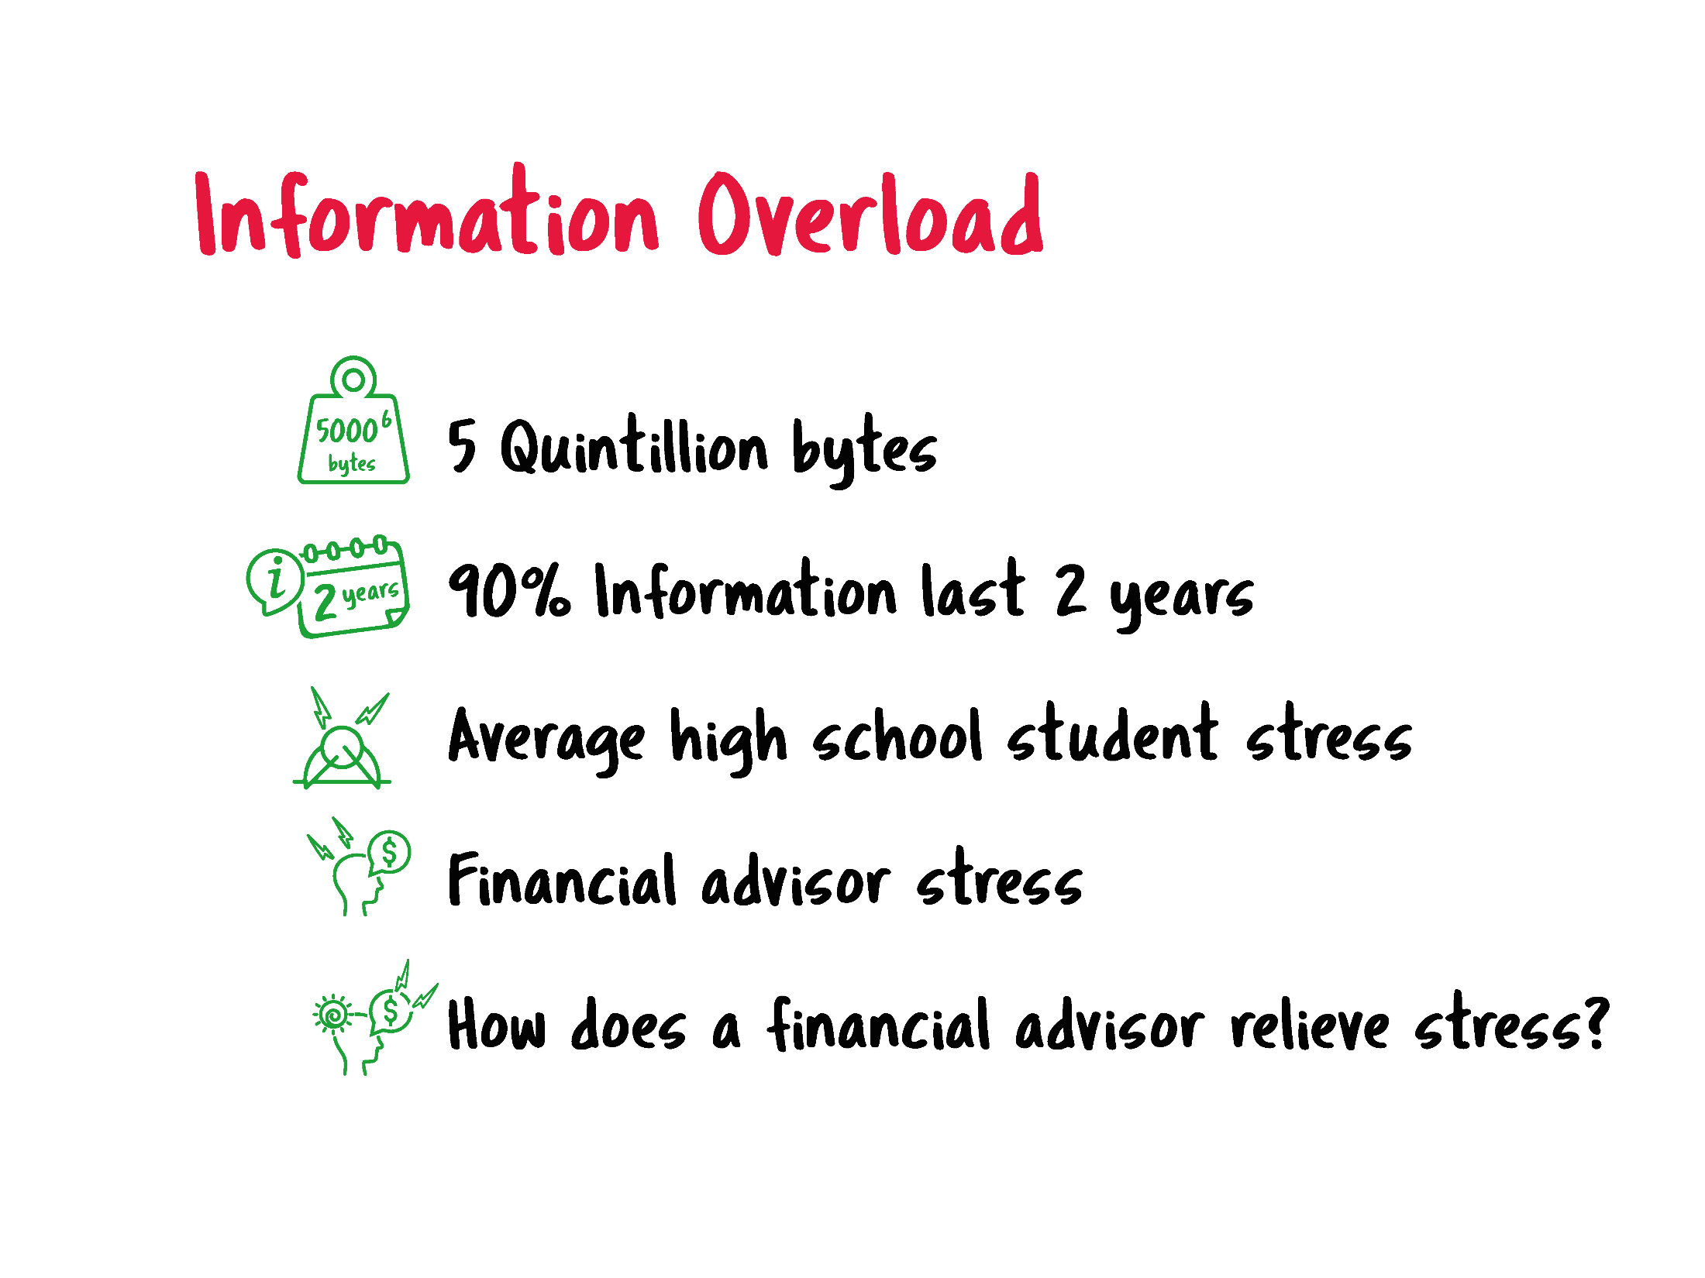

Slide 4


Slide 6
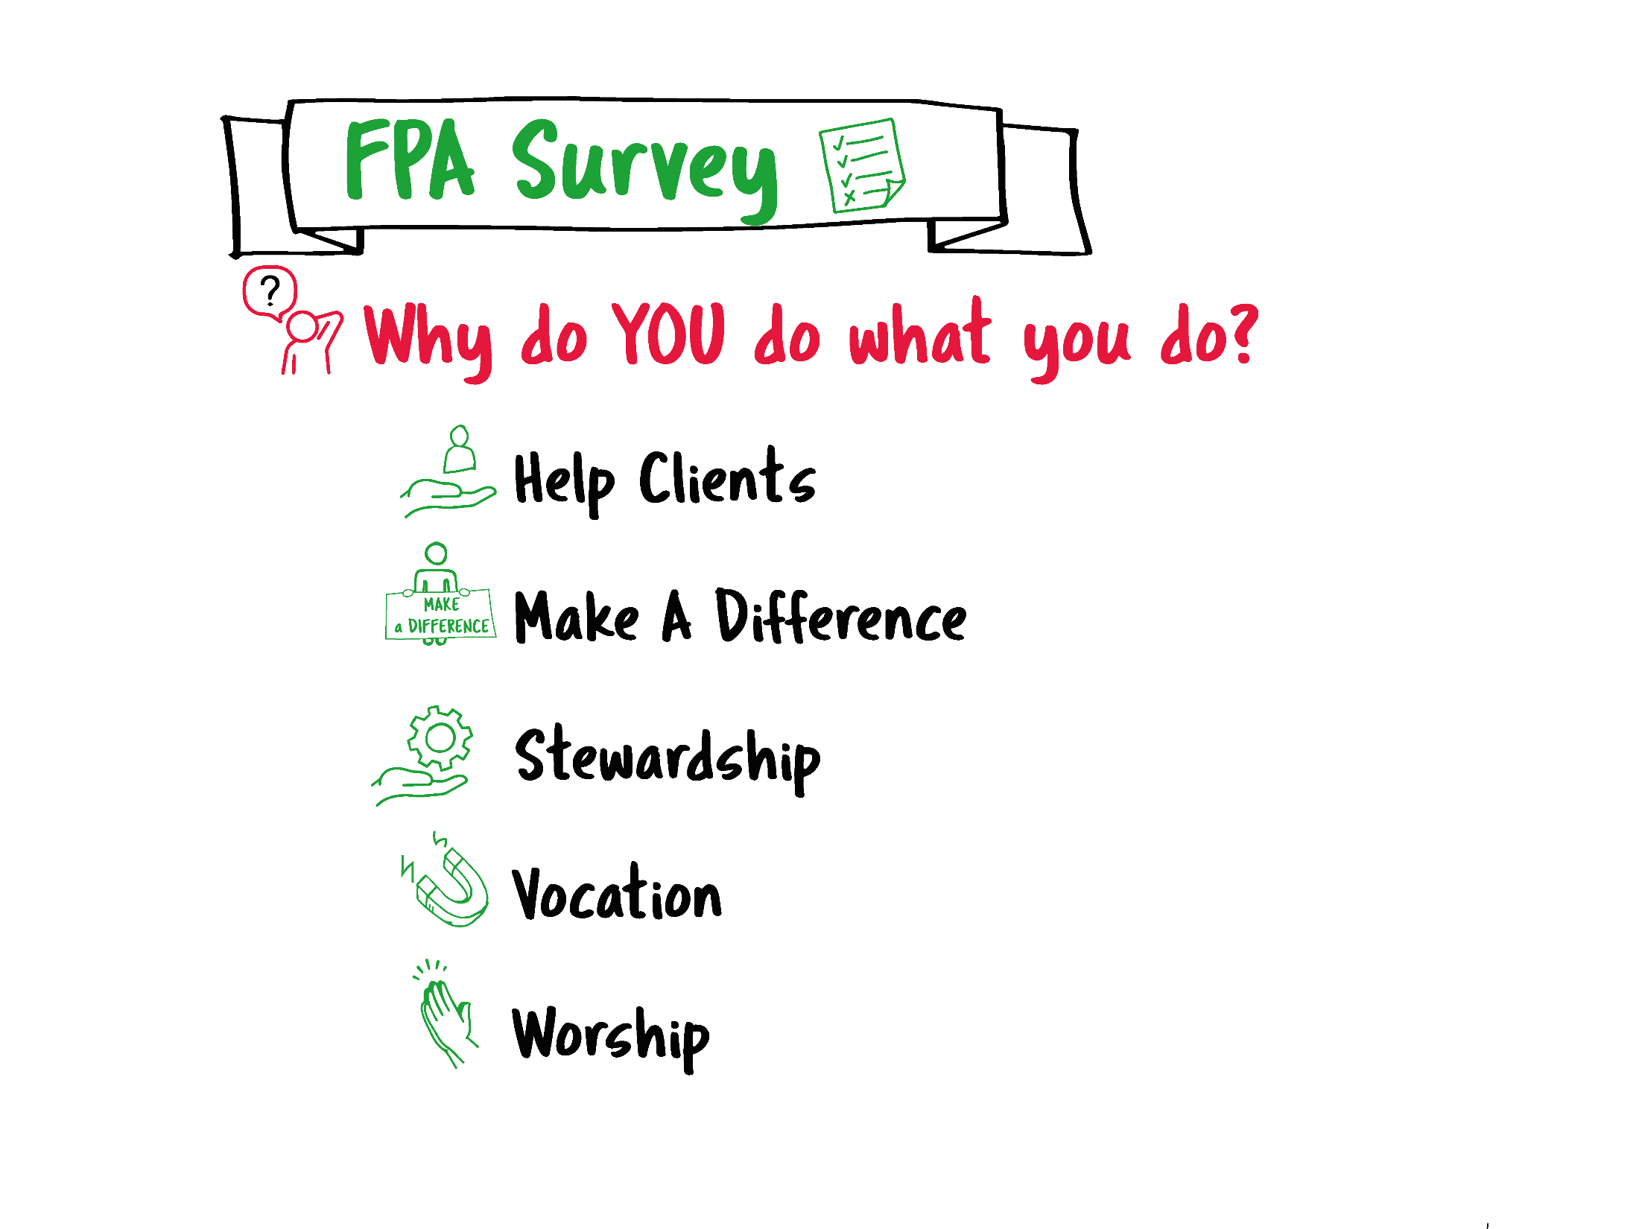


Slide 7
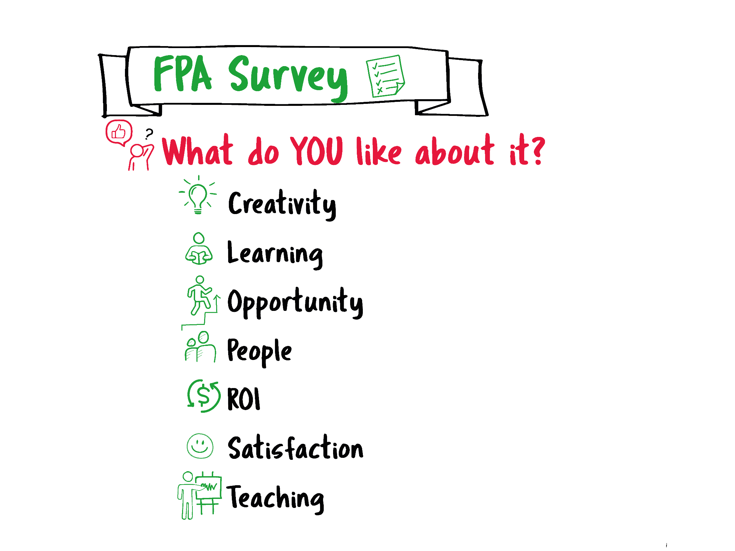

Slide 8
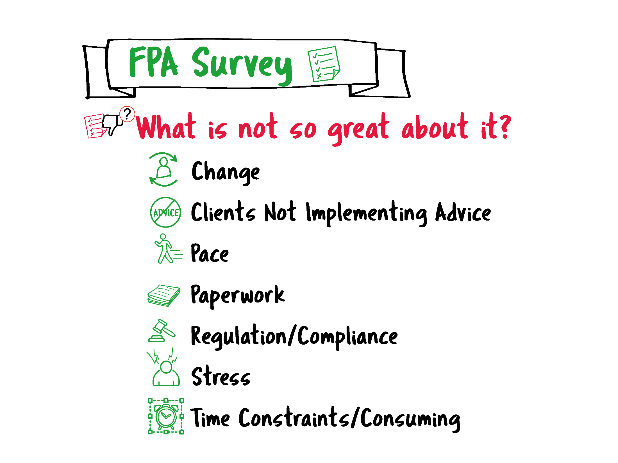

Slide 9
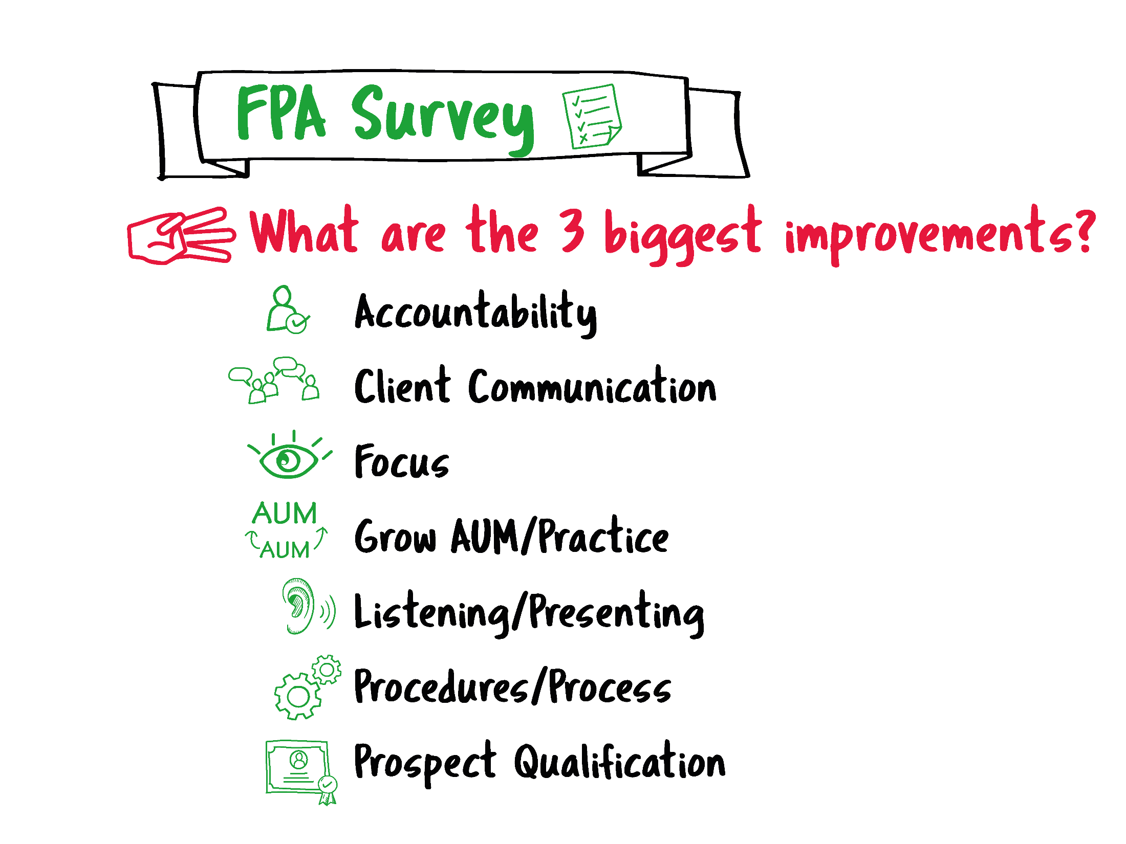

Slide 10
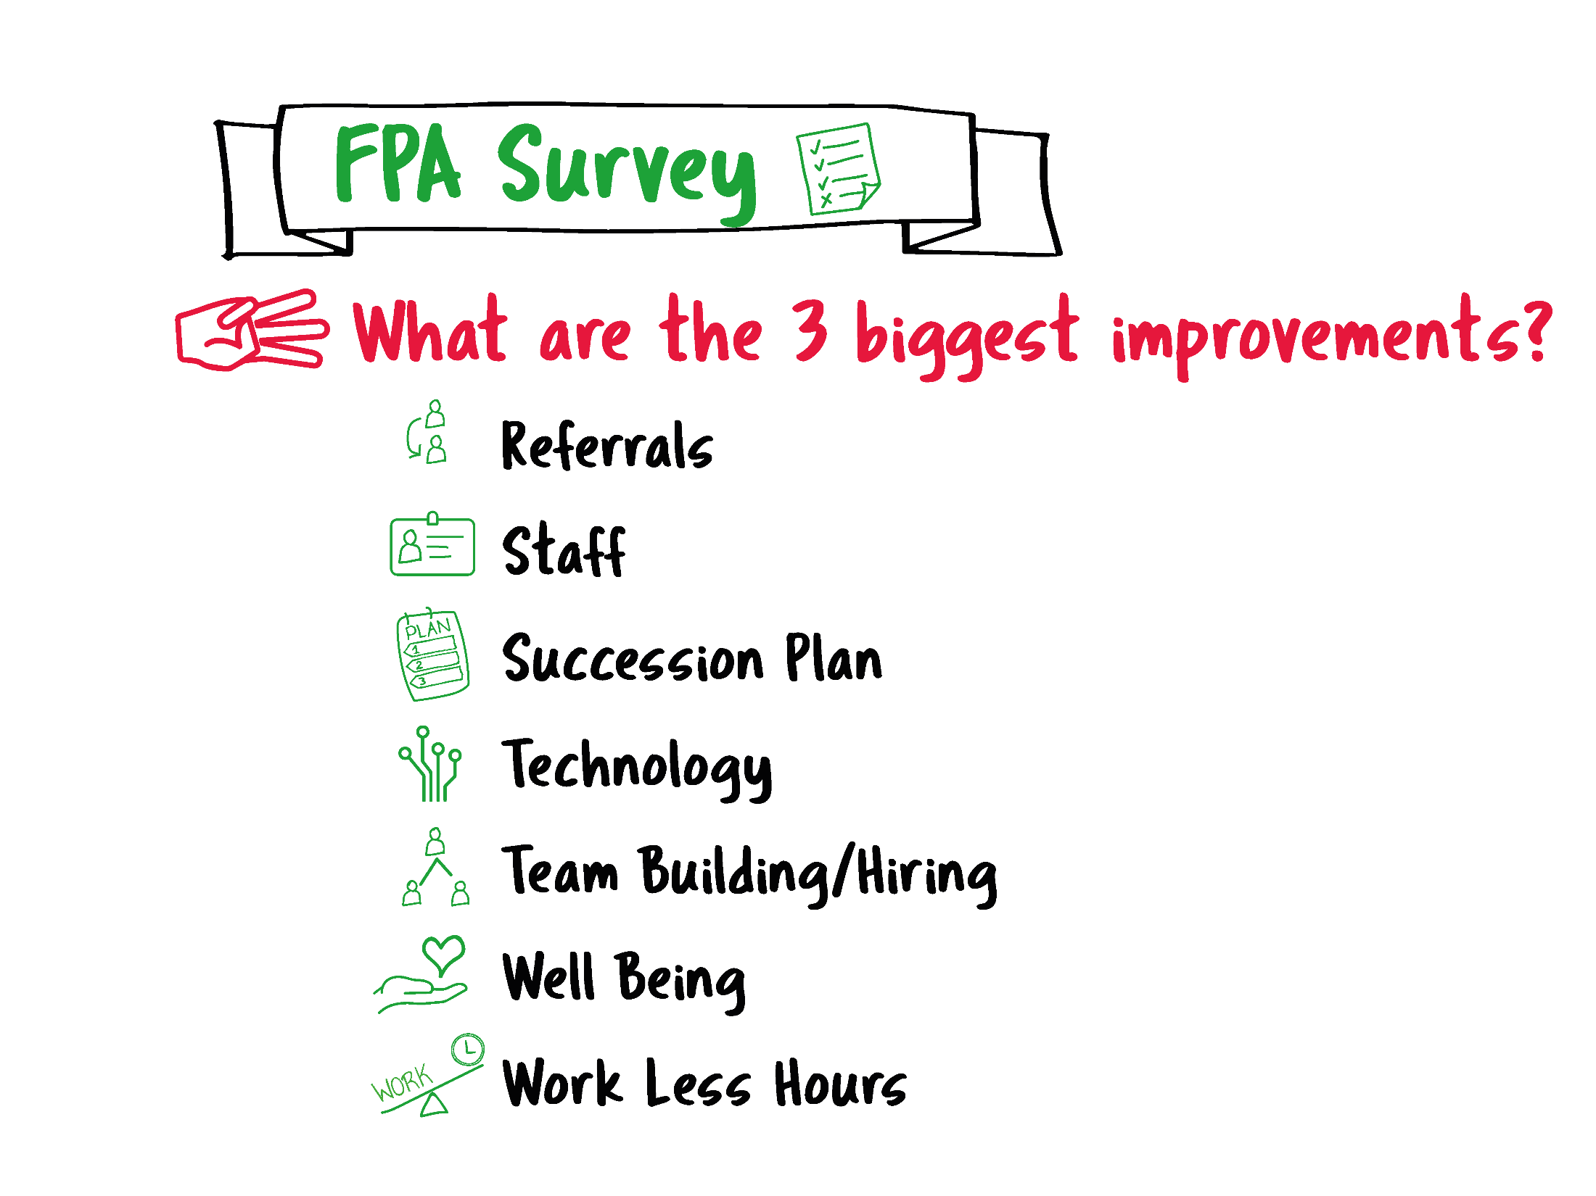

Slide 11
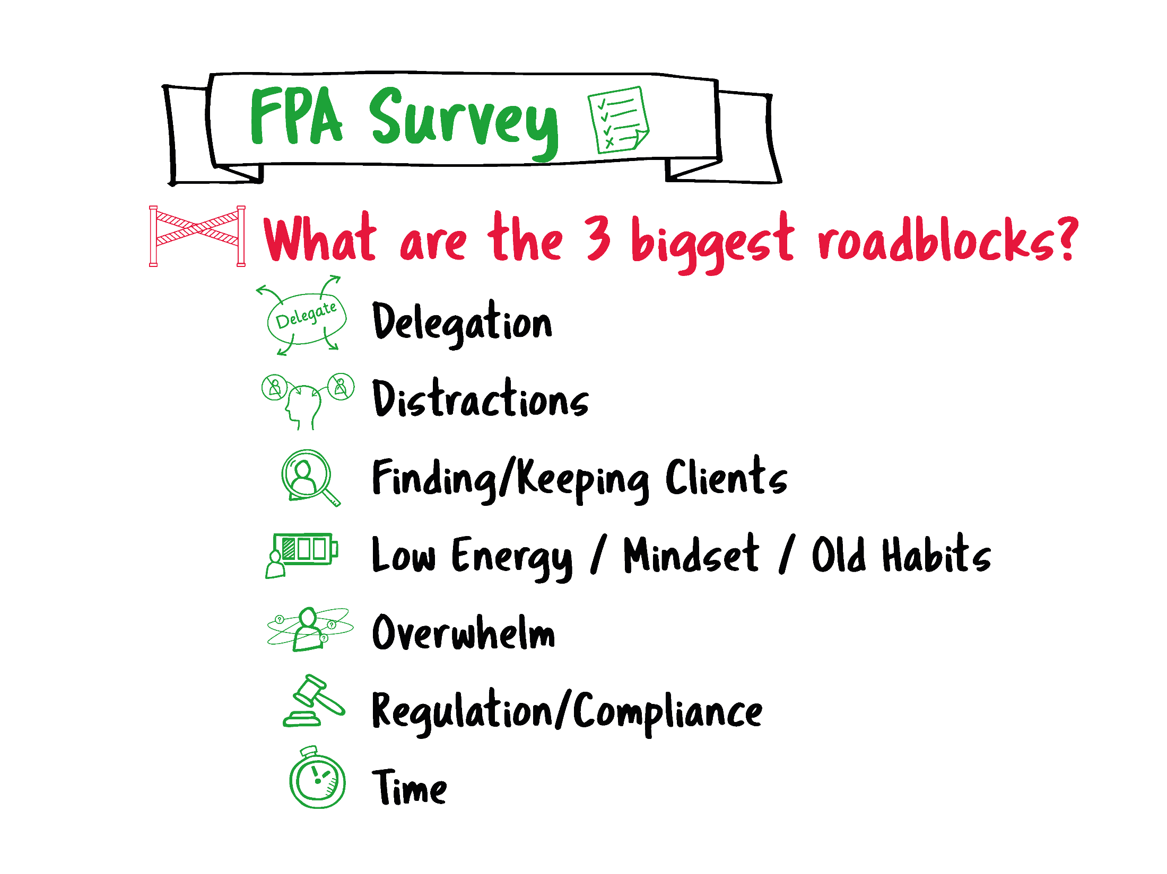

Slide 12
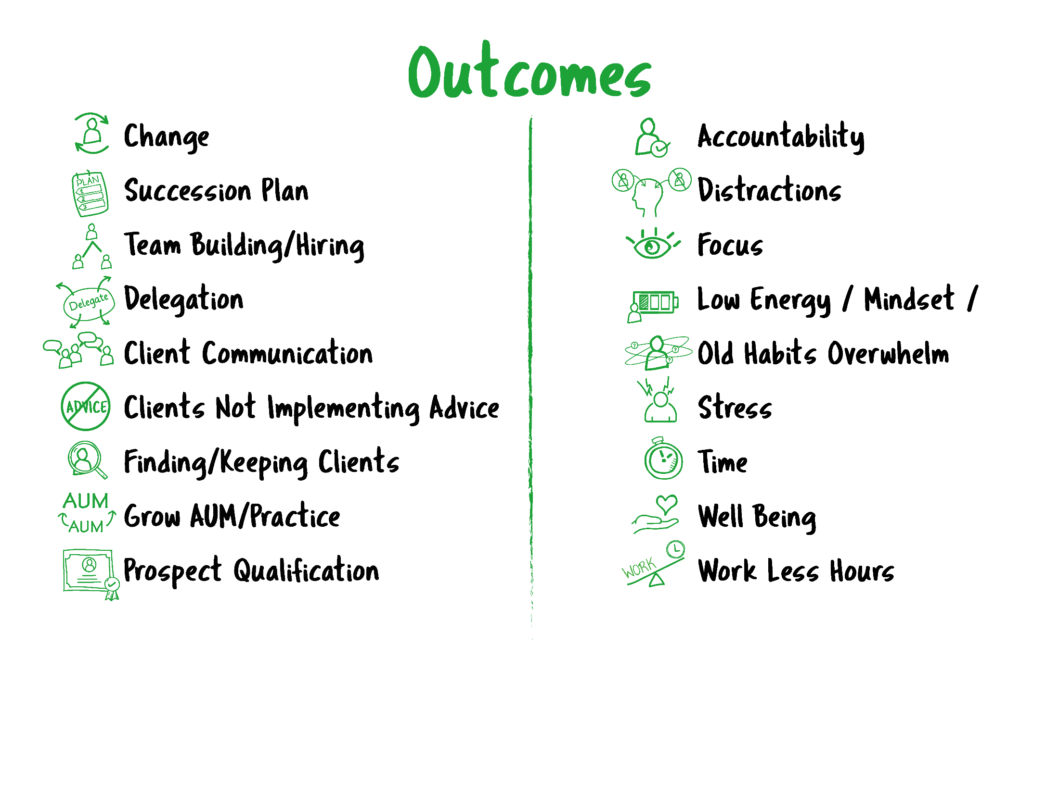

Slide 15
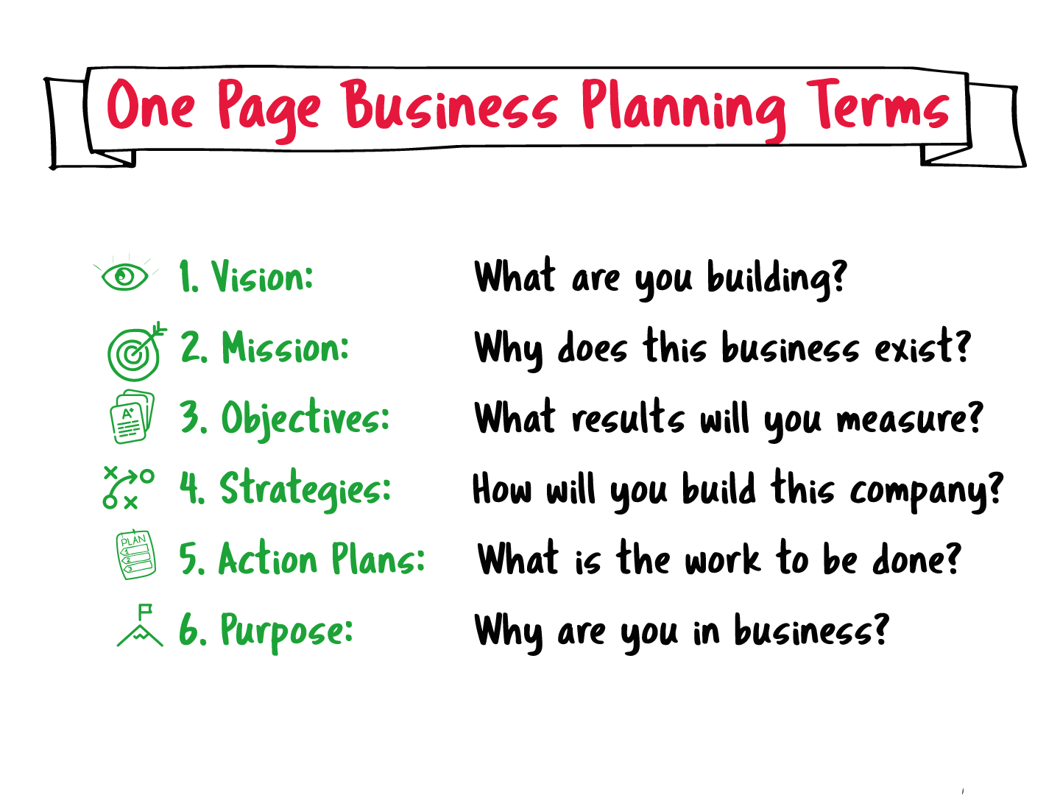

Slide 16
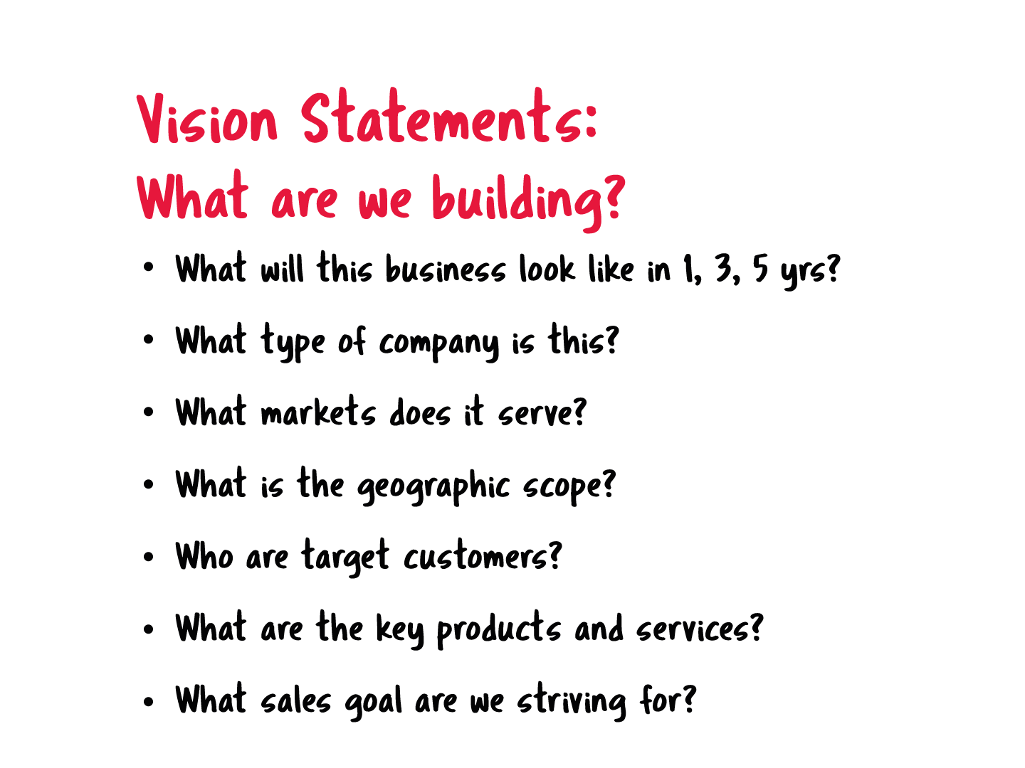
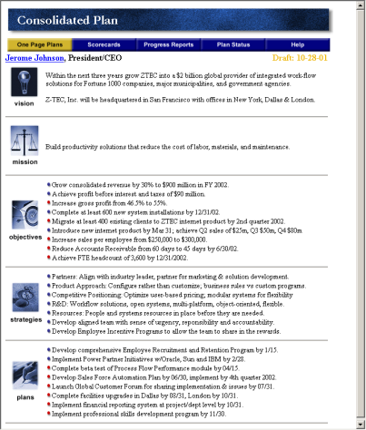

Slide 17
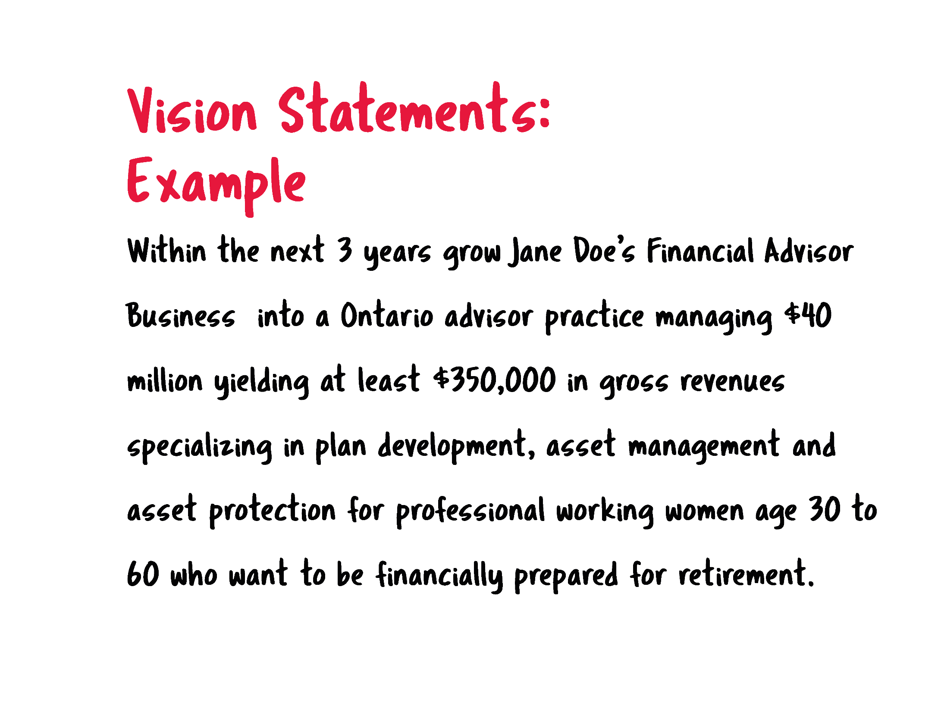

Slide 18
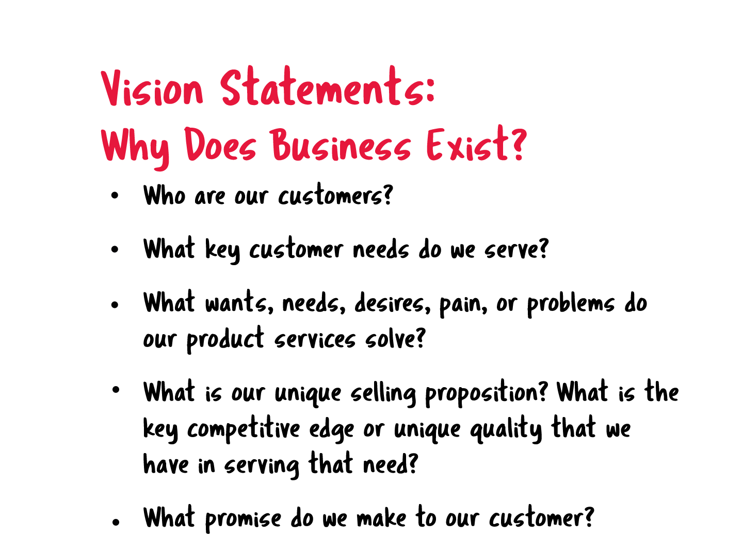

Slide 19
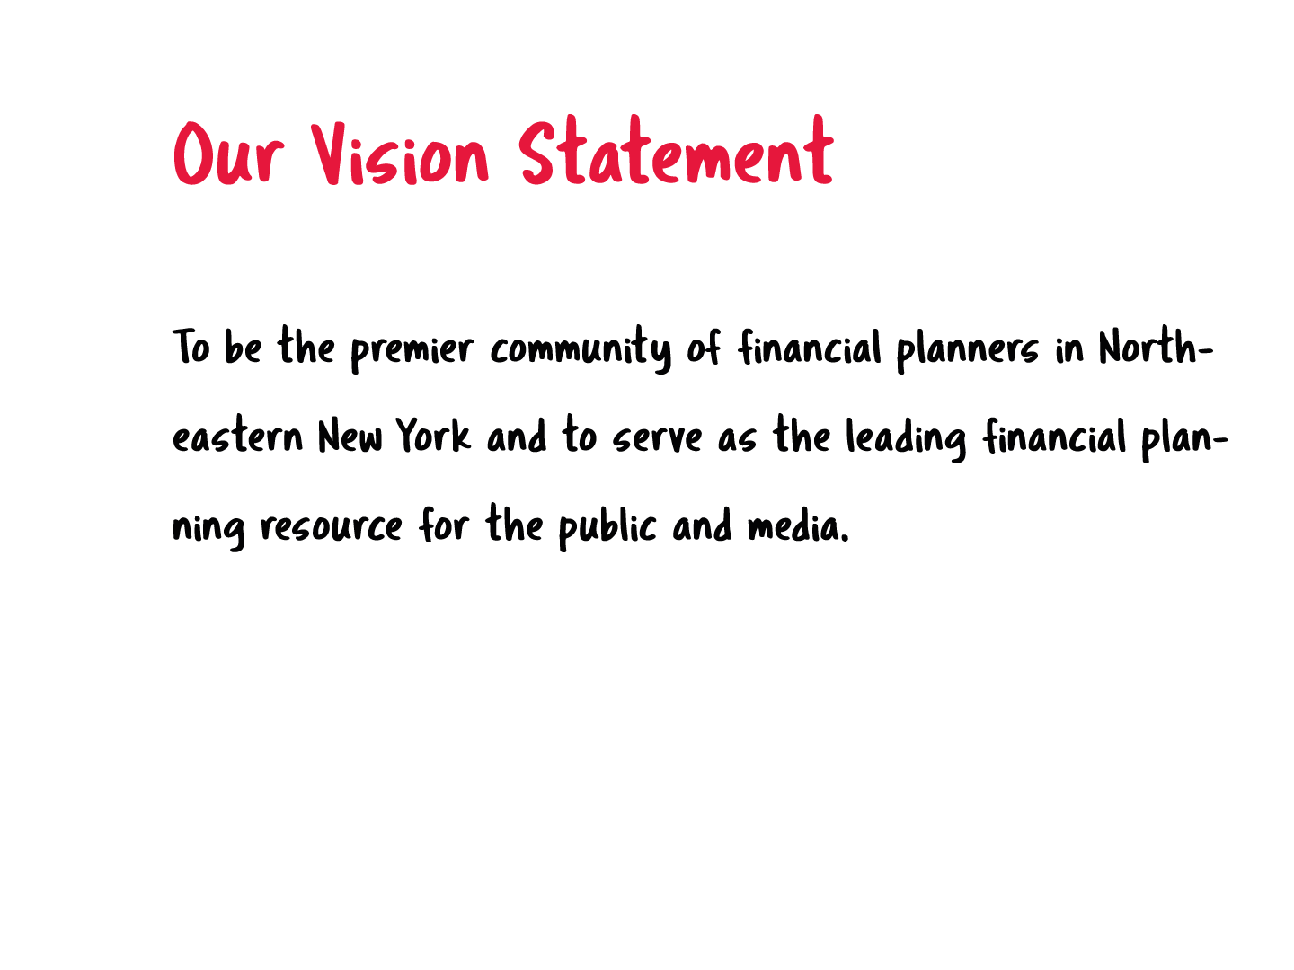


Slide 20
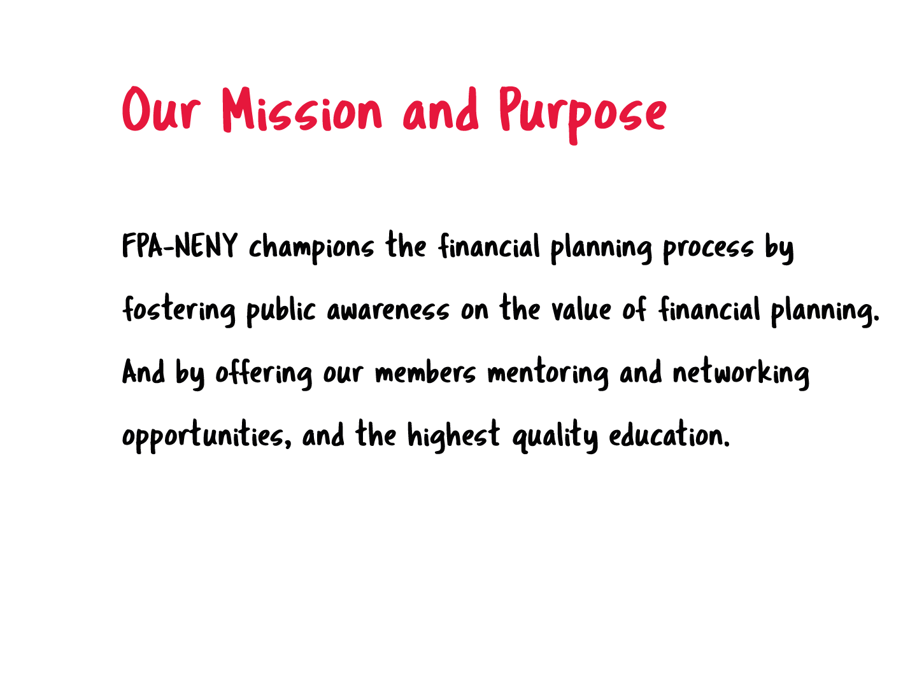

Slide 21
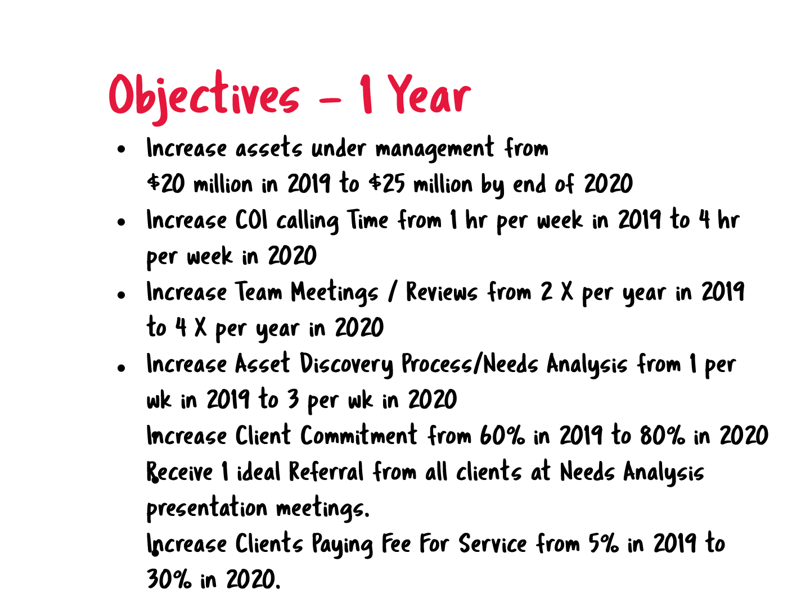

Slide 22
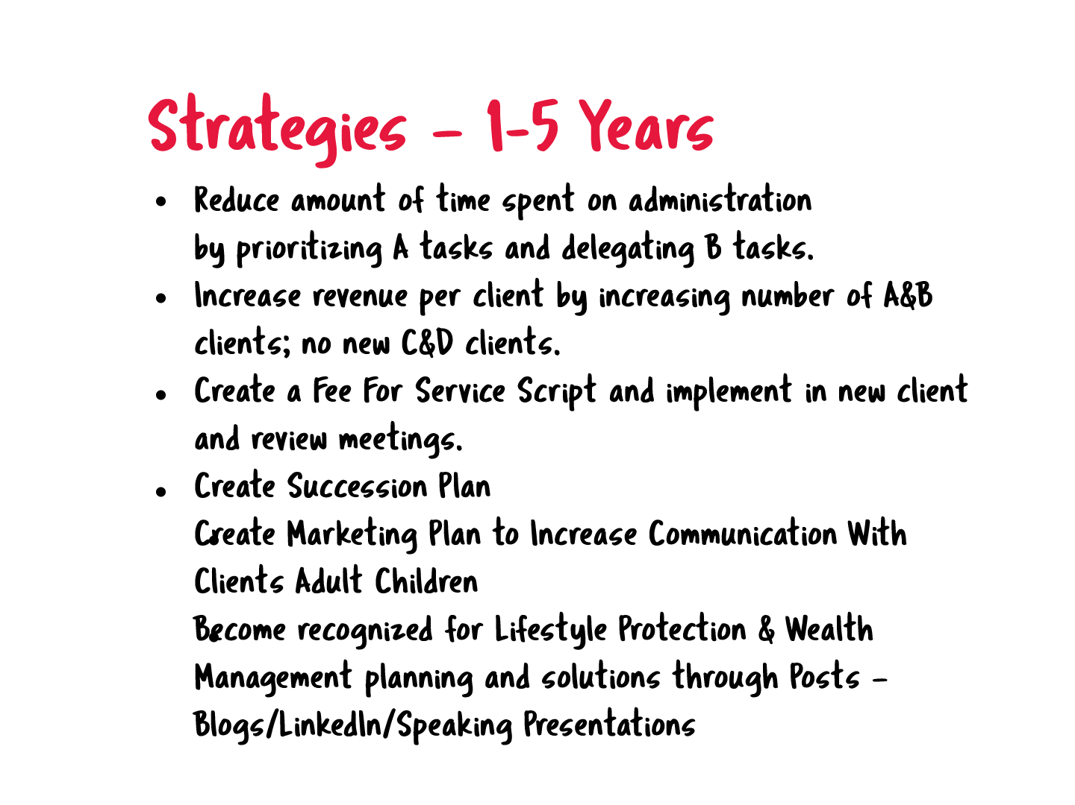

Slide 23
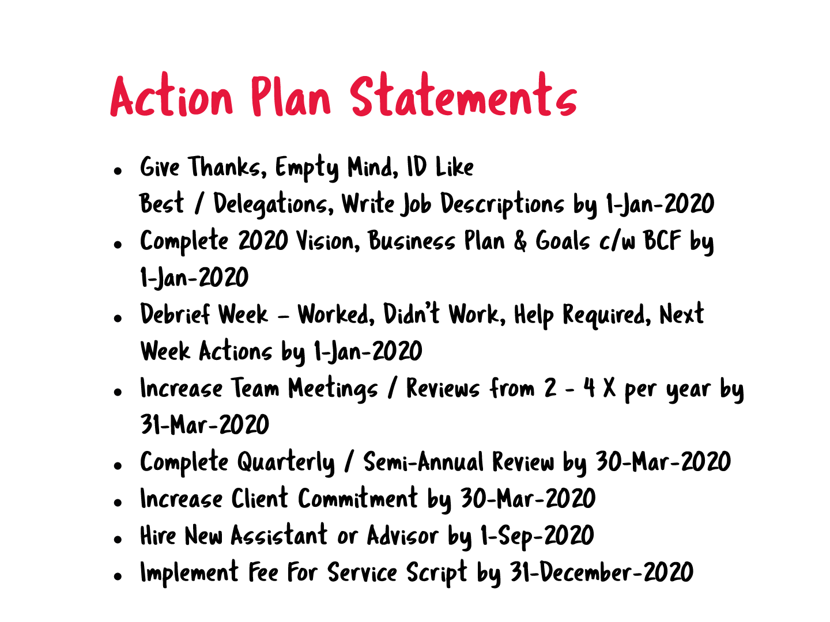

Slide 24
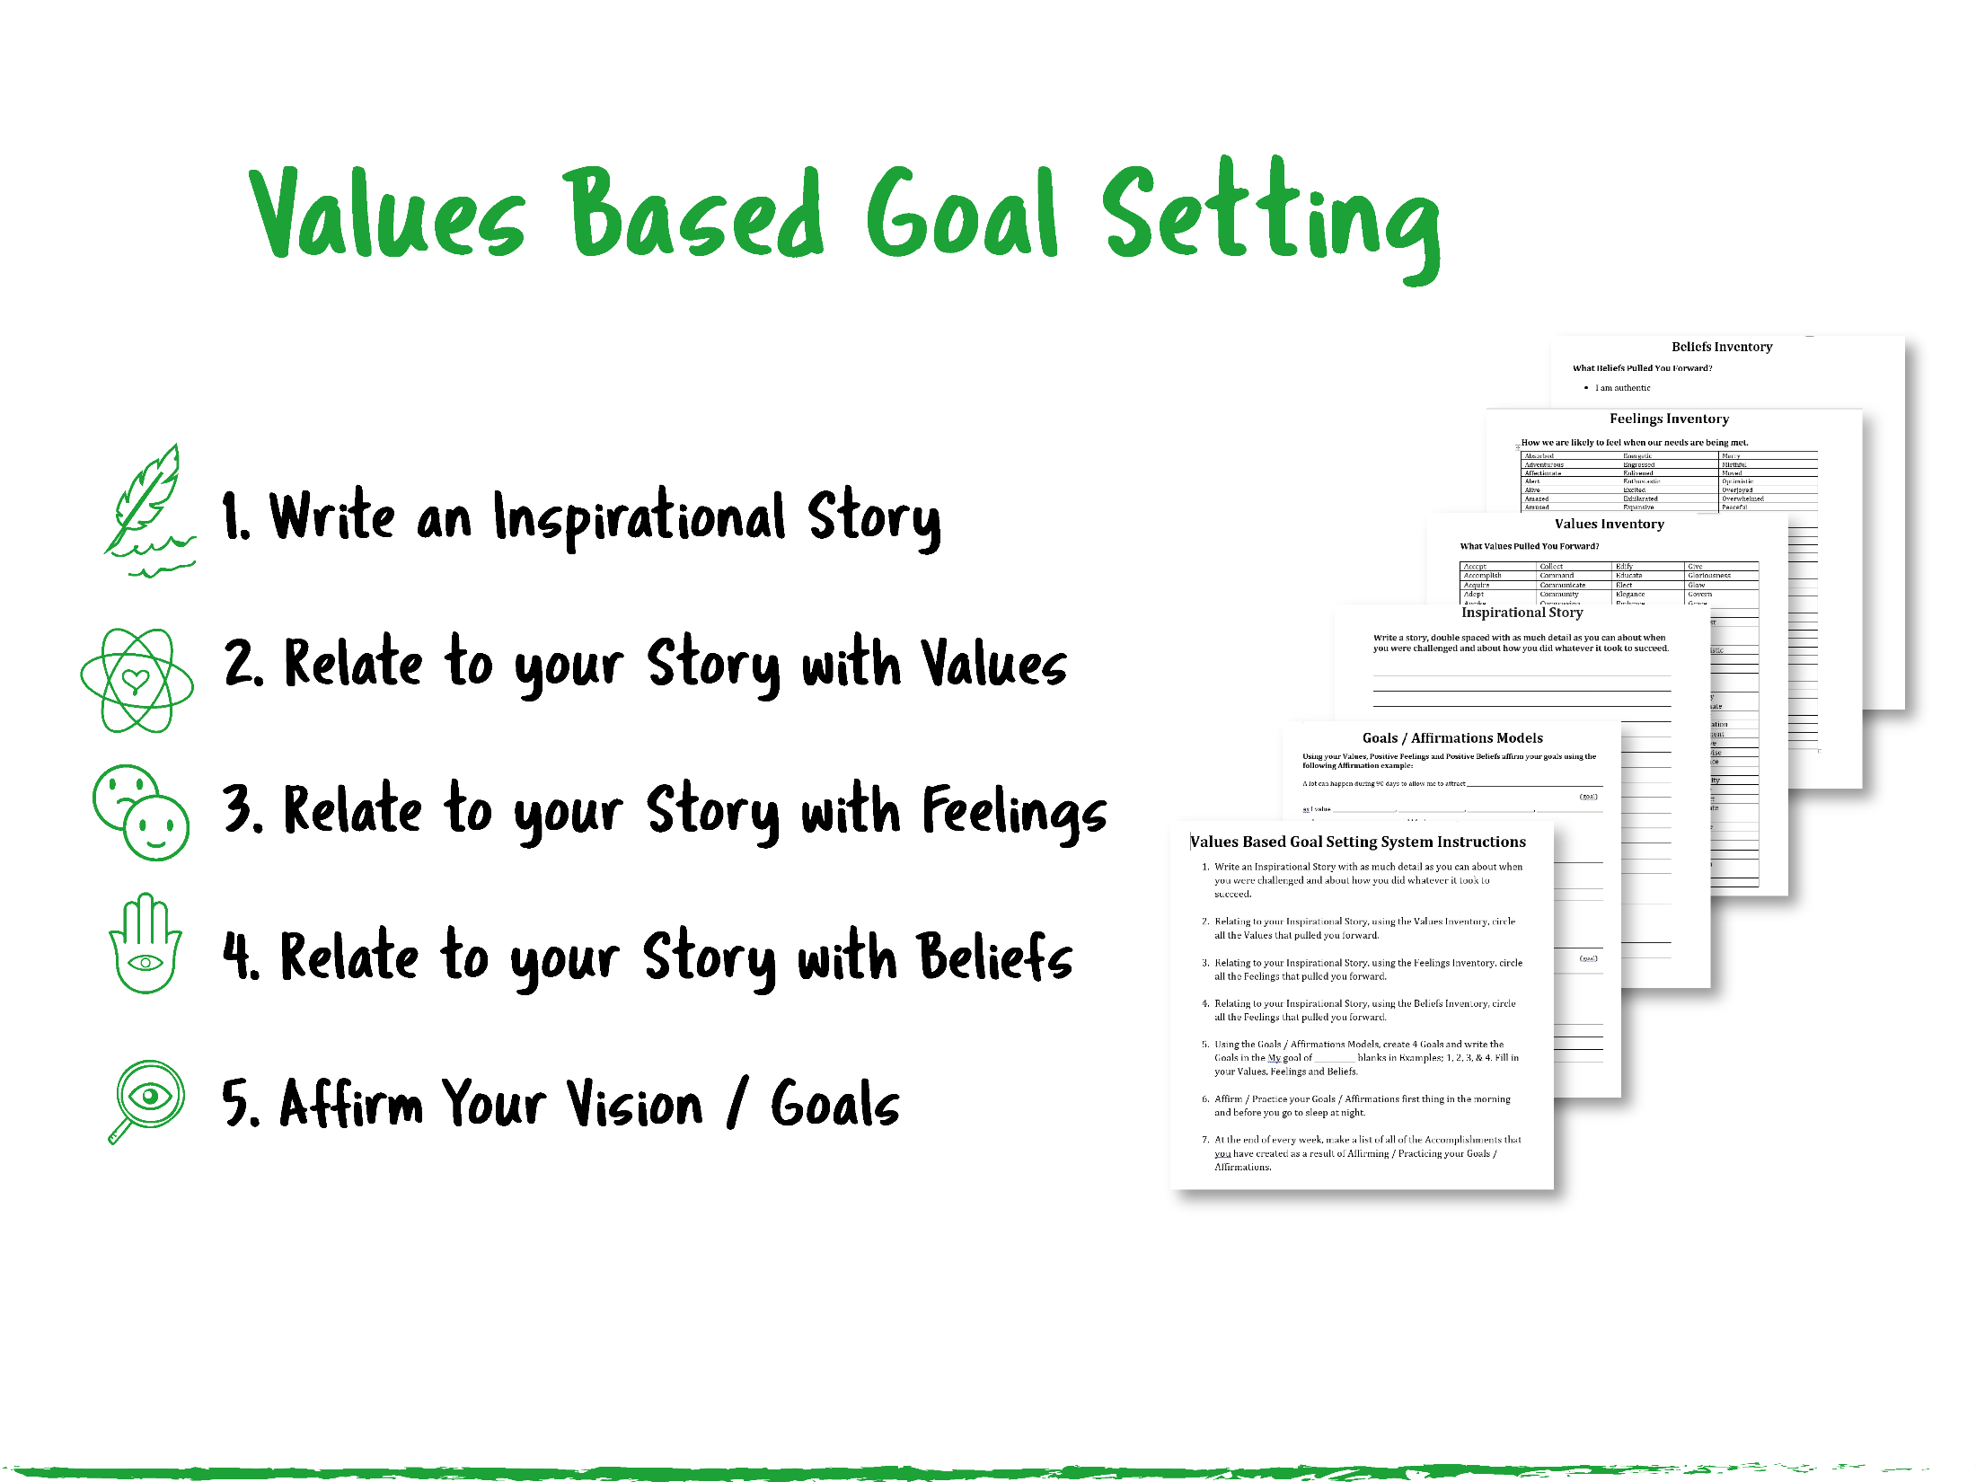

Slide 25
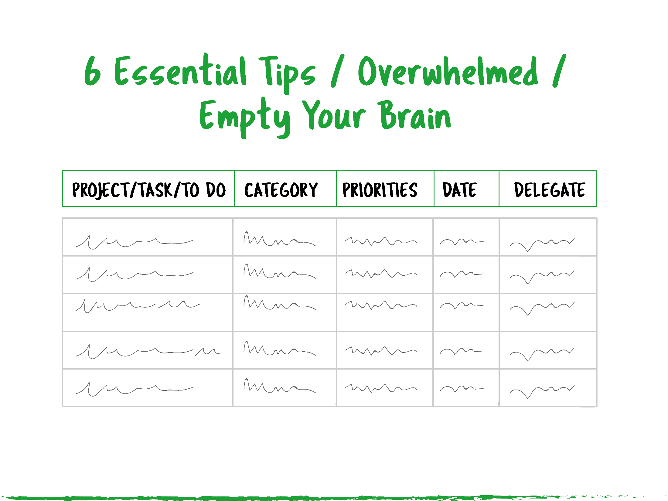

Slide 26
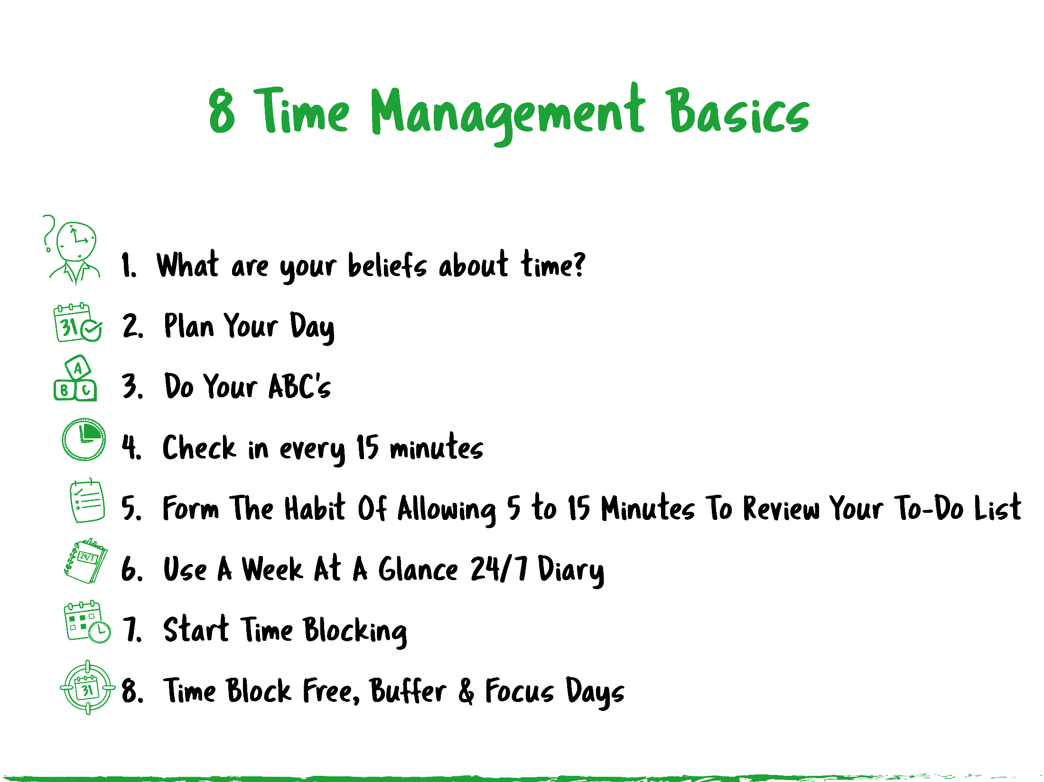
sreilly@leadingadvisor.com

Slide 28

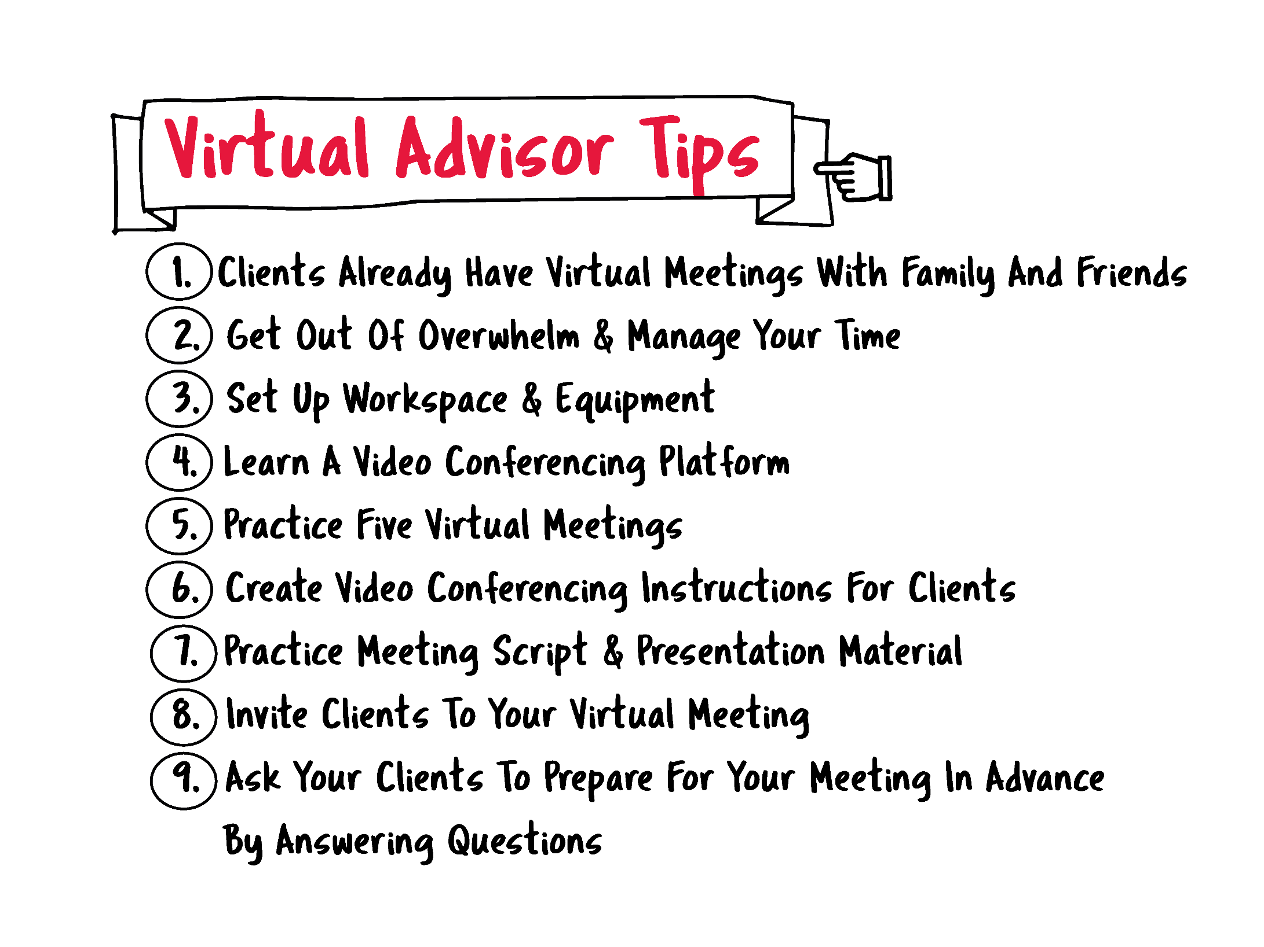

Slide 30
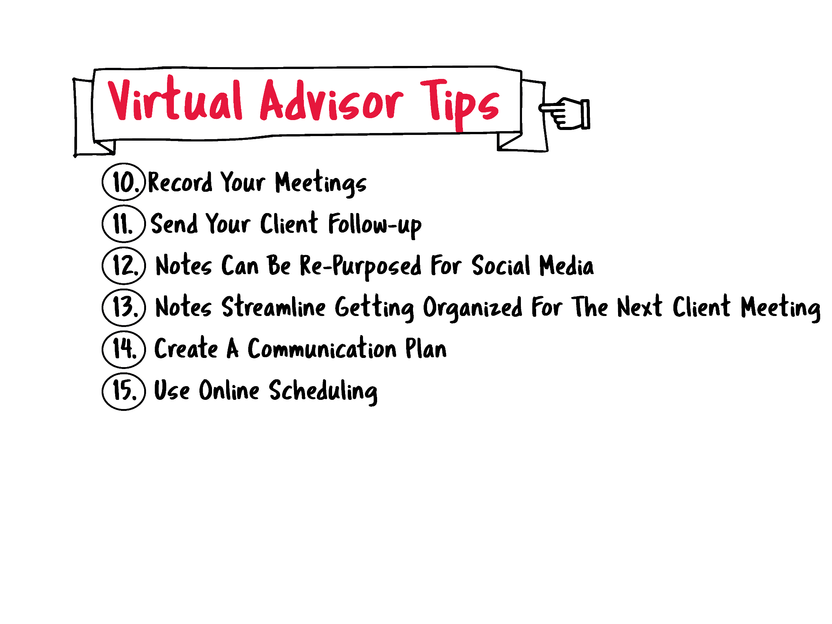

Slide 31
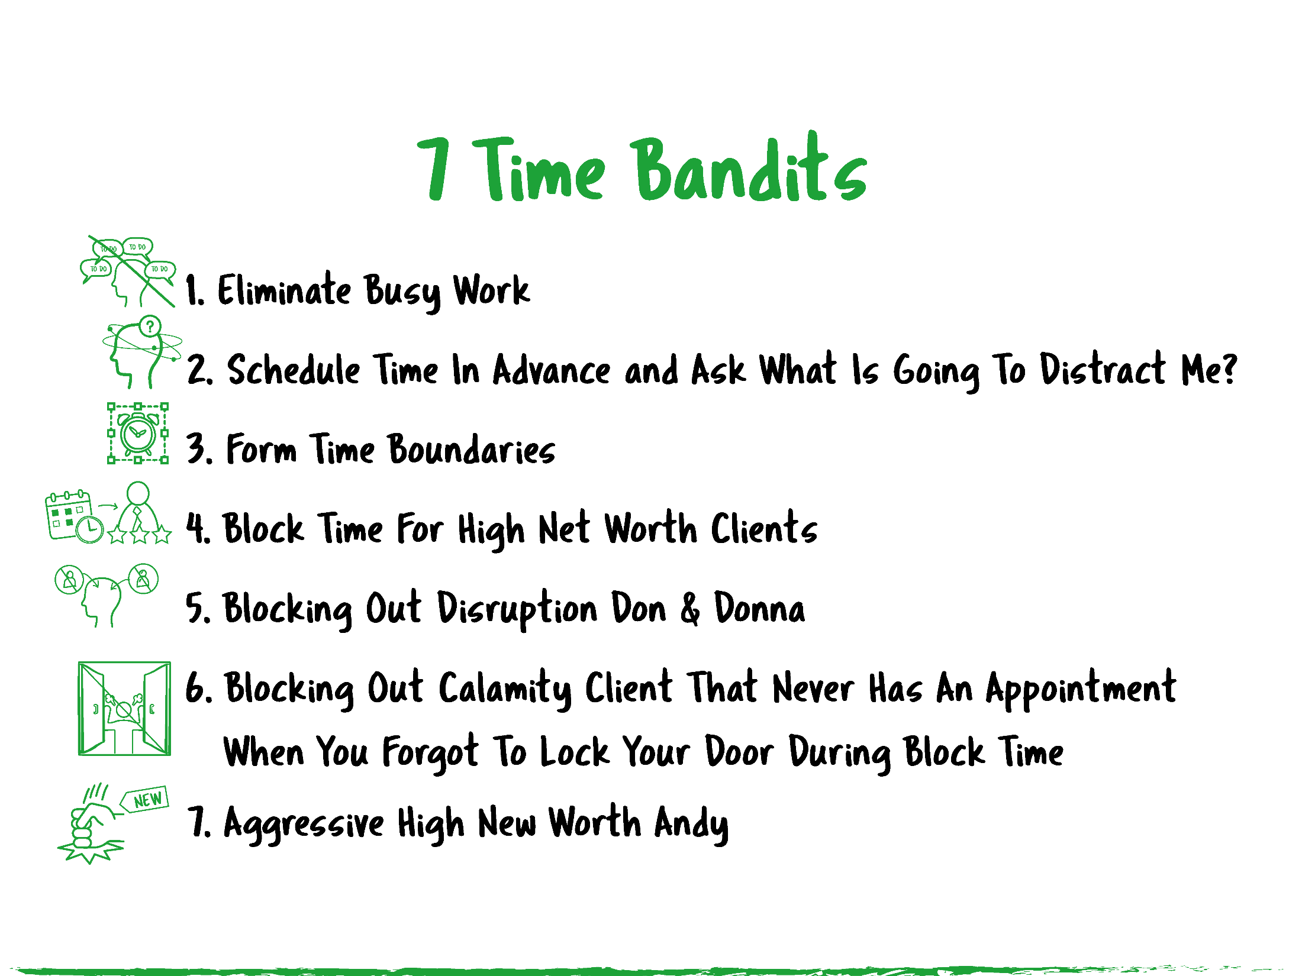
sreilly@leadingadvisor.com

Slide 32


Slide 34
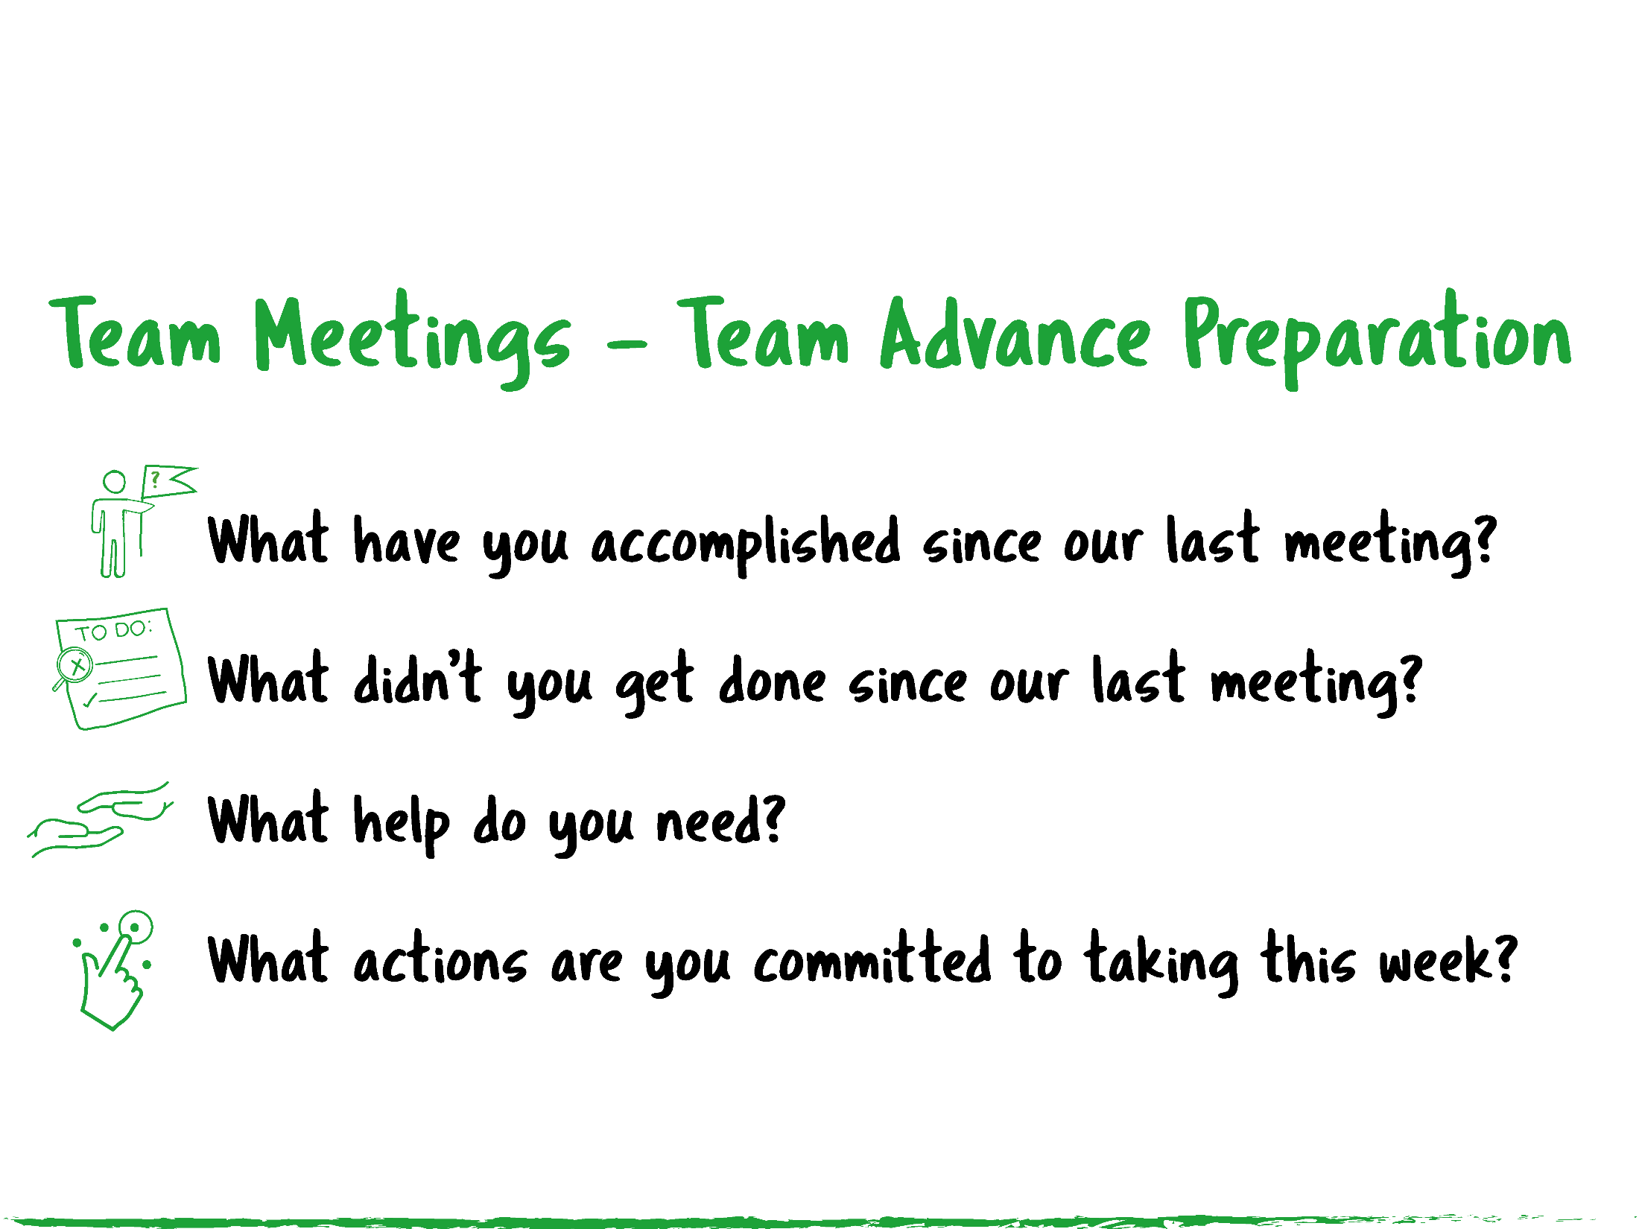

Slide 35
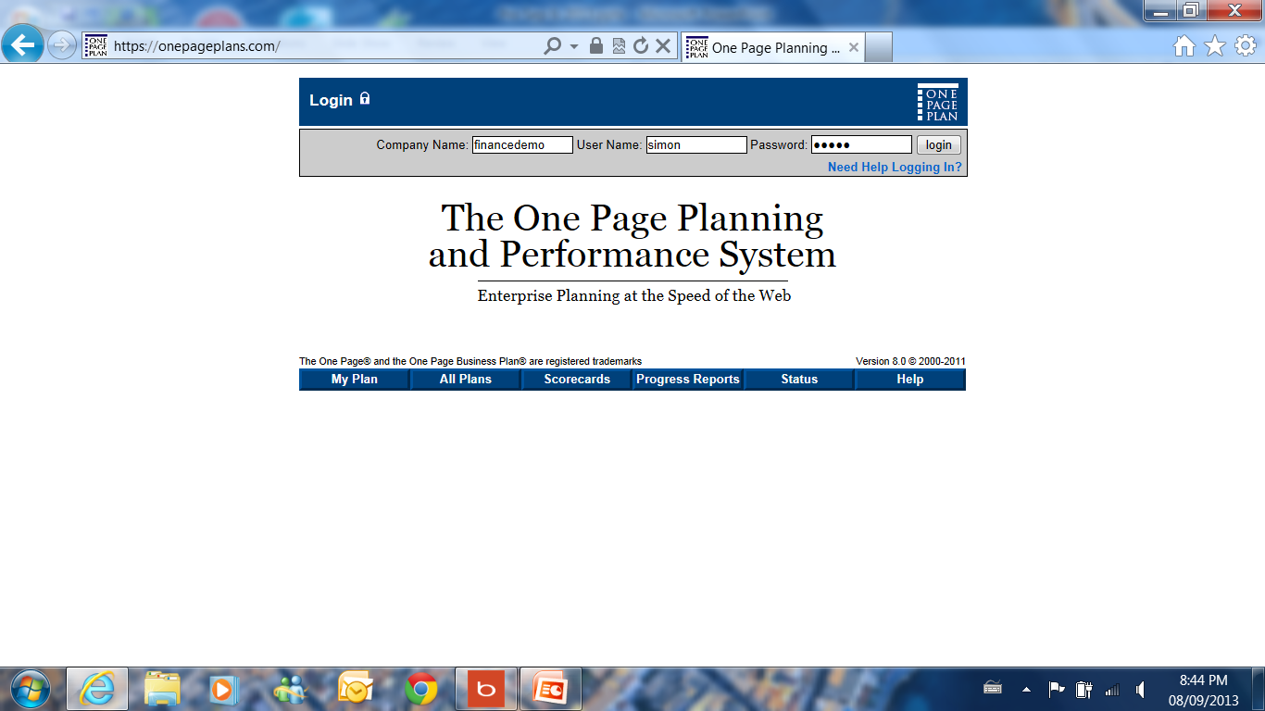

Slide 36
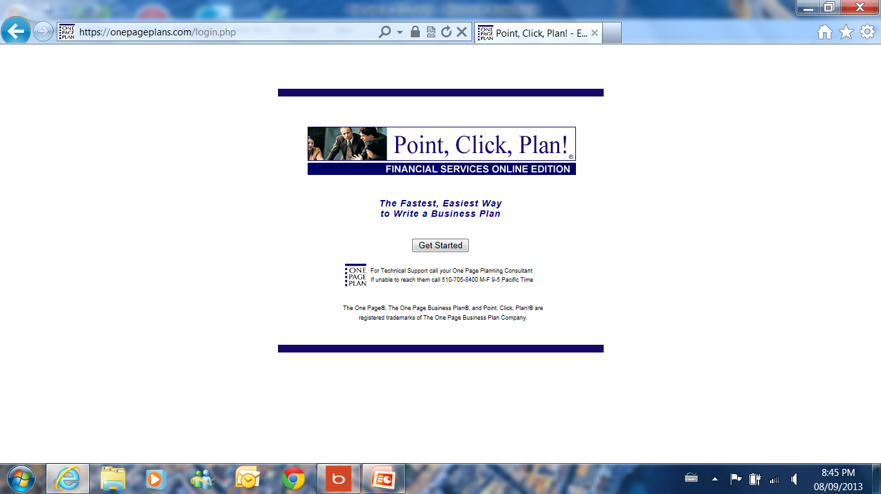

Slide 37
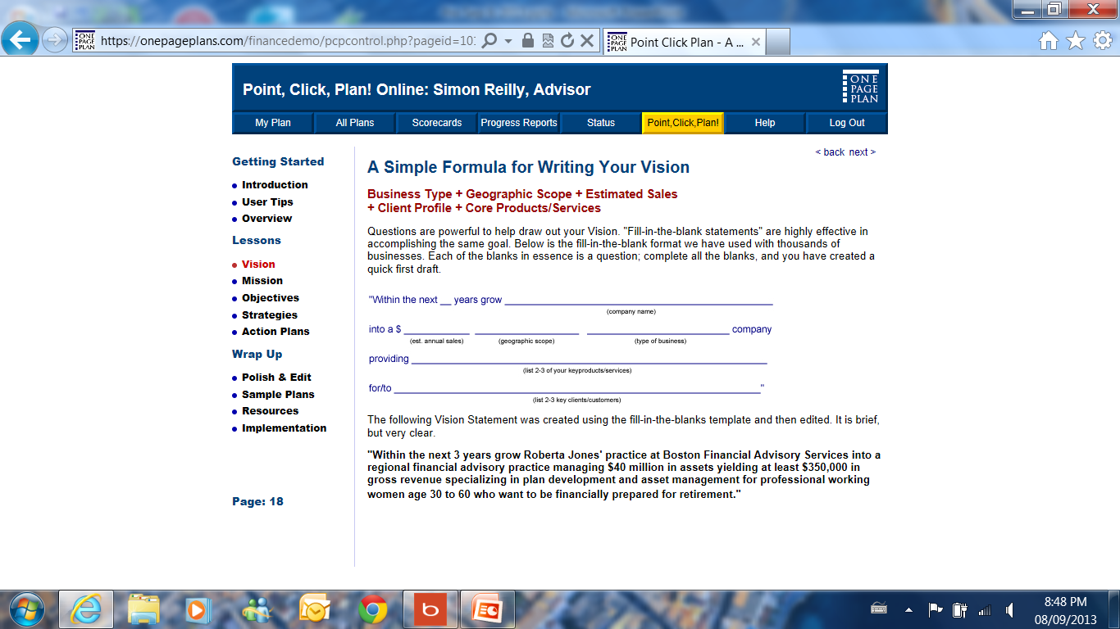

Slide 38
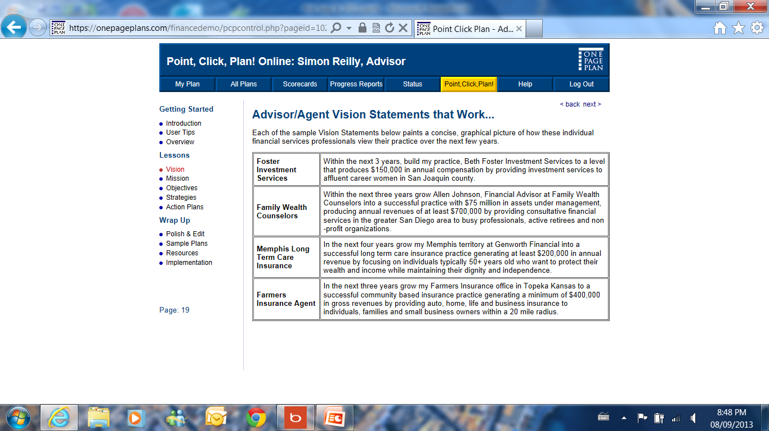

Slide 39
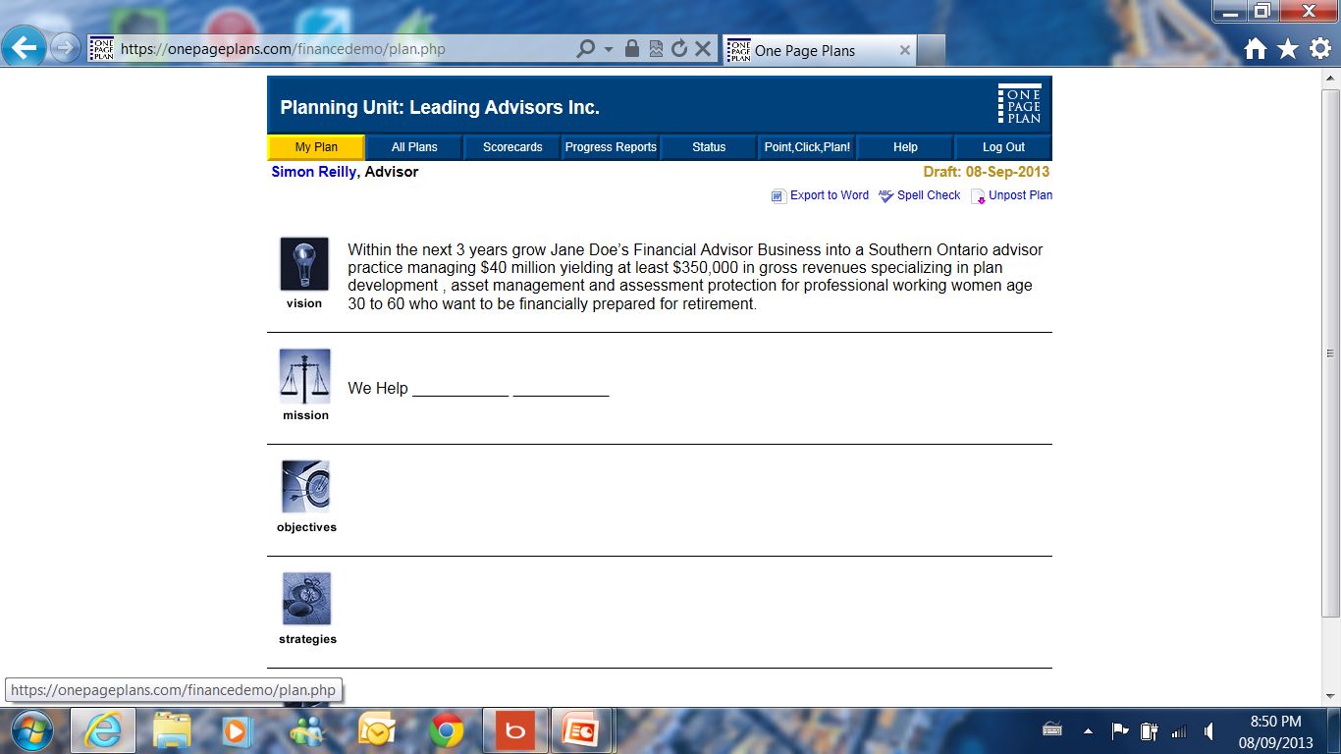

Slide 40
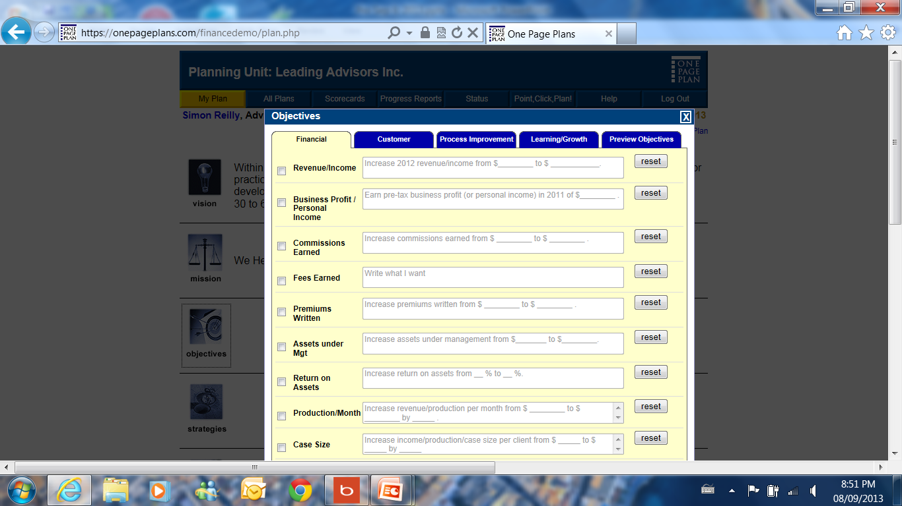

Slide 41
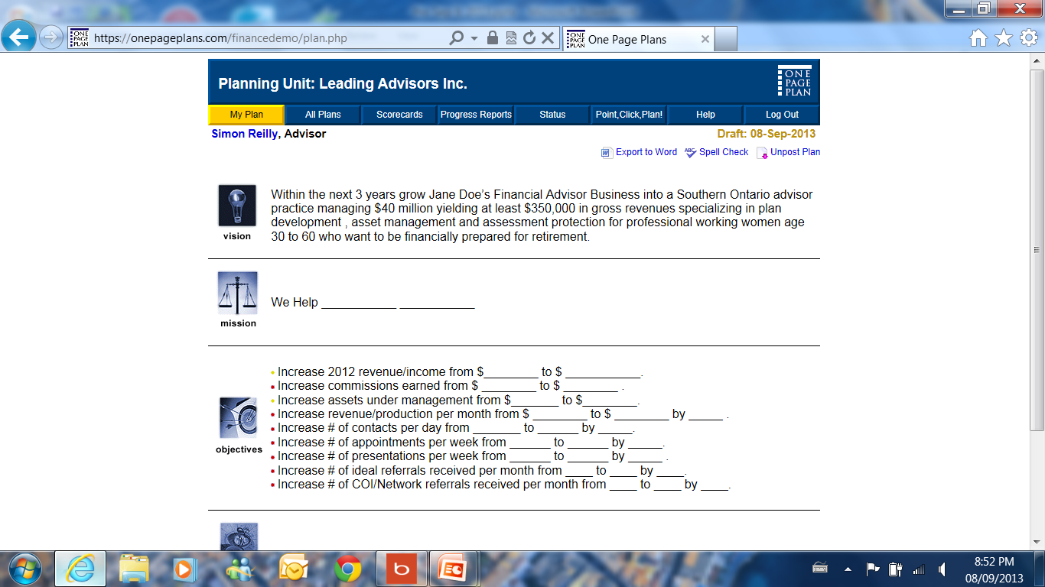

Slide 42
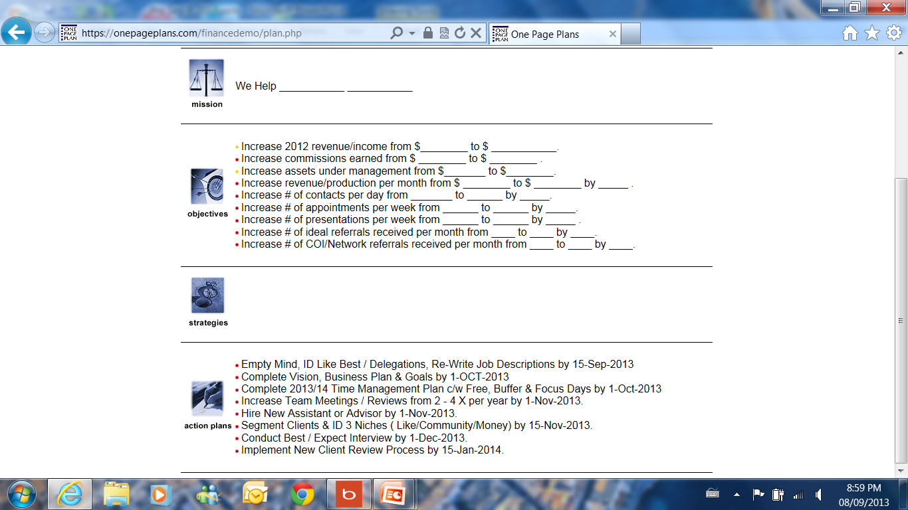

Slide 43




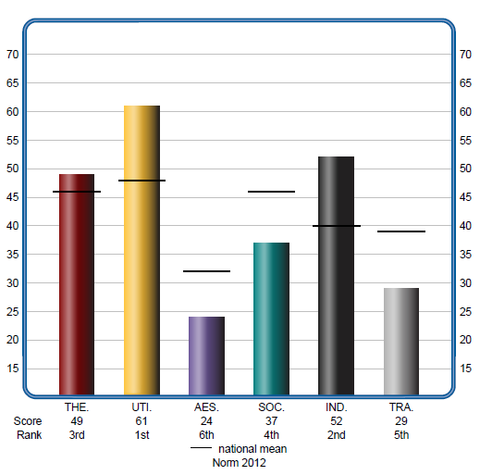
sreilly@leadingadvisor.com

Slide 45
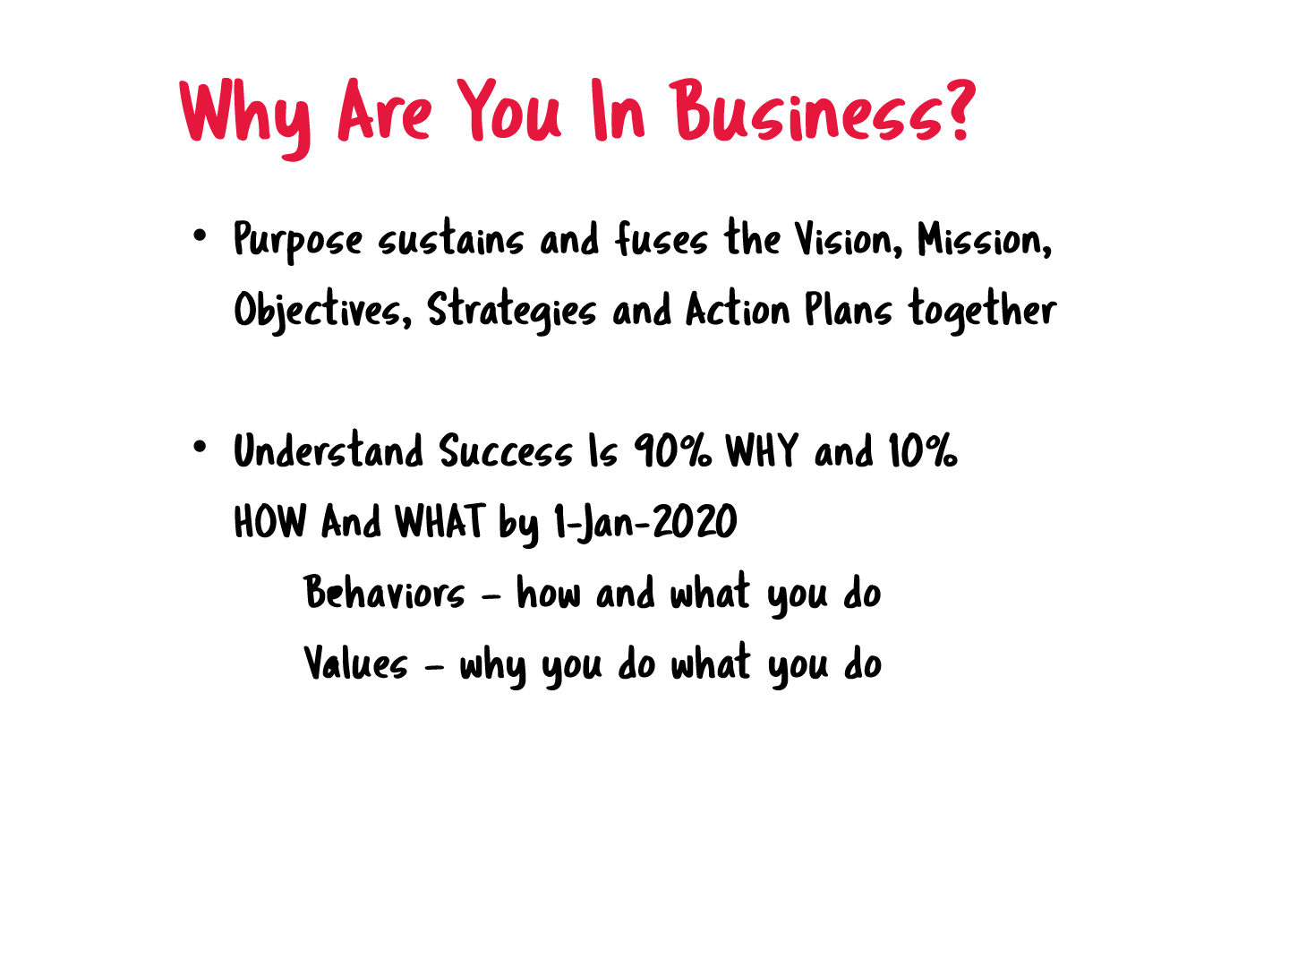

Slide 54
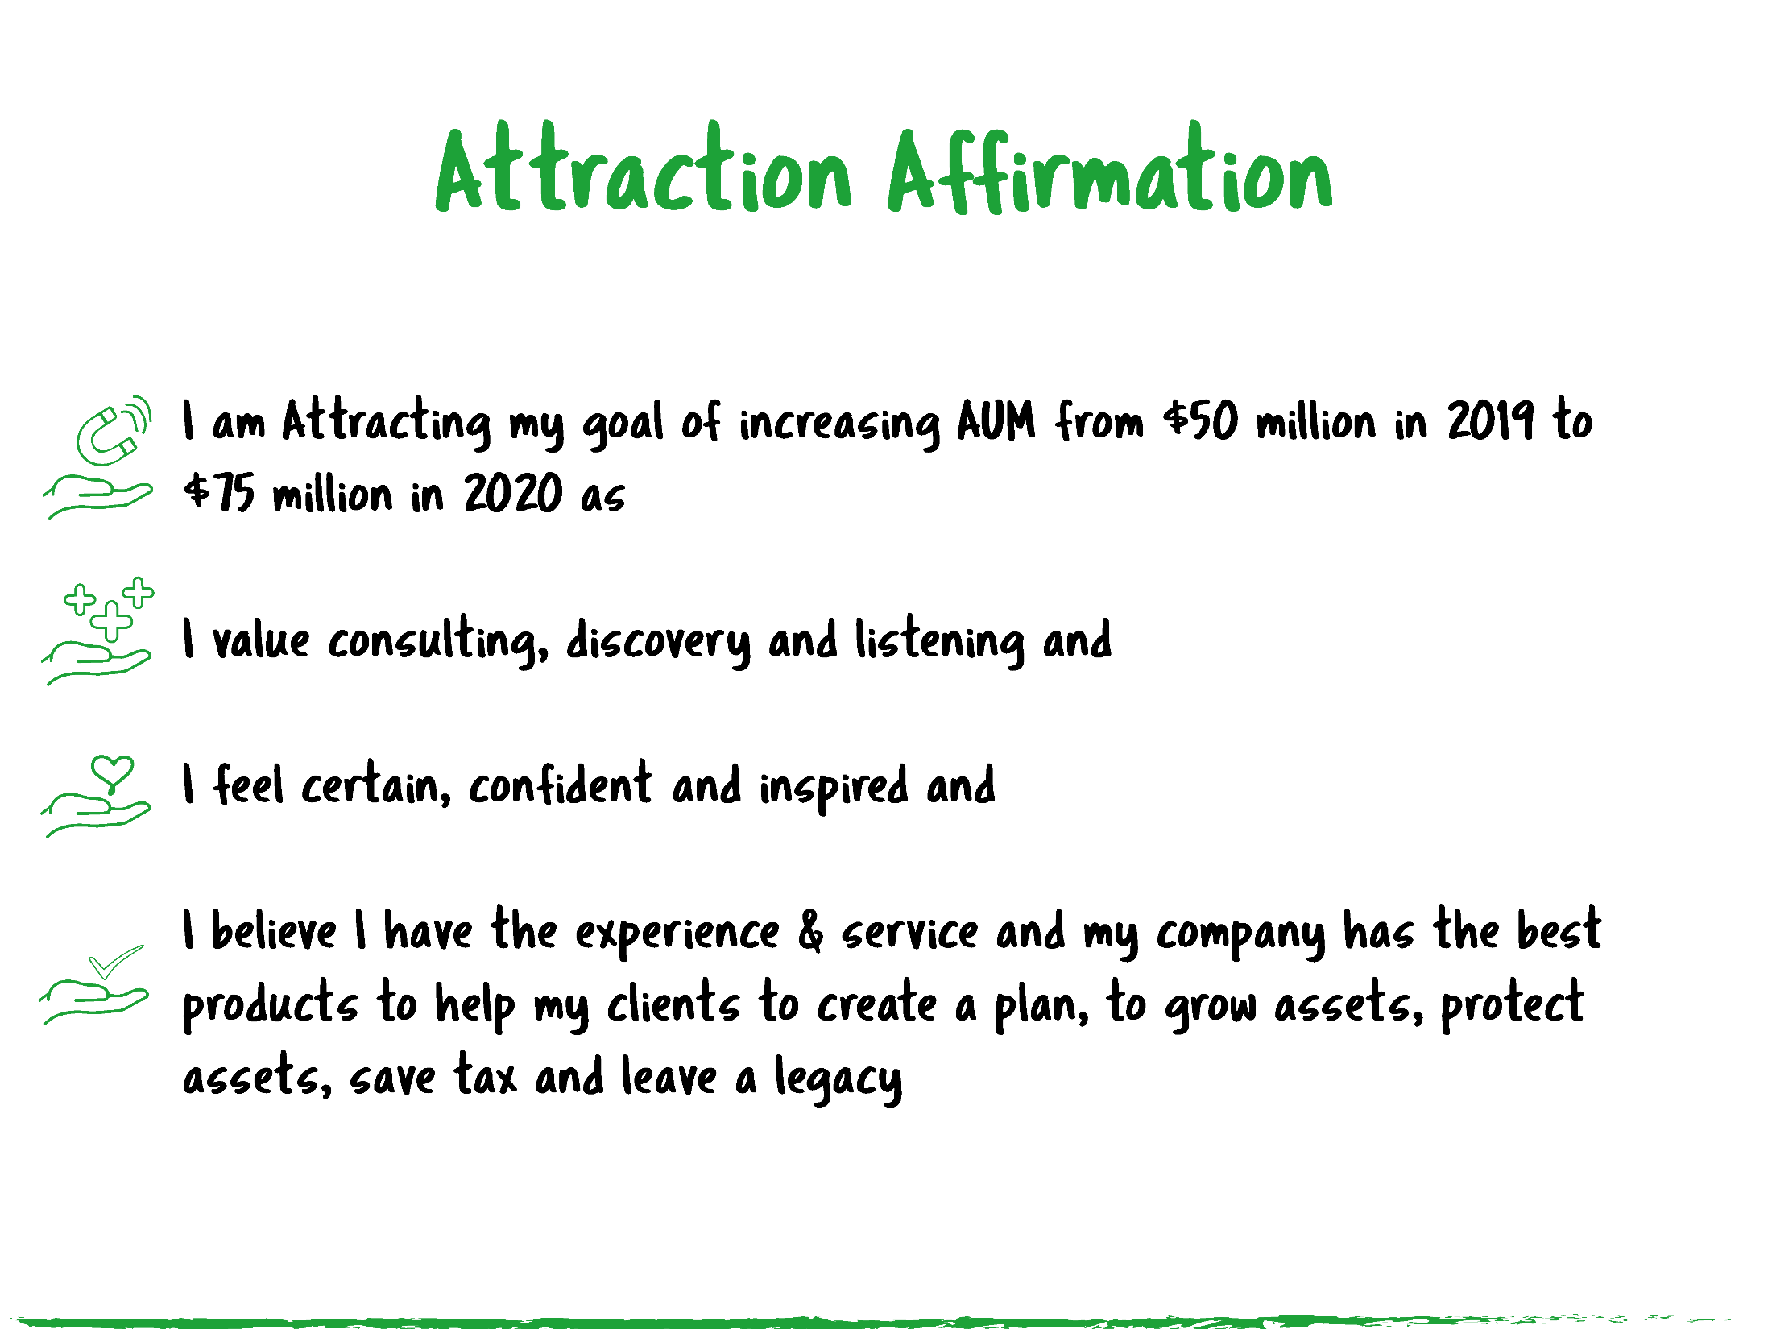

Slide 55
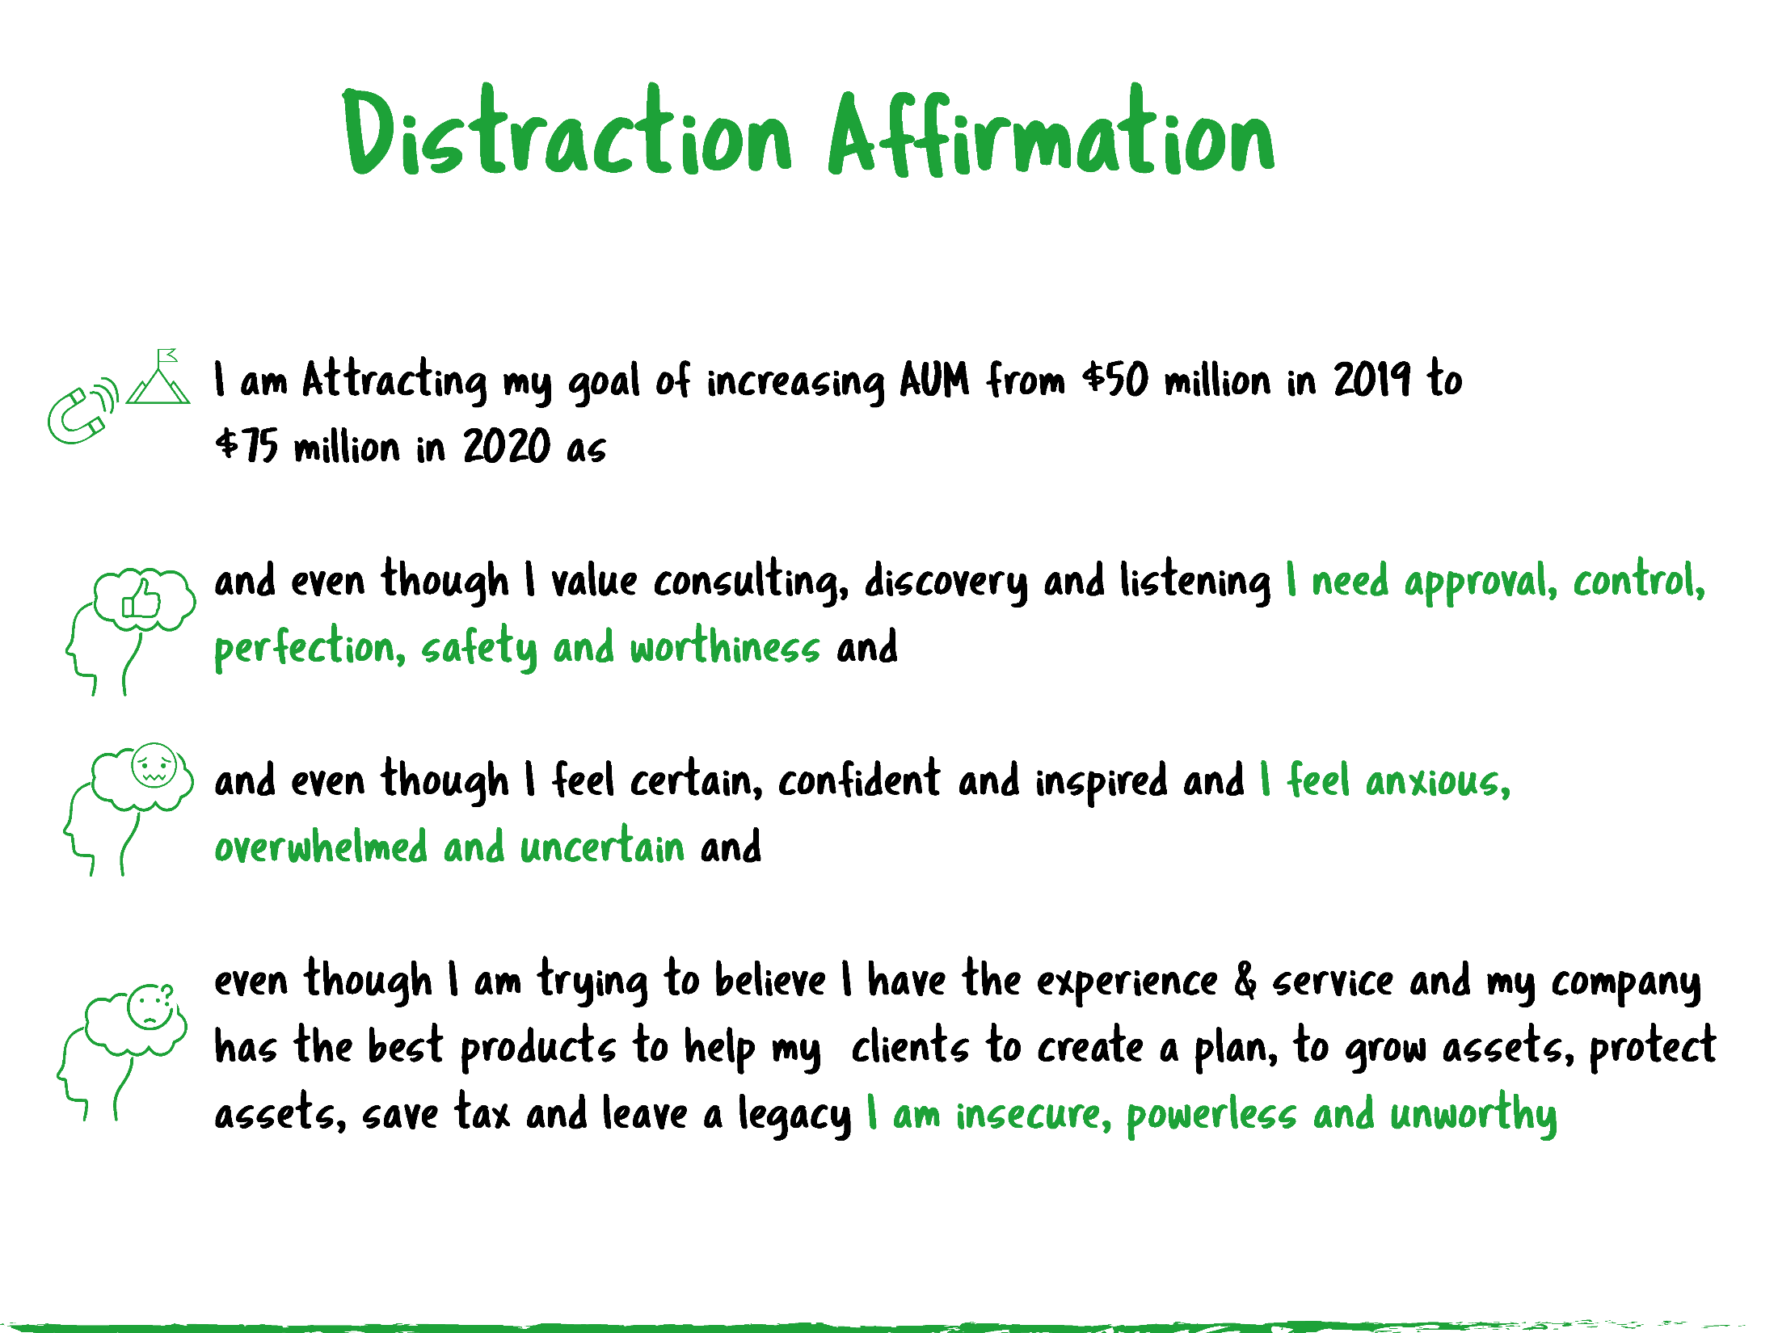

Slide 56
sreilly@leadingadvisor.com

Slide 57
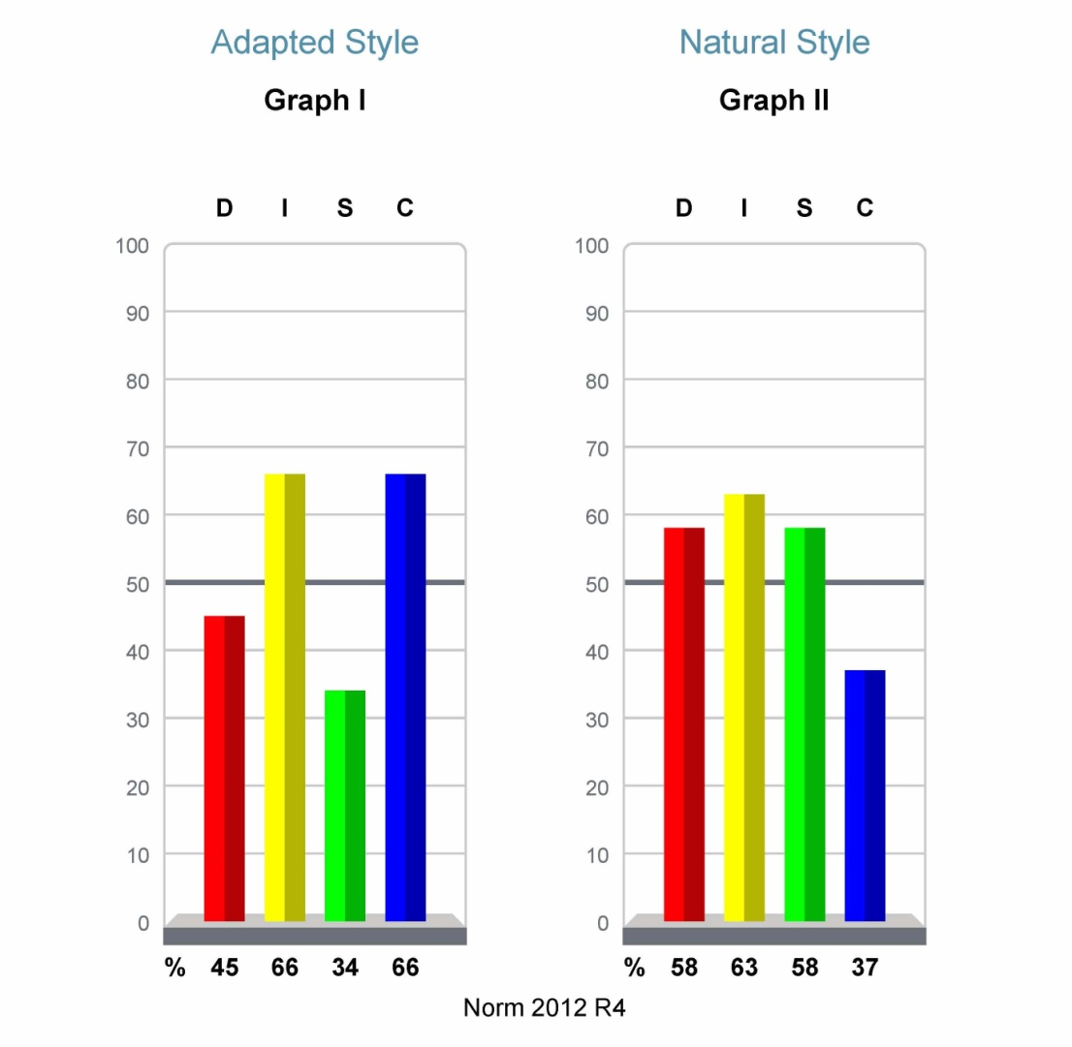

HOW & WHAT
WHY?

Slide 60
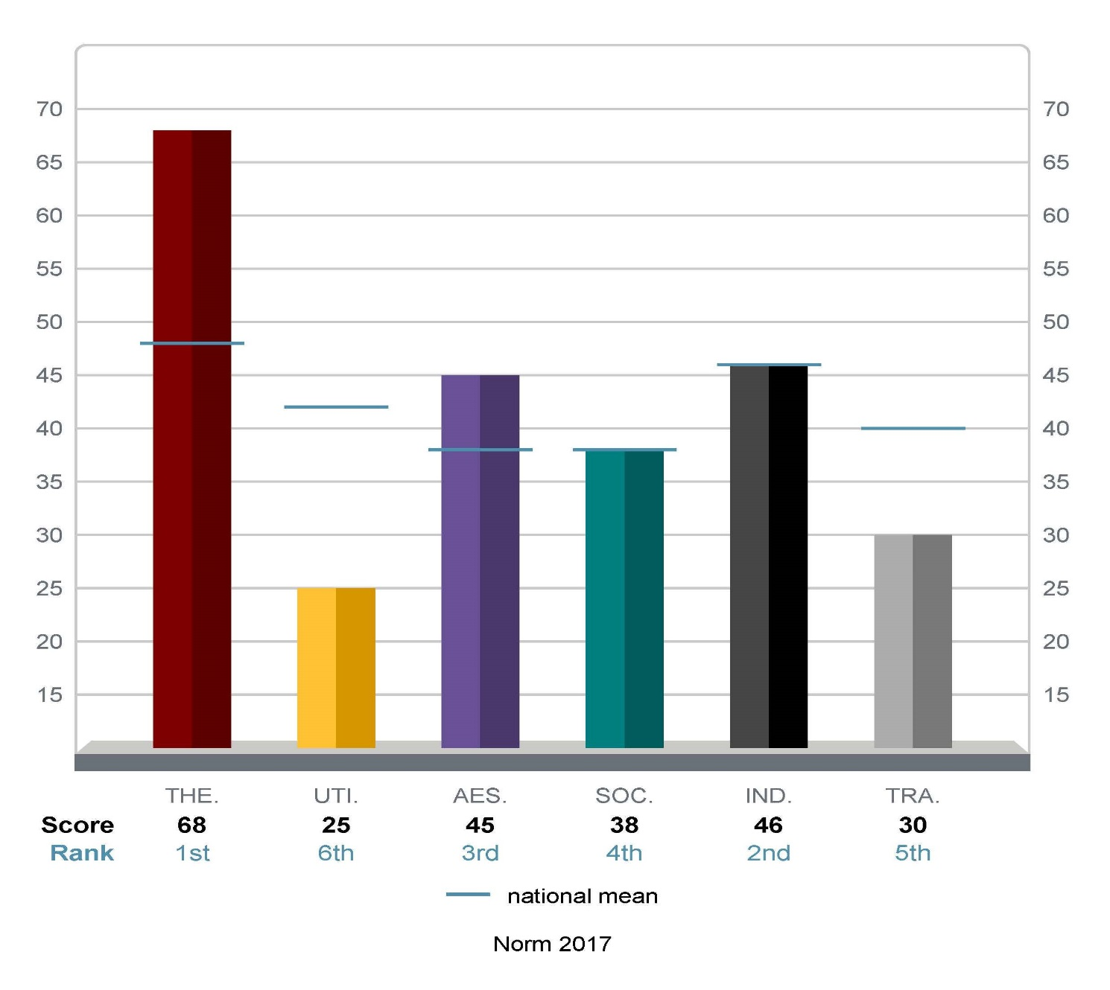

Slide 61
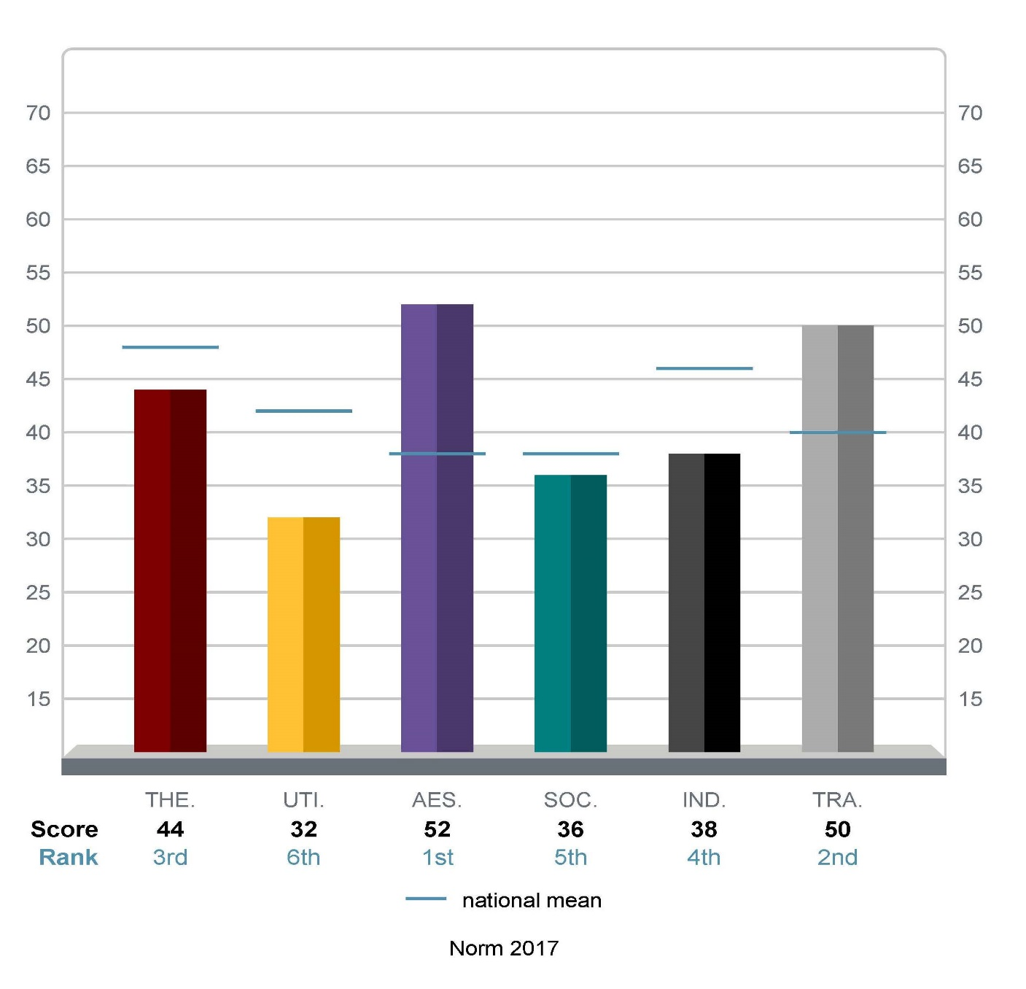

Slide 64
sreilly@leadingadvisor.com

Slide 66
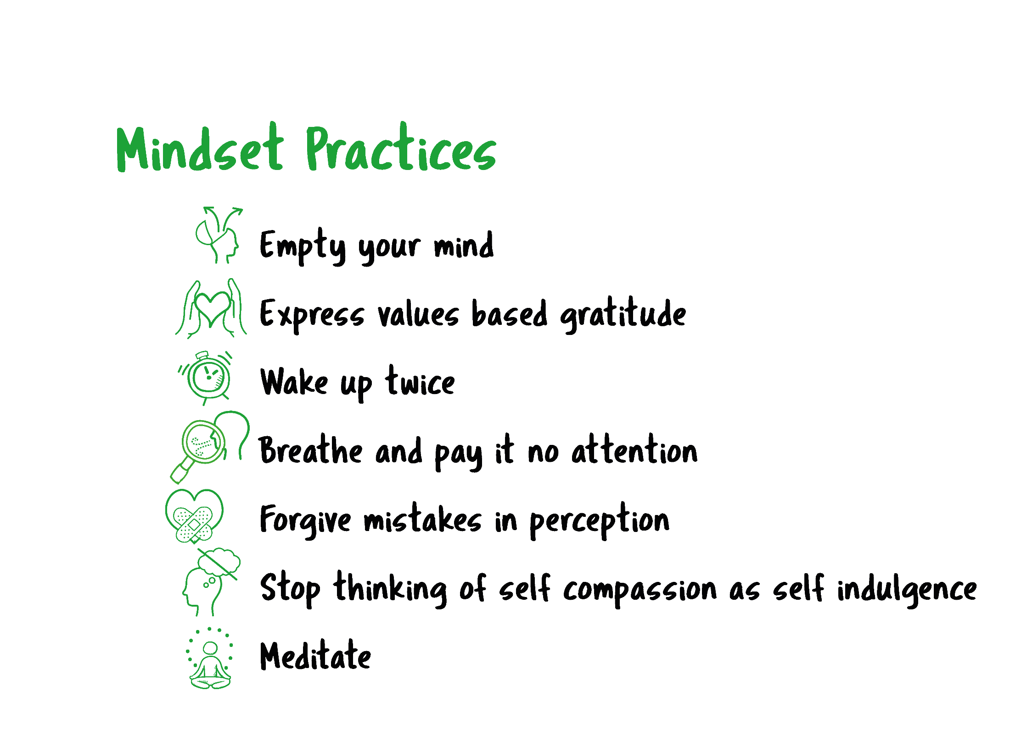


Slide 67

I am so glad that I started working with Simon and the Leading Advisor Coaching Program when I did. I had been struggling with expanding my mental capacity in terms of growth in my practice. Simon helped me take a different perspective which has truly changed my mindset.
His insights helped me clarify what was holding me back in my career. When I would have a breakthrough Simon would help me put it into action. At a deeper level I learned to integrate these new habits in a continuous habit building format. I appreciate how Simon communicated with me through the process--he was very sensitive to how I needed to receive information to process it. I've lowered my stress level dramatically, expanded trust with my team and learned to pinpoint when I'm self-sabotaging. I have gained tools that will be life-long building blocks both personally and professionally.
Abbey Gwin
Independent Broker/CFP
Williamsville, NY

Slide 68

Coaching with Simon has not only impacted my business but is contagious to others around me. With only a few one on one sessions I have created a 25% increase in income and have had my 4th highest month ever. Simon’s coaching approach means a lot to me and I am working with it constantly. Most coaching programs focus on the outside perspective but Simon has focused on working from the inside out. This has helped me to understand why my brain works the way it does and has caused an increase in my day to day enthusiasm and heightening my spirit. I have been working diligently on the assignments and with Simon’s accountability I have conquered my self-limiting beliefs and have become the leader I set out to be, all while understanding other people on a deeper level and being able to give back to them.
Robert Clark
Petersen International Underwriters
Valencia CA

Slide 69

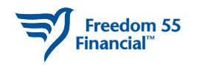
“The Leading Advisor Coaching Program has offered me a new perspective in my business and life. Simon’s guidance, resources and experience have helped me to focus and create the vision to drive toward my ultimate goals. With these same resources, I have a better understanding of myself and my business which is helping me to keep an open mind and to not get caught up in the minutia of life. The work I have done through the coaching program has definitely put me in a better position in life and business.”
Wendy Playfair
Freedom 55 Financial
Mississauga, ON

Slide 70

The Leading Advisor coaching program has set me on fire. I
began using the tips provided in the sessions to change the
language of my onboarding process and it has made an
incredible difference. I have had a 60% increase over last year,
in the number of families that I have the pleasure to serve.
The coaching sessions and assignments have helped me to identify
who I really am and how to be true to that person. In just 3 sessions
the coaching program has already made an incredible difference
in my business long term. It has given me the confidence to move
into the future and really know how I am going to reach my next goal
that I set for myself. The coaching is exactly what I need, exactly
when I needed it. I look forward to continuing to improve my team
with the program value adds and create sustainable long-term growth.
Celine Pastore
Simple Path
Retirement
Palm Harbor FL

Slide 71
sreilly@leadingadvisor.com

